Slide 1
Types of bullying
Made by : Maya/Selena/Sama/Lamya

Slide 2
What is bullying
Bullying is when one or more students employ physical, emotional, or verbal abuse to make life miserable for another student. This abuse can take many forms from simple name calling to physical abuse, there are four types of bullying: Physical, Social, Cyber, Social. And we will be talking about them

Slide 3
CAUSES OF BULLYING
People often bully others because they feel powerless or they have been bullied before, so they bully others to feel powerful and popular,
Other case scenario, they have been taught at a household That bullying is okay, and so they do the same at school

Slide 4
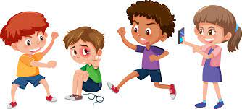
PHYSICAL BULLYING
It is when the type of bullying were somebody physical hurts another individual to gain control over them, it may lead to depression or even worse suicide .

Slide 5
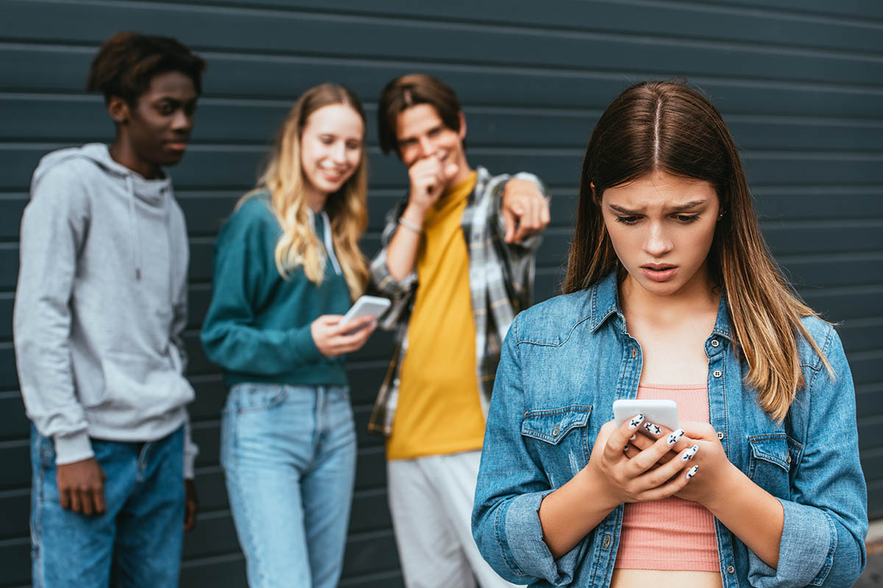
SOCIAL BULLYING
It is when a person leaves someone out more than once and encouraging others to do the same socially , it also leads someone to depression and suicide

Slide 6
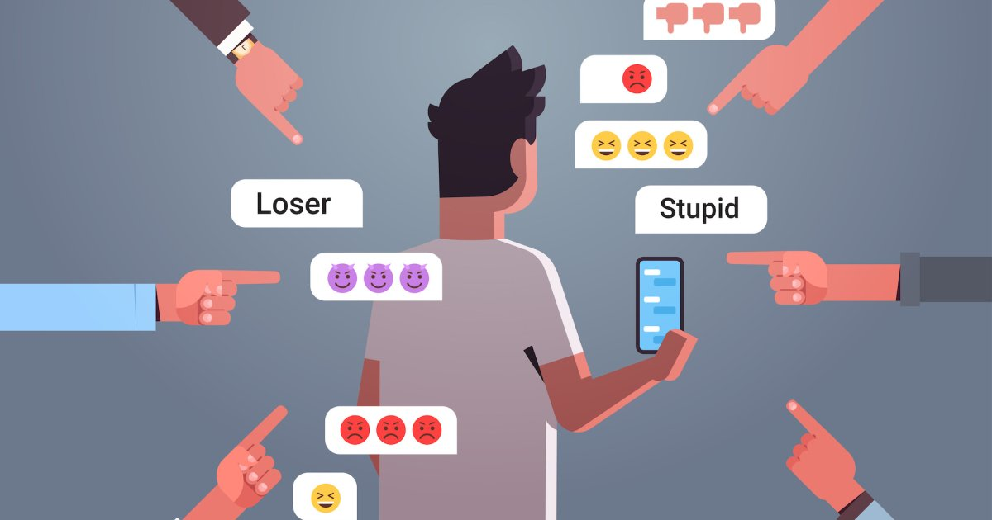
CYBER BULLYING
Cyber bullying or cyber harassment is a form of bullying or harassment using electronic means , it is prone to causing mental health issues such as depression and anxiety to both the victim and perpetrator

Slide 7
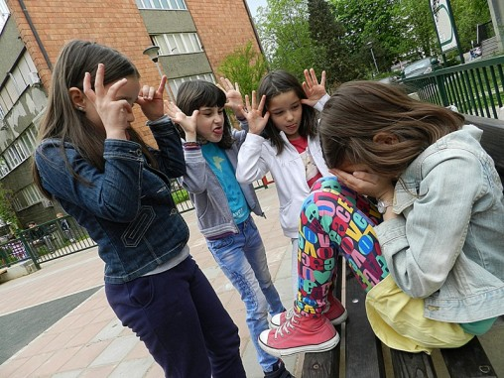
VERBAL BULLYING
It is being called names or insulted by someone , which damages there self image and self esteem

Slide 8
How to prevent bullying ?
By reporting them to a teacher or principle or someone older that you trust or you can talk to them back in a nice way , second solution you can tell your parents and they will give you advice and tell you what to do in this situation

Slide 9
The percentage of bullying ?

Slide 10
The chart of the percentages
 | مواضيع الدراسة | النسبة المئوية | عادي بأبسط صورة | كسر عشري
2010 | الأردن | 47% | 47/100 | 0.47
2010 | الصين | 20% | 20/100 | 0.20
2010 | إيطاليا | 50.3% | 50.3/100 | 0.503
2010 | هند | 37.6% | 37.6/100 | 0.376
The End

Slide 11
RESOUCES
https://WWW.ogschool.org
https://www.positiveaction.net
https://www.stopbullying.gov11220
https://WWW.familylives.org.uk
https://www.richlandlibrary.com
https://www.verywellmin.com

