Slide 1
Types of bullying
Made by : Maya/Selena/Sama/Lamya

Slide 2

What is bullying

Slide 3
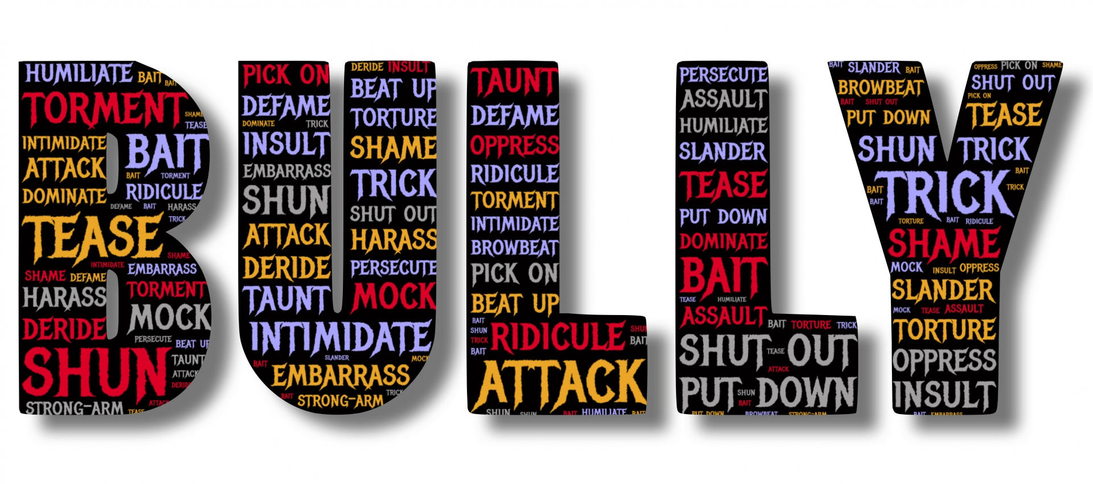
WHAT ARE THE CAUSES OF BULLYING
Notes:
0000000000000000000000ko0oooo

Slide 4
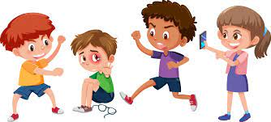
Physical Bullying

Slide 5
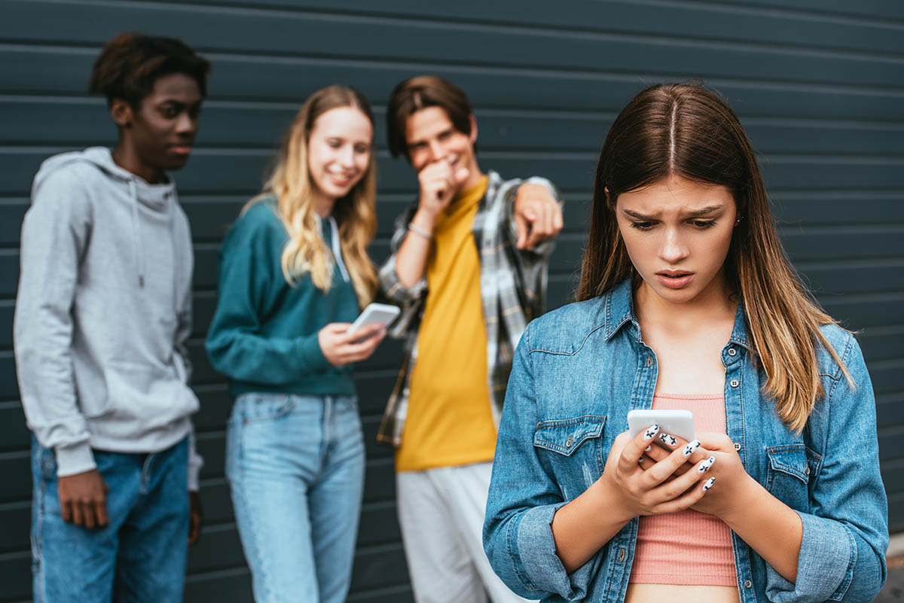
SOCIAL BULLYING

Slide 6
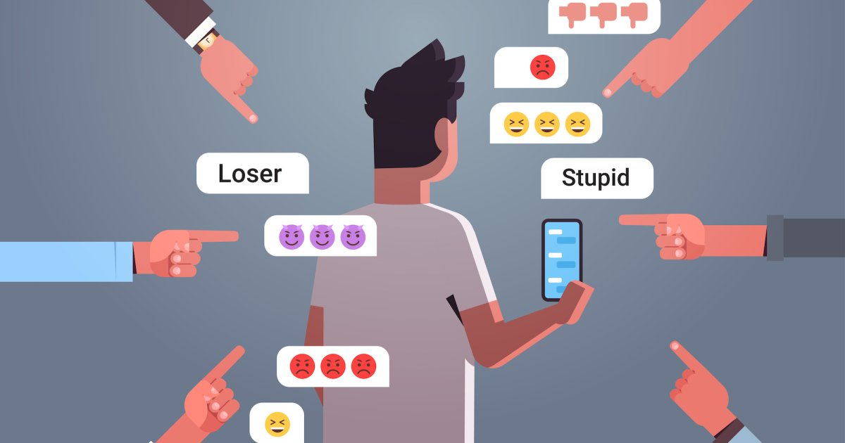
CYBER BULLYING

Slide 7
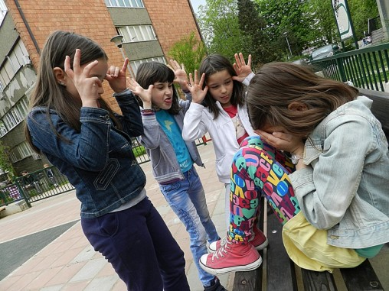
VERBAL BULLYING

Slide 8

How to prevent bullying
This Photo by Unknown Author is licensed under CC BY-SA

Slide 9
The percentage of bullying

Slide 10
The chart of the percentages
 | مواضيع الدراسة | النسبة المئوية | عادي بأبسط صورة | كسر عشري
2010 | الأردن | 47% | 47/100 | 0.047
2010 | الصين | 20% | 20/100 | 0.02
2010 | إيطاليا | 50% | 50,3/100 | 0.503
2010 | هند | 37% | 37,6/100 | 0.376
The End

