Slide 1
Light up your house!
By:Naya alshami, Yasmeen alsalman ,maya atwai, salam moustafa

Slide 2
Subjects
Physics
Math
Ict

Slide 3
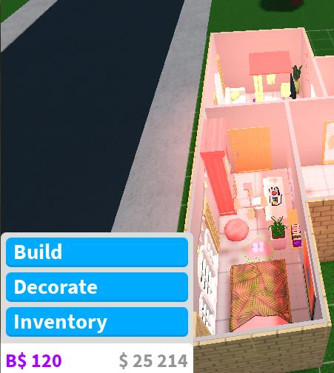
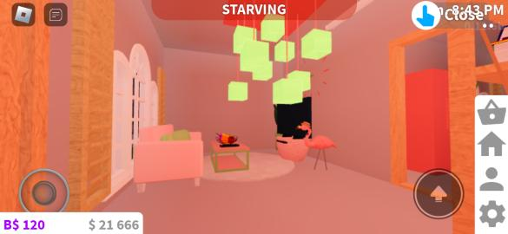
Living room
Living room design
9 lamps
4 batteries
3 switches
12 wires
The voltages on each battery is 9
And the amps on each light bulb is 10 and we have 9 lamps so all of it we have 90 amps and for the voltages combined we have 32 voltages

Slide 4
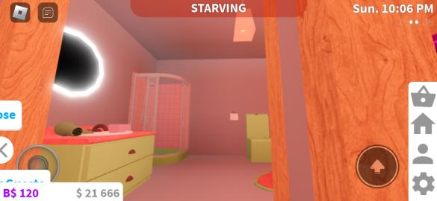
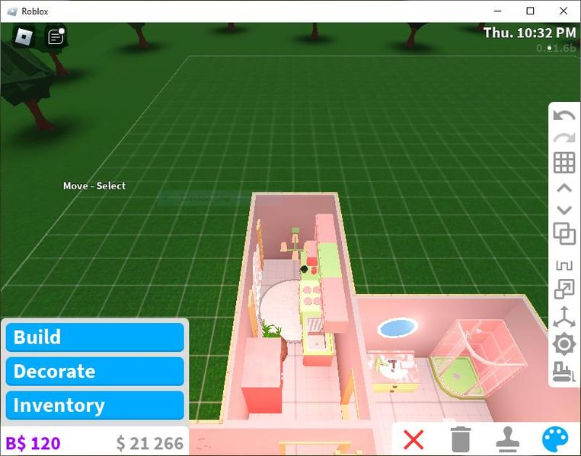
Bathroom
Bathroom design
2 batterys
2 lamps
2 switches
6 wires
The voltage on every battery is 9 so combined we have 18 voltages and we have 10 amps on each lamp combined we have 20 amps

Slide 5
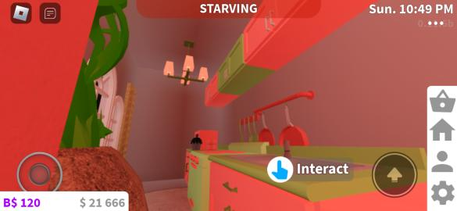
kitchen
kitchen design
4 lamps
2 switches
3 battery
10 wires
On each battery we have 9 voltages so combined we have 27 votls and one each lamp we 10 amps so combined we 40 amps

Slide 6
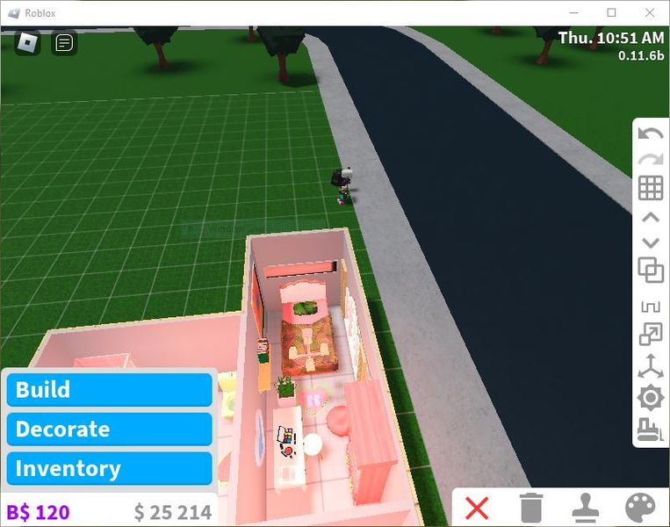
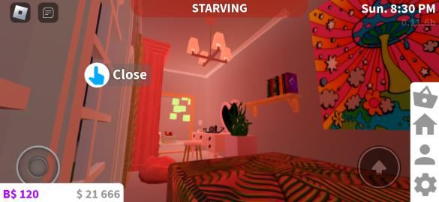
bedroom
Bedroom design
4 lamps
2 switches
3 battery
10 wires
On each battery we have 9 voltages so combined we have 27 votls and one each lamp we 10 amps so combined we 40 amps

Slide 7
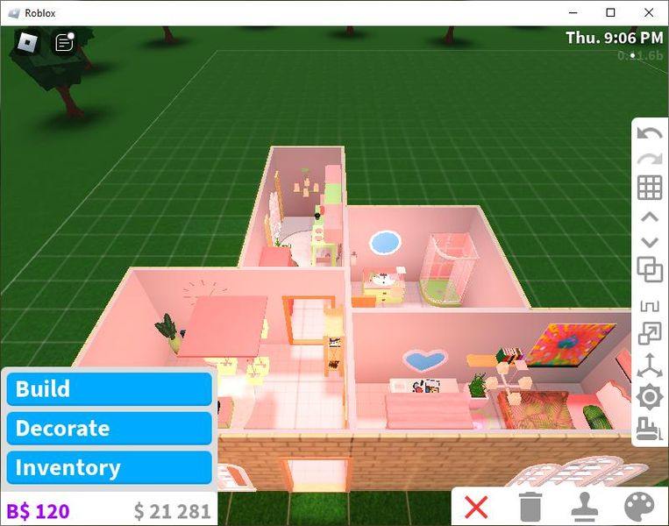
House
House design
Our house 38m^2 and in cm it is 380 cm
The bedroom is:6m^2
The bedroom/kitchen:10m^2
The living room:12m^2

Slide 8
Video screen record for the house
https://scontent.xx.fbcdn.net/v/t42.3356-2/347103129_6164680300286742_1768904941849818048_n.mp4?_nc_cat=107&ccb=1-7&_nc_sid=060d78&_nc_ohc=2RlPdZ9-h9cAX94w74e&_nc_ht=scontent.xx&oh=03_AdSW9PQq2i0_7JdigS3ORySNRR-_39erVzrmliZZ0qqLOA&oe=648B3582&dl=1

Slide 9
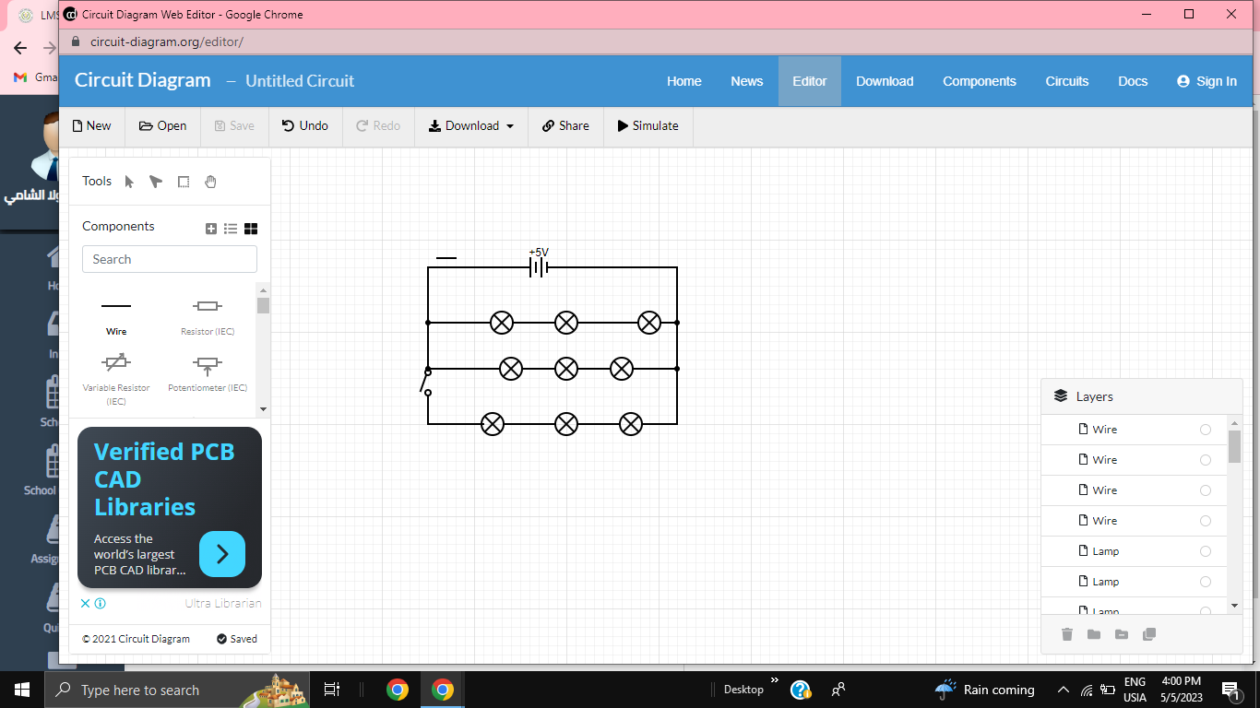
Circuit simulations/design for the living room

Slide 10
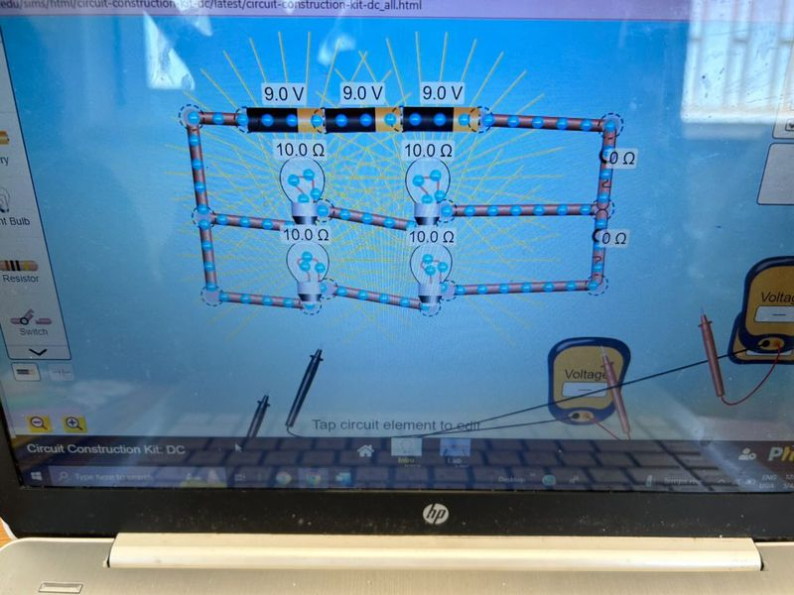
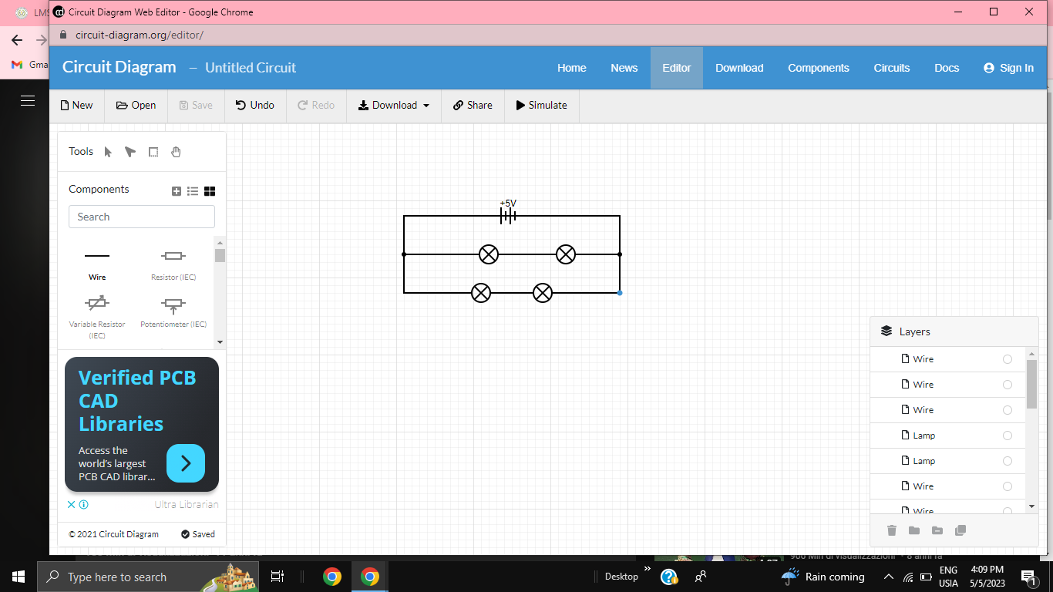
Circuit simulation/design for the kitchen

Slide 11
Circuit simulation/design for the bedroom

Slide 12
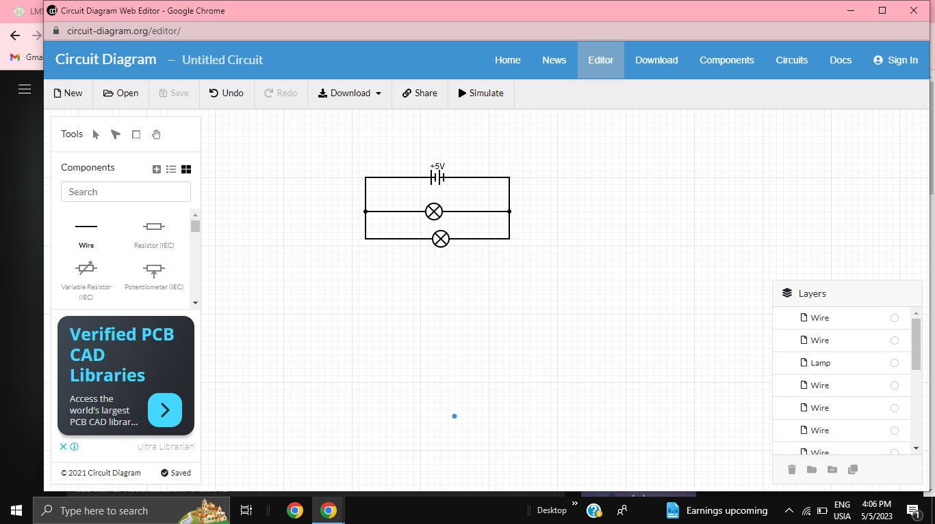
Circuit simulation/design

Slide 13
Electricity bill
electricity bill per month $47.55
Total power energy 48.9
Total cost of kwh $5.87
total electricity bill $176.04
Total amount of all components 131.9
Total cost of all components $308.96
Over/under budget under

