Slide 1
Obesity
By: maria hadaddin , leen habash , natalie awwad

Slide 2
https://youtu.be/9MxloSNj-h4

Slide 3
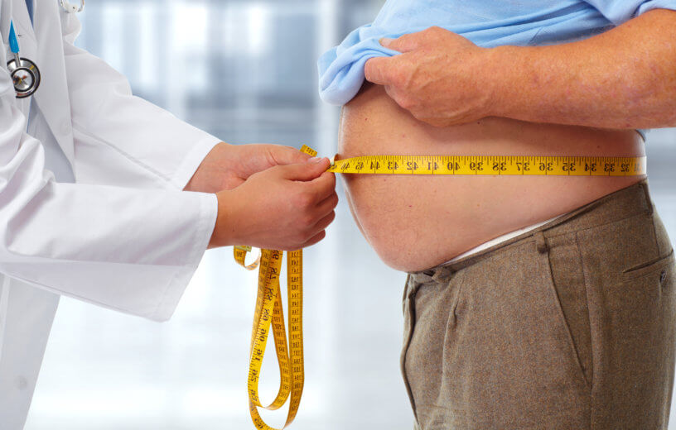
What is obesity ?

Slide 4
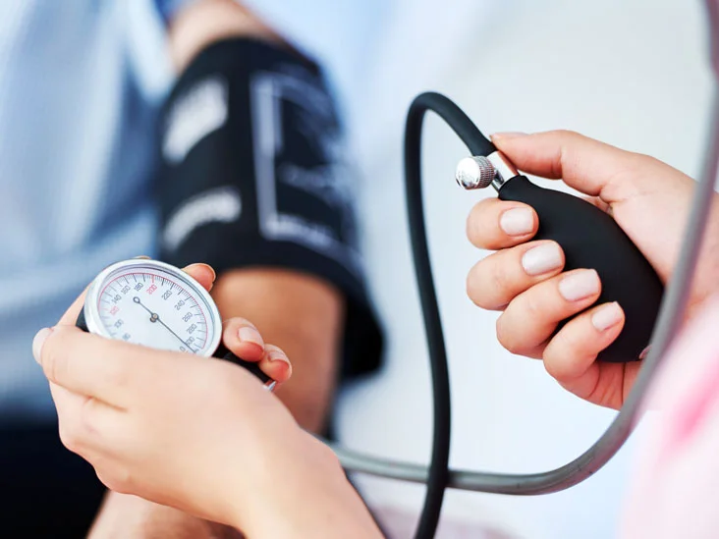
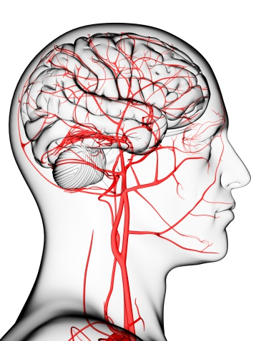
What are the health effects of obesity?

Slide 5
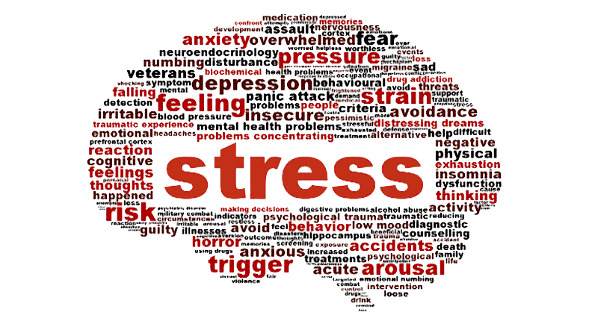
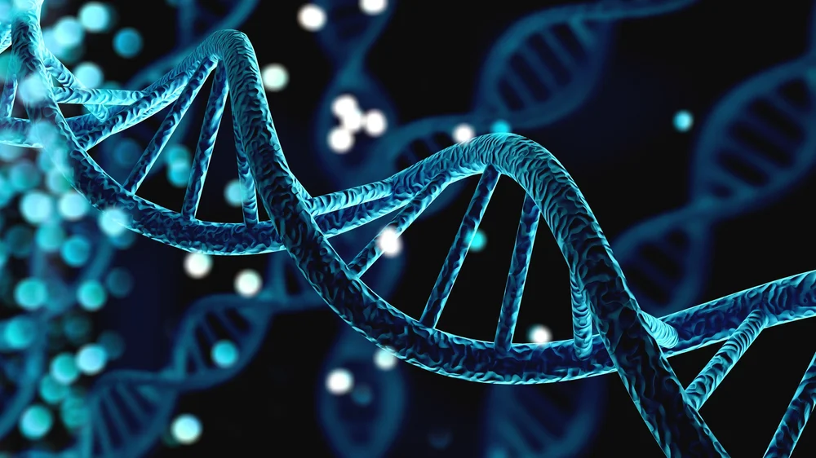
What causes obesity & overweight?

Slide 6
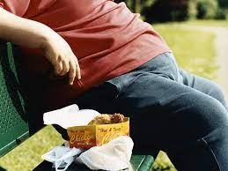
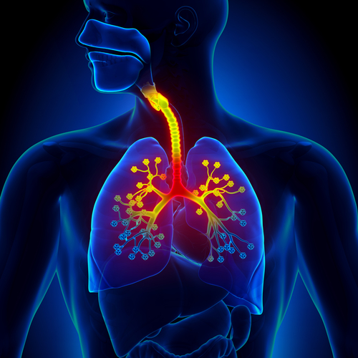
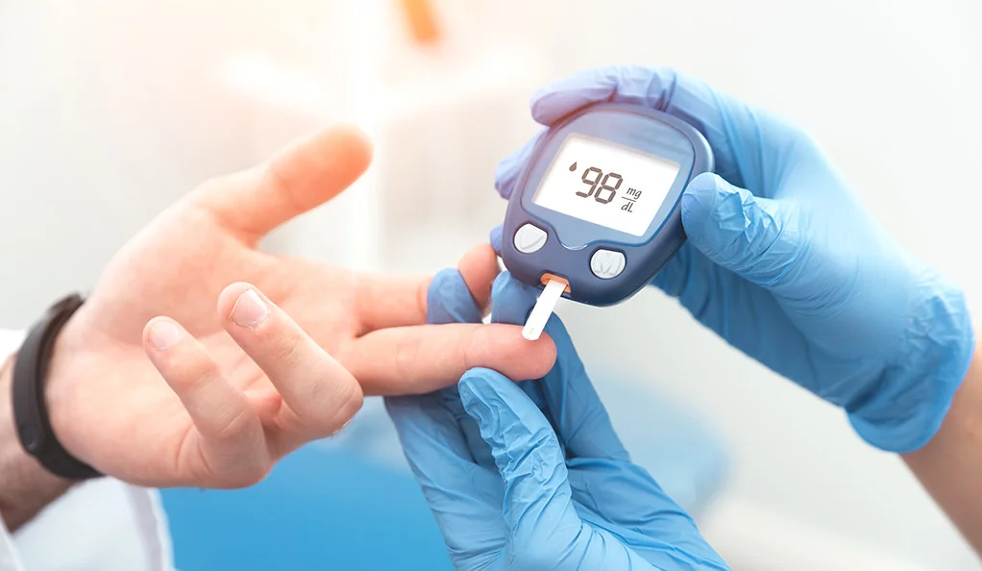
What are the consequences?

Slide 7
What are the solutions for obesity?

