Slide 1
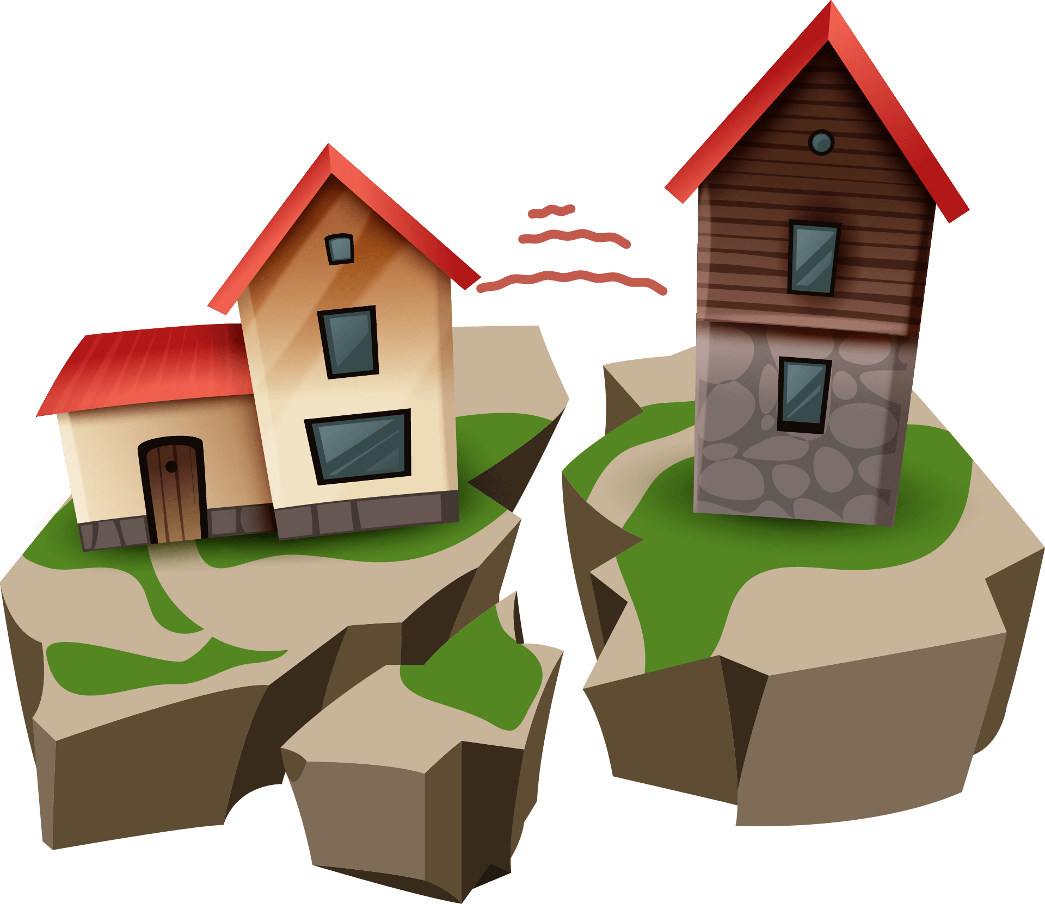
Earthquakes
Prepared by: Tia Nazha and Naya Tadros
Notes:
Earthquakes

Slide 2
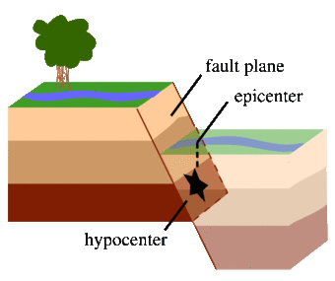
What causes earthquakes?
Notes:
The tectonic plates that make up the earth's crust are moving constantly. As the edges of these plates slide against each other in fault zones, friction can slow them down, leading to the buildup of pressure over long periods of time. When the force of movement finally overcomes the friction, sections of the crust suddenly break or become displaced, releasing the pent-up pressure in the form of seismic waves. This is a naturally occurring earthquake, sometimes referred to as a tectonic earthquake.

Slide 3
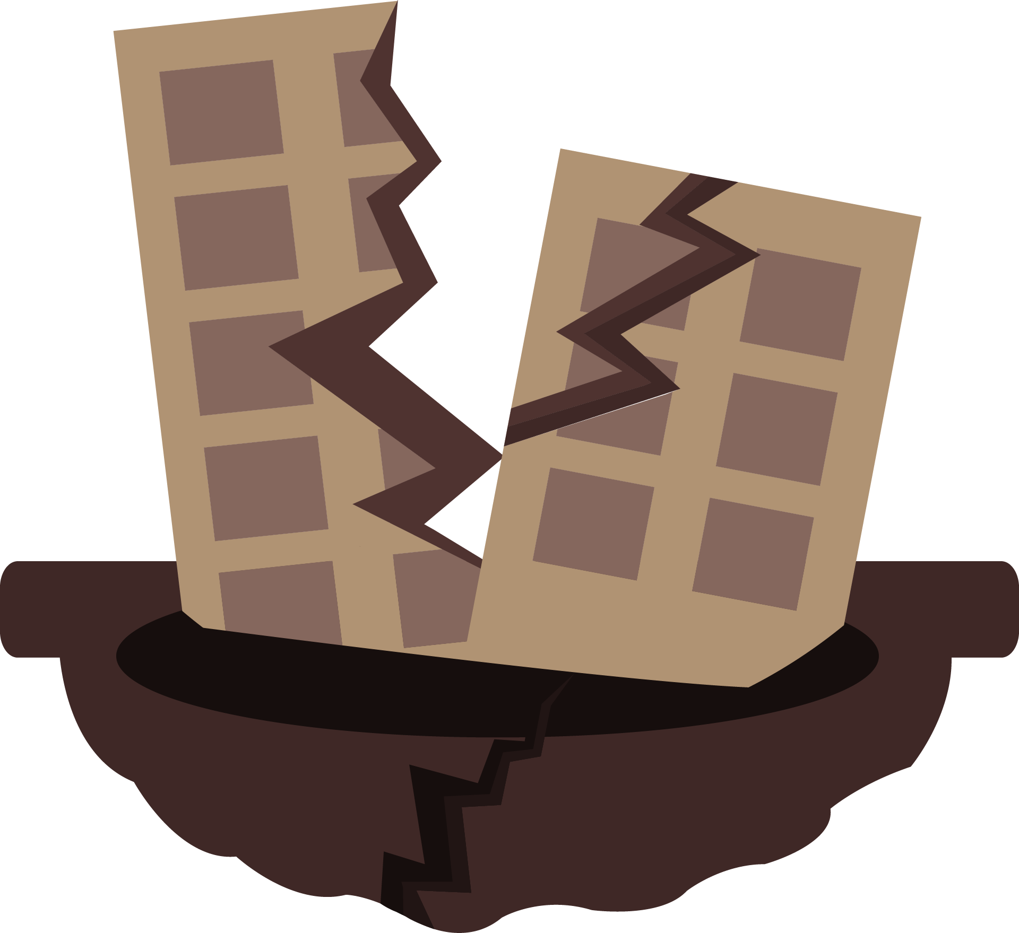
The causes and effects of earthquakes
Earthquakes are any sudden shaking of the ground, caused by the passage of seismic waves through Earth's rocks.
Notes:
An earthquake happens when two blocks of the earth suddenly slip past one another. The surface where they slip is called the fault or fault plane. The location below the earth’s surface where the earthquake starts is called the hypocenter, and the location directly above it on the surface of the earth is called the epicenter.

Slide 4
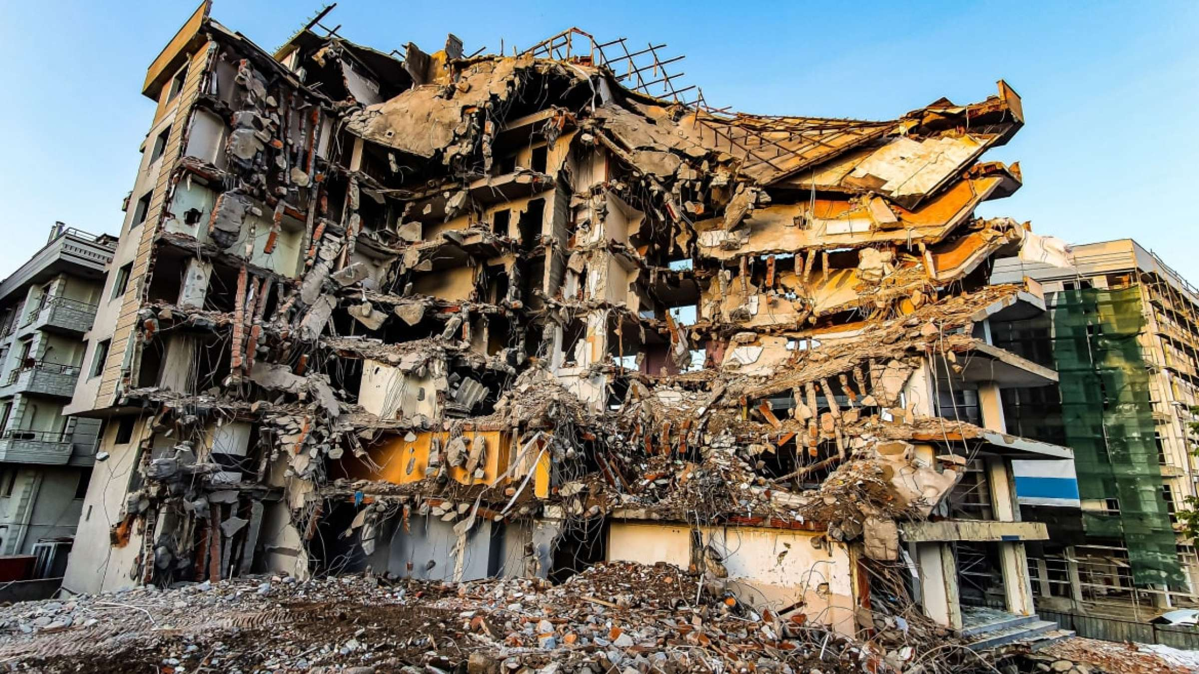
The causes and effects of earthquakes
The effects from earthquakes include ground shaking, surface faulting, ground failure, and less commonly, tsunamis.
Notes:
Ground shaking is a term used to describe the vibration of the ground during an earthquake. Ground shaking is caused by body waves and surface waves.
Surface faulting is the differential movement of the two sides of a fracture at the Earth's surface and can be strike slip, normal, and reverse (or thrust).

Slide 5
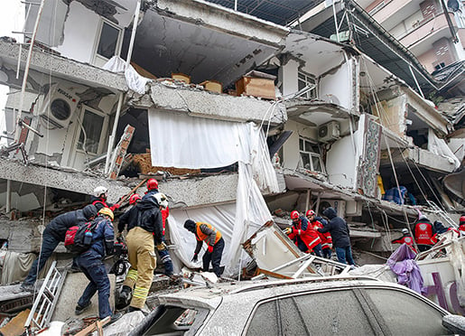
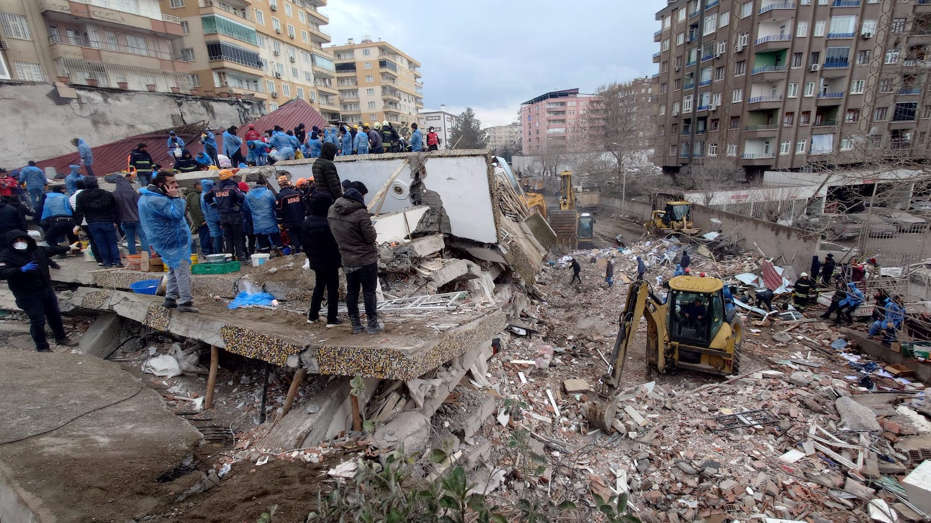
On the 6th of February 2023 an earthquake struck Turkey and Syria.
Notes:
On the 6th of February 2023 an earthquake struck Turkey and Syria.

Slide 6
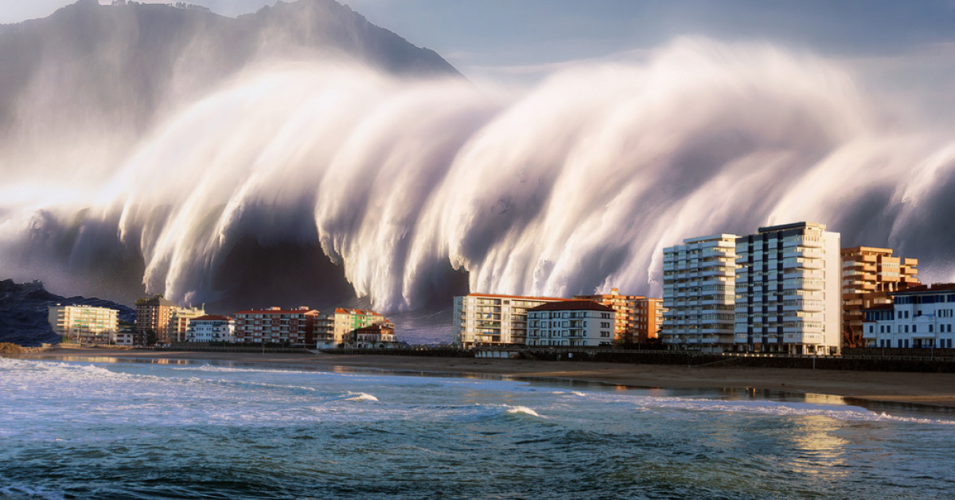
Tsunamis
Notes:
Tsunamis are water waves that are caused by sudden vertical movement of a large area of the sea floor during an undersea earthquake, Tsunamis are giant waves caused by earthquakes or volcanic eruptions under the sea. Out in the depths of the ocean, tsunami waves do not dramatically increase in height. But as the waves travel inland, they build up to higher and higher heights as the depth of the ocean decreases.

Slide 7
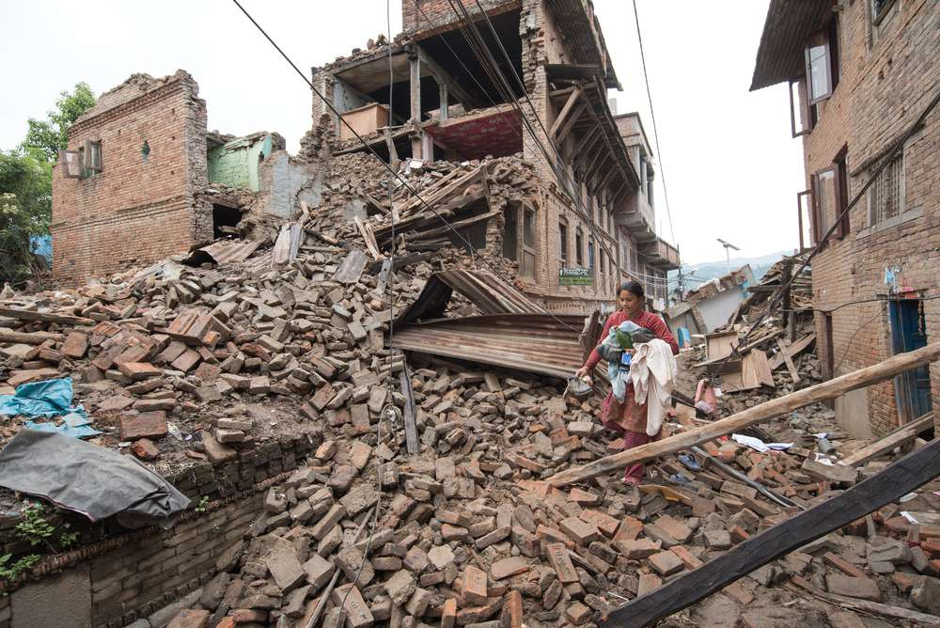
The factors that affect the intensity and frequency of earthquakes.
The underlying soil
Depth
Building Characteristics (particularly height)
Proximity to the fault
Proximity to the fault
Notes:
The factors that affect intensity and frequency of earthquakes are:
1 : Depth
2 : Proximity to the fault
3 : The underlying soil
4 : Building characteristics (particularly height)

Slide 8
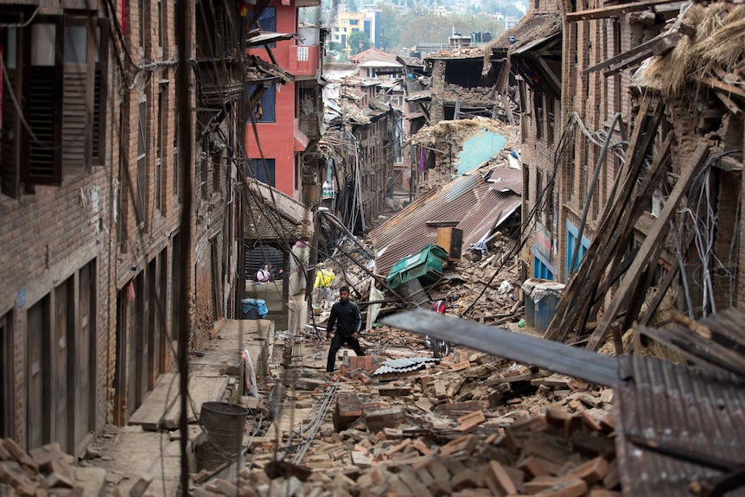
The factors that affect the intensity and frequency of earthquakes.
Notes:
When an earthquake strikes, the intensity of earthquake shaking determines the severity of damage.

Slide 9
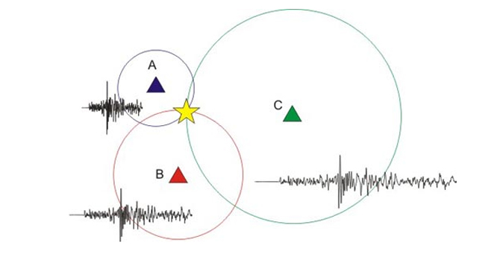
Methods used to detect, measure and predict earthquakes.
Notes:
Seismometers allow us to detect and measure earthquakes by converting vibrations due to seismic waves into electrical signals, which we can then display as seismograms on a computer screen. Seismologists study earthquakes and can use this data to determine where and how big a particular earthquake is.

Slide 10
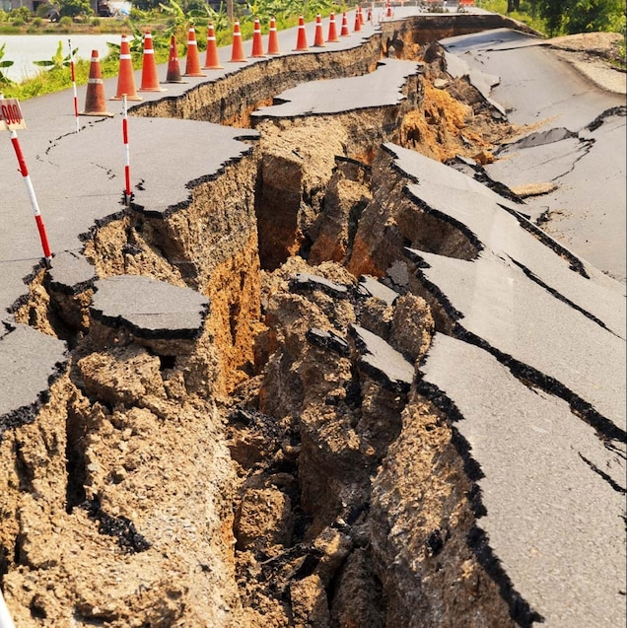
The impacts of earthquakes on the natural environment and ecosystem.
Notes:
Earthquake environmental effects are the effects caused by an earthquake, including surface faulting, tsunamis, soil liquefactions, ground resonance, landslides and ground failure, either directly linked to the earthquake source or provoked by the ground shaking.

Slide 11
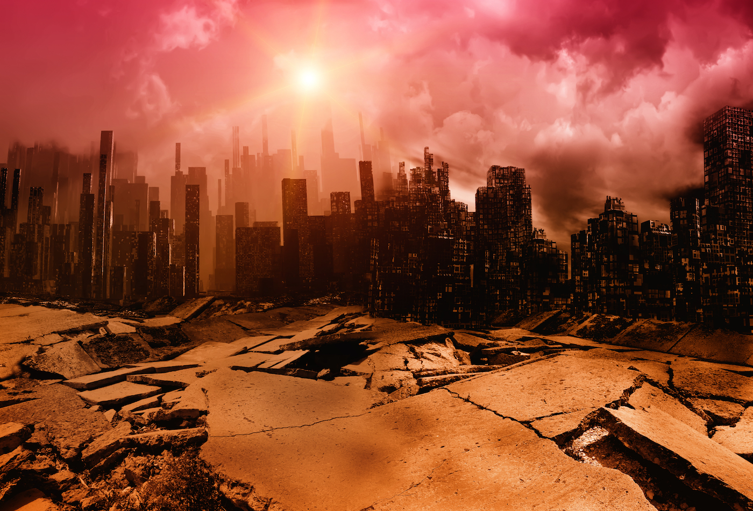
The causes and consequences of earthquakes for others
Notes:
Earthquakes can have immediate and long-term impacts on health. Immediate health impacts include: trauma-related deaths and injuries from building collapse; trauma-related deaths and injuries from the secondary effects of the earthquake, like drowning from tsunamis or burns from fires.

Slide 12
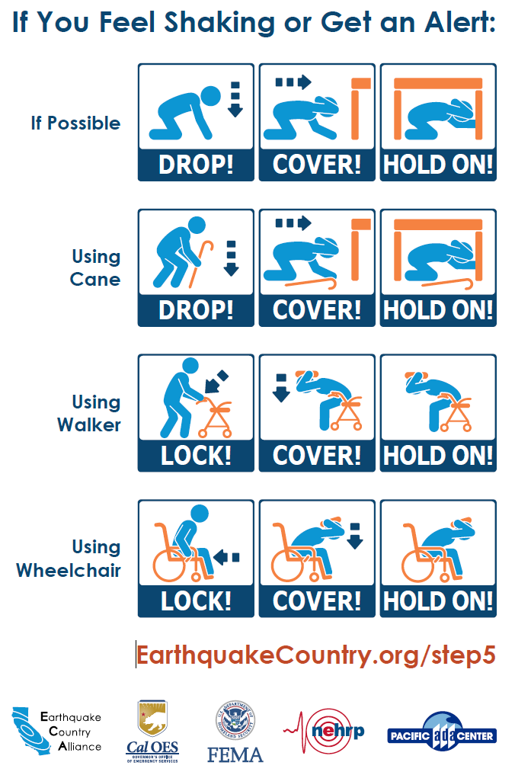
Course of actions
Solutions with some reasoning
Wherever you are, protect yourself!
It is important to think about different scenarios in which an earthquake can suddenly strike.
What if you are driving, in a theater, in bed, at the beach, etc.?
Notes:
Protect yourself!

Slide 13
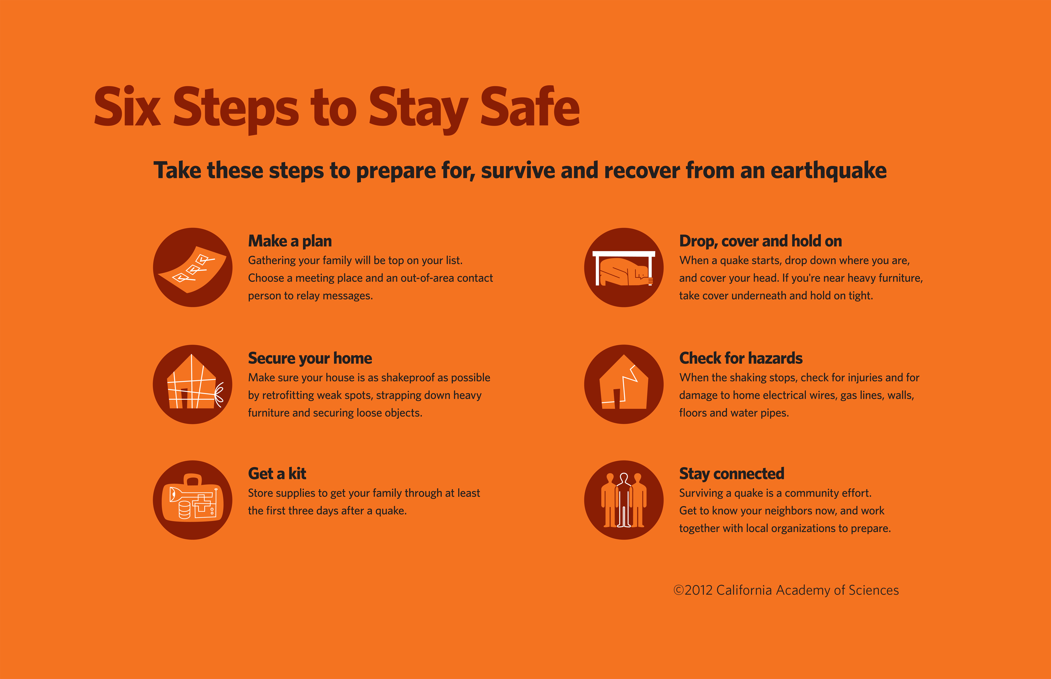
Course of actions
Solutions with some reasoning
Notes:
Steps to stay safe.

Slide 14
Wrap Up!
Q & A
Answer the following questions:
Question | Answer:
Can earthquakes be predicted?
Can earthquakes be recorded and how?
Can earthquakes be prevented?
No, the precise date and place of an earthquake can not be predicted.
Yes, earthquakes can be recorded.
No, Earthquakes can not be prevented
Does the location of an earthquake affect the intensity of it?
Yes, the intensity will vary depending where you are
Resources for the questions: https://www.eskp.de
https://www.usgs.gov
https://www.mona.uwi.edu
Notes:
Wrap up!

Slide 15
RESOURCES
PHOTOS:
https://www.who.int/europe/emergencies/situations/turkiye-and-syria-earthquakes
https://cnr.ncsu.edu/news/2023/02/turkey-syria-earthquakes/
https://www.unesco.org/en/tsunami-warning-system-preparing-unpredictable
https://www.nationalgeographic.com/science/article/human-induced-earthquakes-fracking-mining-video-spd
INFORMATION:
https://www.usgs.gov/programs/earthquake-hazards/what-are-effects-earthquakes
https://www.bgs.ac.uk/discovering-geology/earth-hazards/earthquakes/how-are-earthquakes-detected/
https://oceanservice.noaa.gov/facts/tsunami.html
https://scienceexchange.caltech.edu/topics/earthquakes/what-causes-earthquakes
Notes:
Here you can find all the resources we used.

Slide 16
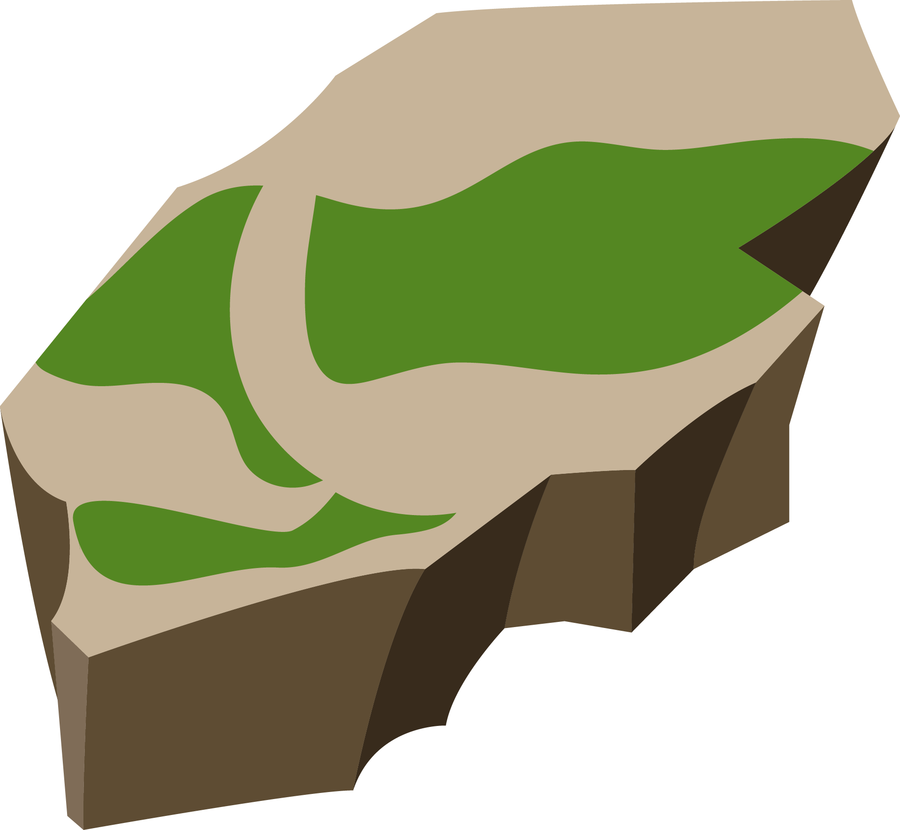

Thank You ☺
Tia Nazha and Naya Tadros
Notes:
Thank you!

