Slide 1
BULLYING
Done By: George Barjeel/Saif Haddad/Rami Hamarneh

Slide 3
Types of bullying:
physical
verbal
social
cyber

Slide 4
What are the problem off bullying?

Slide 6
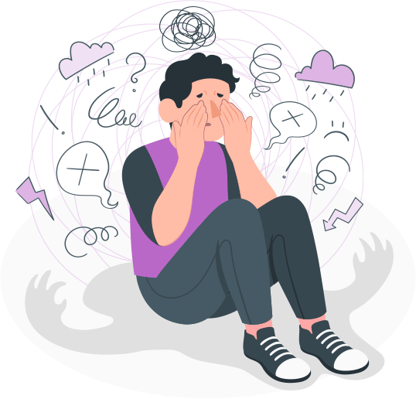

Slide 7
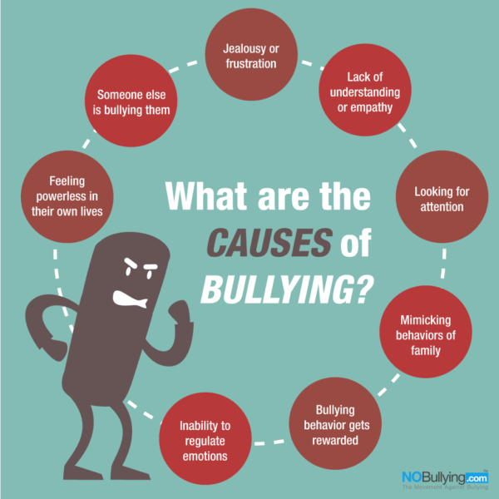
What are the causes of bullying?

Slide 8
The percentage of bullying in jordan
The year | percentage | A decimal fraction | Normal break
2000 | 47% | 0.47 | $$\frac{47}{100}$$
2005 | 5.3% | 0.053 | $$\frac{5.3}{100}$$
2015 | 5.3% | 0.053 | $$\frac{5.3}{100}$$
2020 | 1.7% | 0.017 | $$\frac{1.7}{100}$$

Slide 10
The percentage of bullying in countries
The country | The year | Percentage | A decimal fraction | Normal break
USA | 2000-2020 | 44.6% | 0.446 | $$\frac{44.6}{100}$$
Japan | 2000-2020 | 49.2% | 0.492 | $$\frac{49.2}{100}$$
Saudi Arabia | 2000-2020 | 41.1% | 0.411 | $$\frac{41.1}{100}$$
Palestine | 2000-2020 | 98% | 0.98 | $$\frac{98}{100}$$

Slide 12
https://youtu.be/w6FfxnhRssw

Slide 13
Recourses https://www.jahonline.org https://www.understood.org www.stompoutbullying.org https://extension.umn.edu https://www.cdc.gov/violenceprevention/pdf/yv/bullying-suicide-translation-final-a.pdf

