Slide 1
Overweight Breakthrough
By: Tala Dababneh, Yara Jajjawi, Loay Kawar

Slide 2
What is obesity
Obesity is a treatable disease that is a worldwide health concern associated with having an excess amount of body fat. It is caused by genetic and environmental factors and can be difficult to control through dieting alone. It is also a disease that can lead to other health problems not only caused by food.

Slide 3
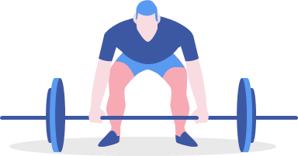
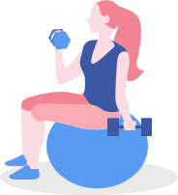
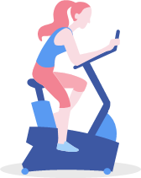
How do people become obese
When extra calories are stored in the body as fat.
If high amounts of energy are consumed that are usually found in high-fat and high-sugar foods.
When you use all of the energy through physical activity, much of the extra energy will be stored in the body as fat.
By increasing eating patterns and lack of physical activity.

Slide 4
Health consequences of being overweight
Being overweight can have some significant effects on your health. Carrying extra fat leads to serious health consequences such as Cardiovascular disease (mainly Heart disease and Stroke), Type 2 Diabetes, Musculoskeletal disorders like Osteoarthritis, and some Cancers (Endometrial, Breast, and Colon). These conditions cause premature death and substantial disability.
Consequences don’t only affect your health but also affect your physical, emotional, and mental such as:
Low self-esteem and lower self-reported quality of life.
major depression, bipolar disorder , and panic attacks

Slide 5
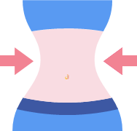
How to prevent obesity
The best way to treat obesity is to eat a healthy, reduced-calorie diet and exercise regularly. To do this you should:
eat a balanced, calorie-controlled diet as recommended by your GP or weight loss management health professional (such as a dietitian)
join a local weight loss group with will help emotionally physically and mentally
take up activities such as fast walking, jogging, swimming or tennis for 150 to 300 minutes (two-and-a-half to five hours) a week
eat slowly and avoid situations where you know you could be tempted to over eat

Slide 6
Make a donation!
If you are interested in raising awareness and learning more about obesity for this cause to help this community overcome an unhealthy lifestyle we have linked a site for you to donate. By donating you could change the lives of people who are affected by this disease.
https://www.obesityaction.org/our-community/make-a-donation

Slide 7
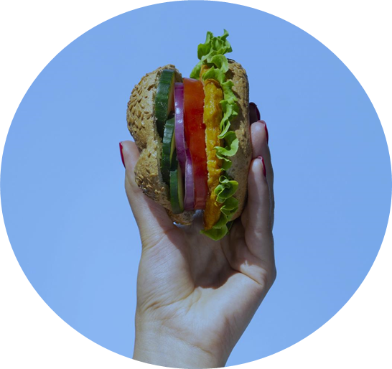
Thanks!

Slide 8
Resources
https://www.obesityaction.org/education-support/learn-about-obesity/causes/
https://www.nhsinform.scot/illnesses-and-conditions/nutritional/obesity#:~:text=The%20best%20way%20to%20treat,a%20local%20weight%20loss%20group
https://www.nhsinform.scot/illnesses-and-conditions/nutritional/obesity#causes-of-obesity

Slide 9
Cited Sources
“About Obesity (Causes and Classifications).” Obesity Action Coalition, 7 June 2022, www.obesityaction.org/education-support/learn-about-obesity/causes/.
Obesity causes and treatments (no date) causes &amp; treatments - Illnesses &amp; conditions | NHS inform. Available at: https://www.nhsinform.scot/illnesses-and-conditions/nutritional/obesity#:~:text=The%20best%20way%20to%20treat,a%20local%20weight%20loss%20group (Accessed: 14 May 2023).
Obesity causes and treatments (no date a) causes &amp; treatments - Illnesses &amp; conditions | NHS inform. Available at: https://www.nhsinform.scot/illnesses-and-conditions/nutritional/obesity#causes-of-obesity (Accessed: 14 May 2023). Obesity causes and treatments (no date b) causes &amp; treatments - Illnesses &amp; conditions | NHS inform. Available at: https://www.nhsinform.scot/illnesses-and-conditions/nutritional/obesity#:~:text=The%20best%20way%20to%20treat,a%20local%20weight%20loss%20group (Accessed: 14 May 2023).

