Slide 1
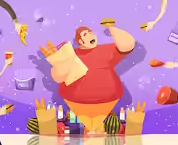
Obesity
Made by :Sanad Madanat,Saif Fashho,Sinan Shawareb

Slide 2
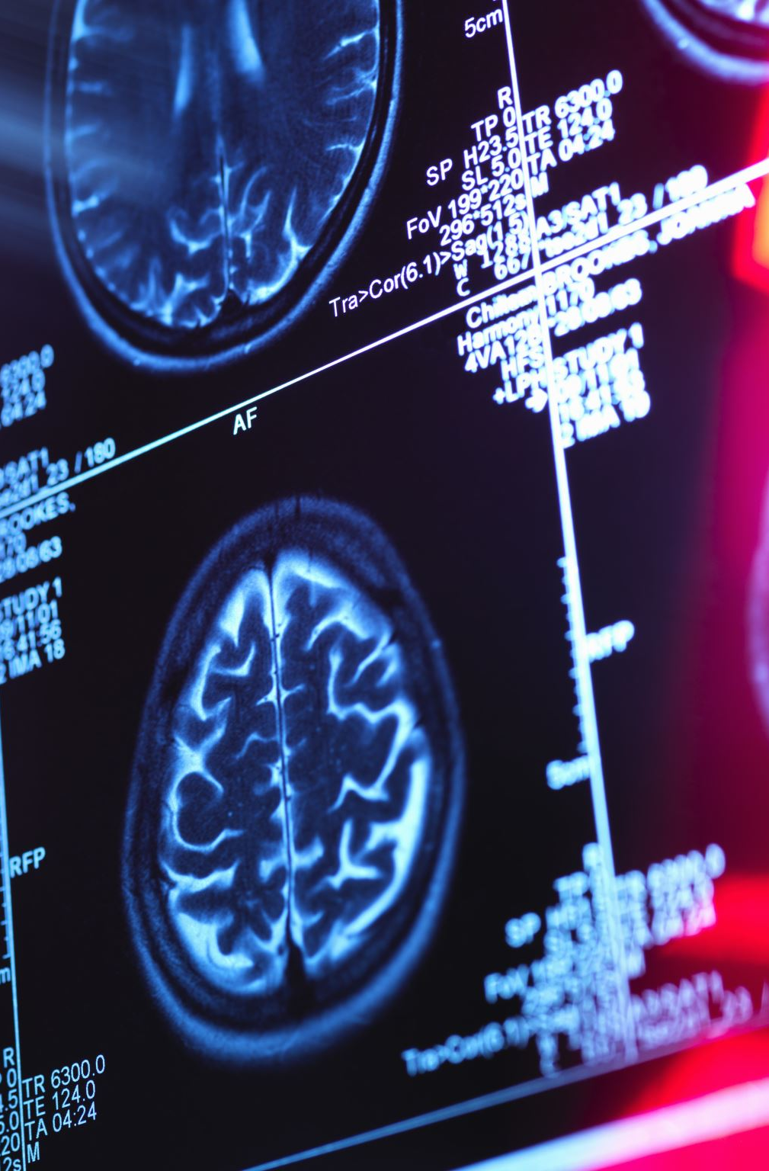
What is obesity ?
Obesity is defined as abnormal or excessive fat that presents a risk to health. It is usually defined as having a body mass of 30 or higher. Obesity can increase the risk of various health problems.

Slide 3
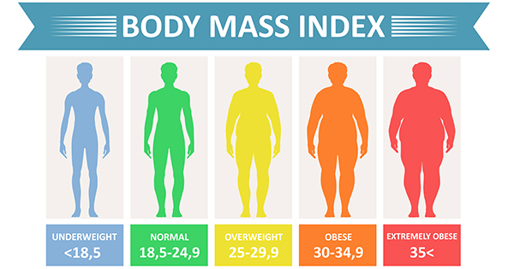
Types of obesity
Obesity is frequently subdivided into 3 categories:
Obesity Class 1: has a BMI of 30 to < 35.
Obesity Class 2: has a BMI of 35 to < 40.
Obesity Class 3: has a BMI of 40 or higher. Class 3 obesity is sometimes categorized as “severe” obesity.

Slide 4
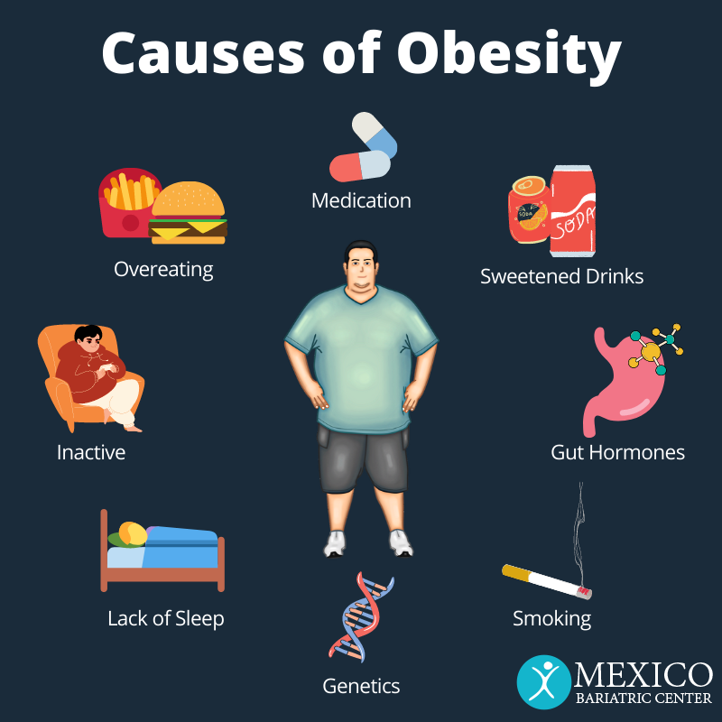
Causes of obesity
Obesity is a complex condition that can be caused by a variety of factors, including lifestyle choices, and environmental factors.
Some contributing factors to obesity may include a lack of physical activity, poor nutrition, stress, lack of sleep, and medical conditions.

Slide 5

What can obesity lead to ?(medically)
Obesity can lead to many health problems such as:
High blood pressure
Strokes
Diabetes type 2
Cancer
Coronary heart disease

Slide 6
Effects of obesity
Breathless
Increased sweating
Snoring
Feeling insolated
Low confidence and self esteem
Joint and back pain
Often feeling very tired
Depression
laziness

Slide 7
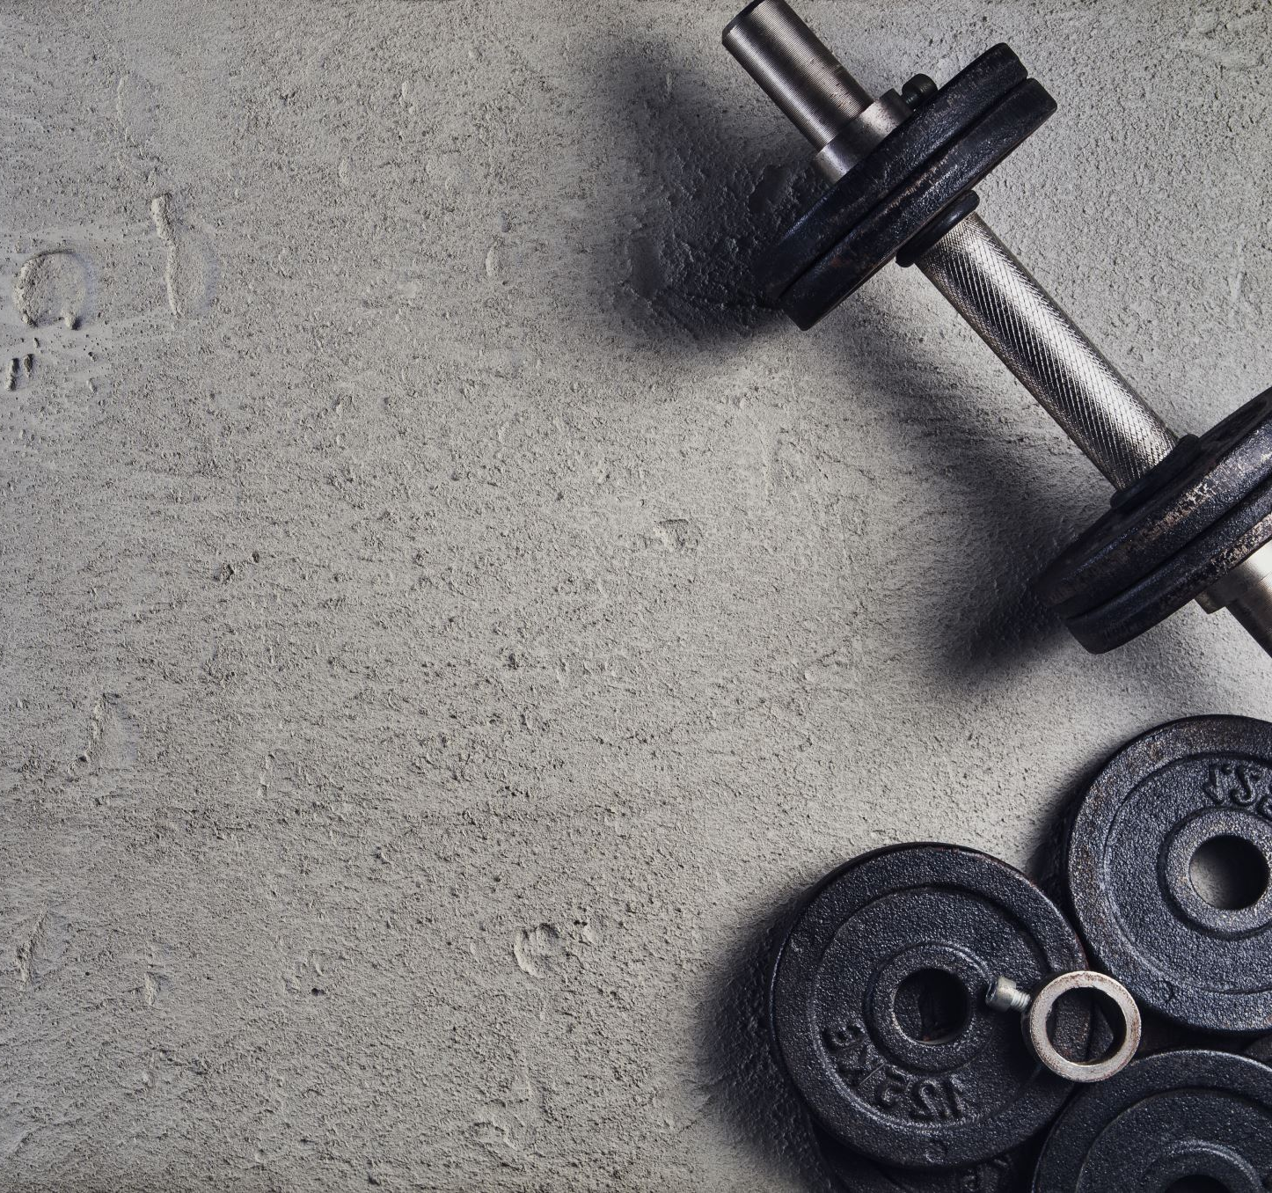
How can you prevent obesity ?
Choosing healthier foods and beverages.
Increasing physical activity.
Limiting television time, screen time, and others.

Slide 8
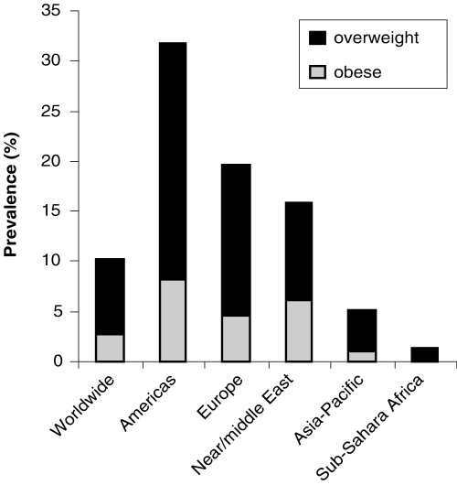
How many people die yearly due to obesity ?
Yearly, 2.8 million people die due to being obese. Mostly in America.
Pakistan

Slide 9
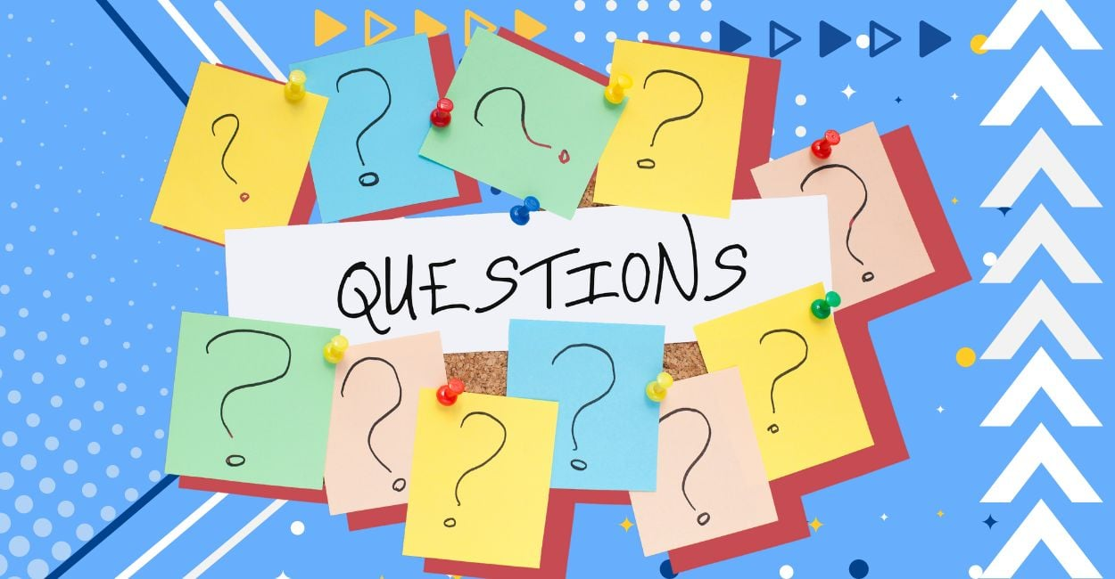

Slide 10
What is obesity?
Obesity is defined as abnormal or excessive fat that presents a risk to health. It is usually defined as having a body mass of 30 or higher. Obesity can increase the risk of various health problems.
Obesity is considered when there is BMI of 25 or higher

Slide 11
Causes of obesity
Obesity is a complex condition that can be caused by a variety of factors, including lifestyle choices, and environmental factors.
Choosing healthier foods and beverages.
Increasing physical activity.
Limiting television time, screen time, and others.

Slide 12


Slide 13


Slide 14
Sources
AhWcWaQEHTRnBHQQFnoECBQQAw&url=https%3A%2F%2Fwww.cdc.gov%2Fhealthyweight%2Feffects%2Findex.html&usg=AOvVaw068Rd1KngKjde0g86x6Je1
https://www.who.int/
AhW3T6QEHbXmDOUQFnoECAgQAw&url=https%3A%2F%2Fwww.hsph.harvard.edu%2Fobesity-prevention-source%2Fobesity-prevention%2F&usg=AOvVaw3M_yinFK2M3uWw_AmWtYbC
DnoQFnoECAgQAw&url=https%3A%2F%2Fwww.nichd.nih.gov%2Fhealth%2Ftopics%2Fobesity%2Fconditioninfo%2Fcause&usg=AOvVaw0Cynz164iHUAYcxK_HTKj7

Slide 15


