Slide 1
Obesity
Made by :Sanad Madanat,Saif Fashho,Sinan Shawareb

Slide 2
What is obesity ?
obesity is defined as abnormal or excessive fat that presents a risk to health. It is usually defined as having a body mass of 30 or higher. Obesity can increase the risk of various health problems.

Slide 3
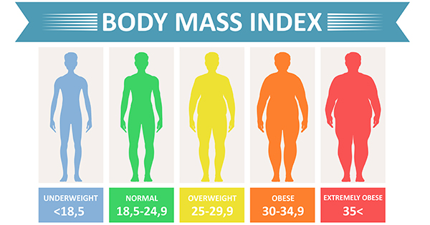
Types of obesity
Obesity is frequently subdivided into 3 categories:
Obesity Class 1: has a BMI of 30 to < 35.
Obesity Class 2: has a BMI of 35 to < 40.
Obesity Class 3: has a BMI of 40 or higher. Class 3 obesity is sometimes categorized as “severe” obesity.

Slide 4
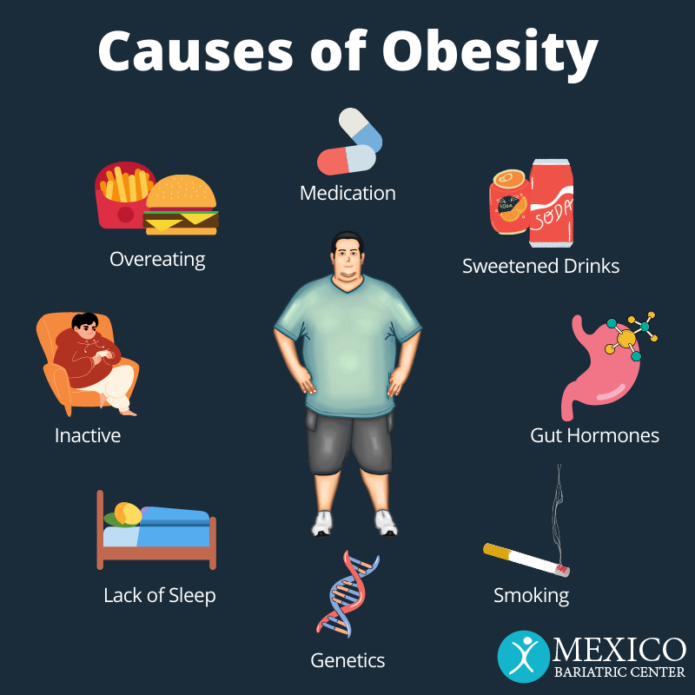
Causes of obesity
Obesity is a complex condition that can be caused by a variety of factors, including lifestyle choices, and environmental factors.
Some contributing factors to obesity may include a lack of physical activity, poor nutrition, stress, lack of sleep, and medical conditions.

Slide 5
What can obesity lead to ?
Obesity can lead to many health problems such as:
high blood pressure
strokes
diabetes type 2
cancer
Coronary heart disease

Slide 6
Effects of obesity
Breathless
Increased sweating
Snoring
Feeling insolated
Low confidence and self esteem
Joint and back pain
Often feeling very tired
depression
laziness

Slide 7
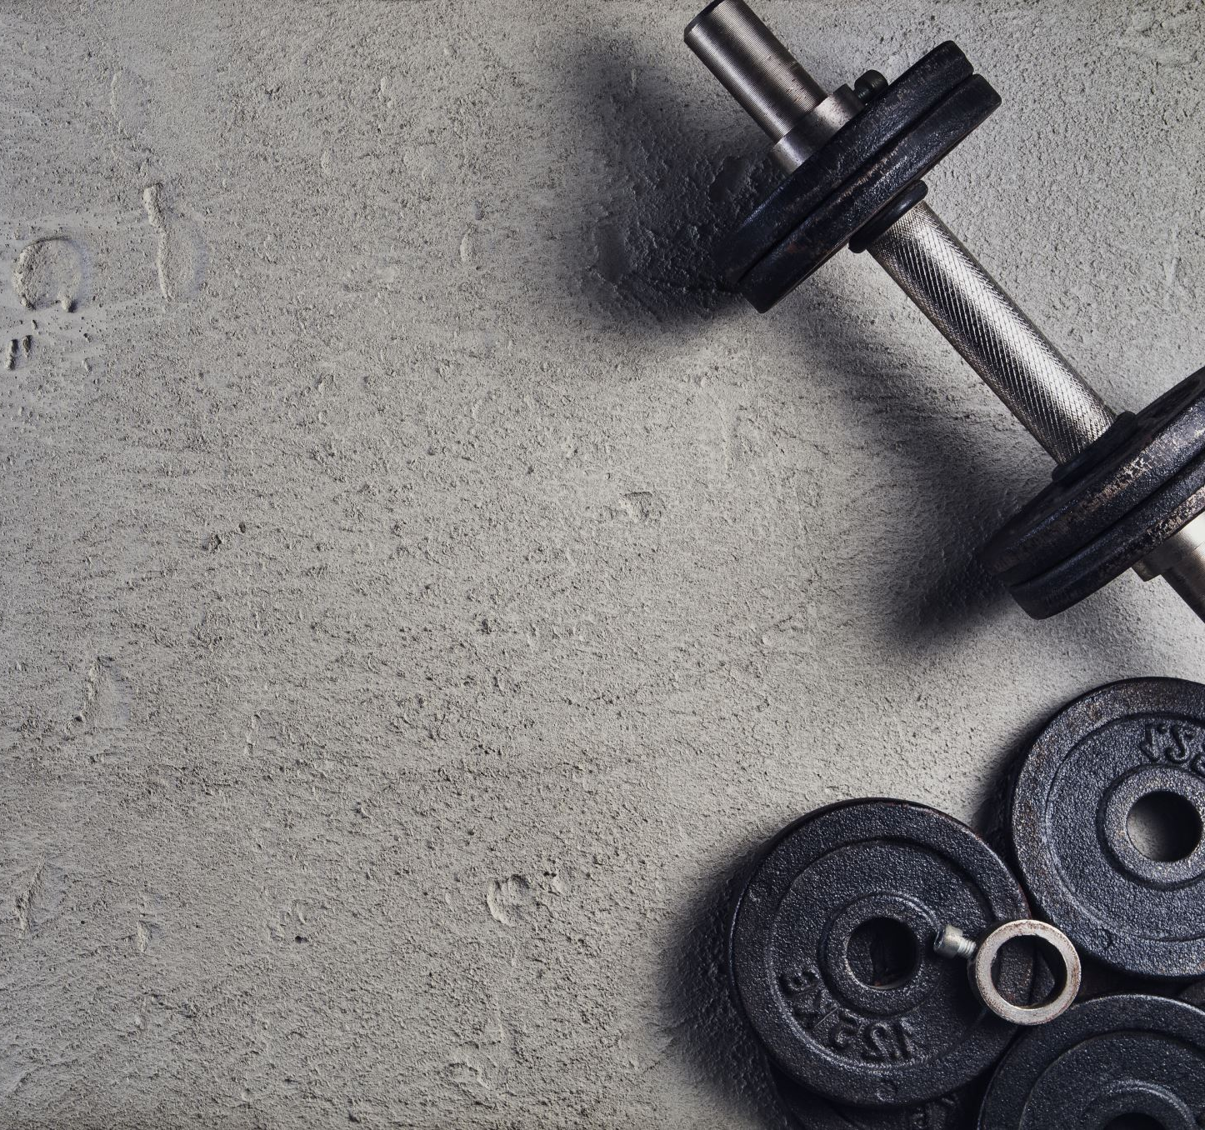
How can you prevent obesity ?
Choosing healthier foods and beverages.
Increasing physical activity.
Limiting television time, screen time, and others.

Slide 8
Sources
AhWcWaQEHTRnBHQQFnoECBQQAw&url=https%3A%2F%2Fwww.cdc.gov%2Fhealthyweight%2Feffects%2Findex.html&usg=AOvVaw068Rd1KngKjde0g86x6Je1
https://www.who.int/
AhW3T6QEHbXmDOUQFnoECAgQAw&url=https%3A%2F%2Fwww.hsph.harvard.edu%2Fobesity-prevention-source%2Fobesity-prevention%2F&usg=AOvVaw3M_yinFK2M3uWw_AmWtYbC
DnoQFnoECAgQAw&url=https%3A%2F%2Fwww.nichd.nih.gov%2Fhealth%2Ftopics%2Fobesity%2Fconditioninfo%2Fcause&usg=AOvVaw0Cynz164iHUAYcxK_HTKj7

