Slide 1
Earthquakes
Rafael, Gio,
Karam

Slide 2
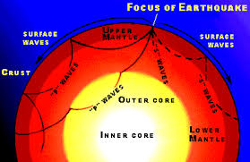
Cause of Earthquakes
Notes:
Introduction:
Earthquakes are usually cause when underground rock suddenly breaks there is a rapid motion along
a fault. This sudden release of energy causes the seismic waves that make the ground shake.
mtu.edu

Slide 3
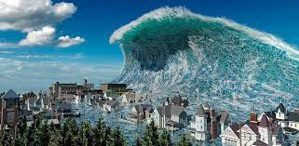
Earthquakes causes tsunamis and ground shaking
Notes:
Ground shaking:
Ground Shaking is caused by body waves and surface waves. As a generalization, the serverity
Of ground shaking increases as magnitude increases and deceases as distance from the causative fault increases.
Tsunamis:
Tsunamis are giant waves caused by earthquakes or volcanic eruptions under the sea. Out in the depths of the ocean, tsunami waves do not dramatically increase in height. But as the waves travel inland, they build up to higher and higher heights as the depth of the ocean decreases.
Uses.gov

Slide 4

How to prepare for a earth quake
Notes:
Make an Emergency Plan: Create a family emergency communications plan that has an out-of-state contact. Plan where to meet if you get separated. Make a supply kit that includes enough food and water for several days, a flashlight, a fire extinguisher and a whistle.31.01.2023
Earthquakes | Ready.gov

Slide 5
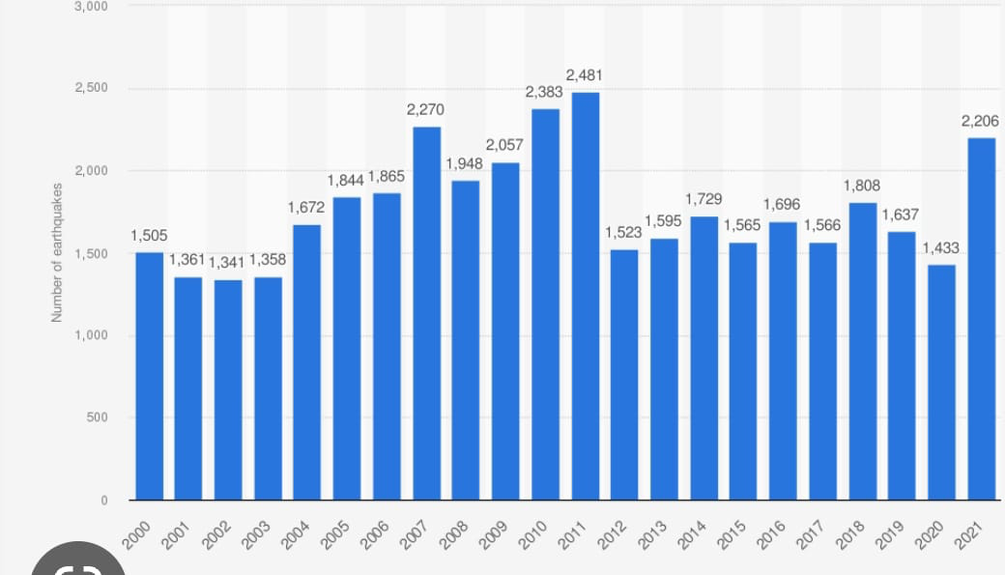
Number of people dying in a year
Notes:
Earthquakes account for the majority of deaths from a r ange of natural disasters which amounts to about 60,000 people a year worldwide – around 90 percent of which occur in developing countries (OECD, 2008). https://www.google.de/url?sa=t&rct=j&q=&esrc=s&source=web&cd=&ved=2ahUKEwiIlKye-9r-AhVLgv0HHU7dBg8QFnoECA0QAw&url=https%3A%2F%2Fopenknowledge.worldbank.org%2Fbitstream%2Fhandle%2F10986%2F4042%2FWPS4823.pdf&usg=AOvVaw3RIMYJXw59PCIVjmN8zgzf

Slide 6
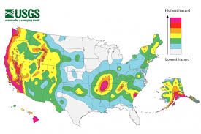
Countries with most earthquakes
Notes:
For which country do we locate the most earthquakes? Japan. The whole country is in a very active seismic area, and they have the densest seismic network in the world, so they are able to record many earthquakes.
Which country has the most earthquakes? - USGS.gov

Slide 7
Thank you, here are some videos and links for more information
https://youtu.be/vxmoxDznXe4
https://youtu.be/Hd4xCmuwiBw
https://youtu.be/vS55NgX-JgM

