Slide 1
Obesity
By:maria hadaddin,leen habash,natalie awwad

Slide 2
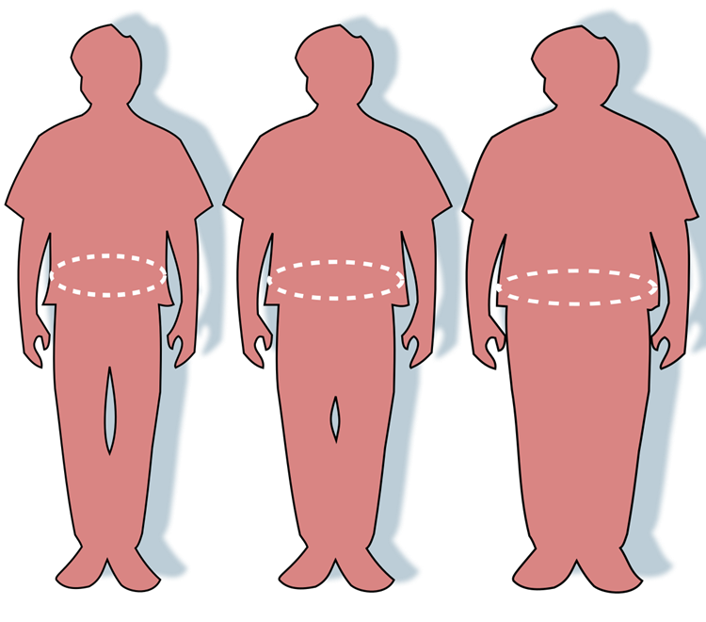
What is obesity
Obesity is a complex disease involving an excessive amount of body fat. Obesity isn't just a cosmetic concern. It's a medical problem that increases the risk of other diseases and health problems.

Slide 3
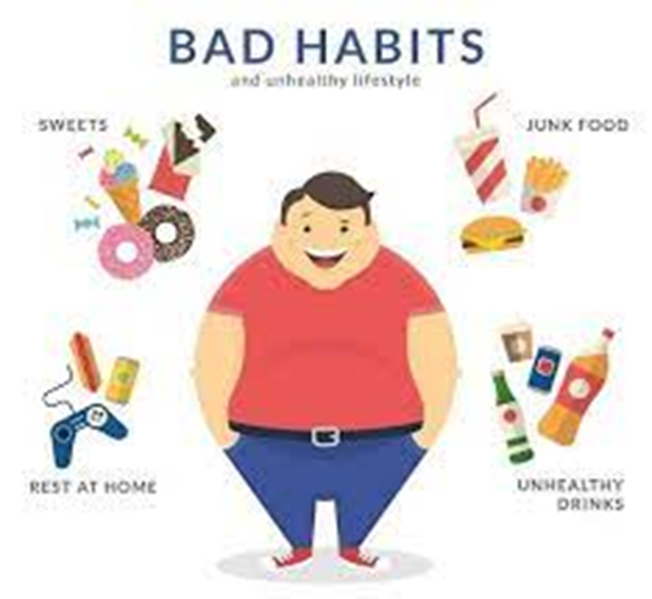
Health Effects of Overweight and Obesity
All-causes of death (mortality).
High blood pressure (hypertension).
High LDL cholesterol, low HDL cholesterol, or high levels of triglycerides (dyslipidemia).
Type 2 diabetes.
Coronary heart disease.
Stroke.
Gallbladder disease.

Slide 4
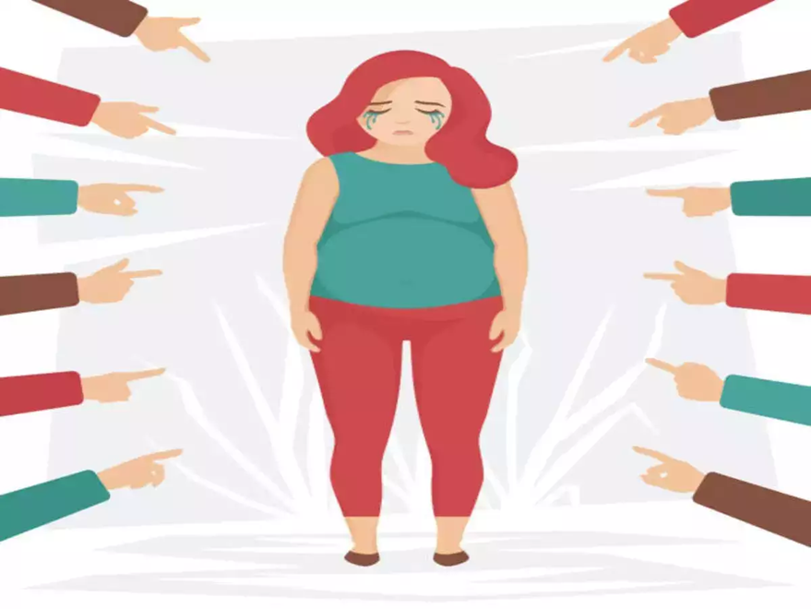
What causes obesity & overweight?
Food and Activity
Environment
Genetics
Health Conditions and Medications
Stress, Emotional Factors, and Poor Sleep

Slide 5
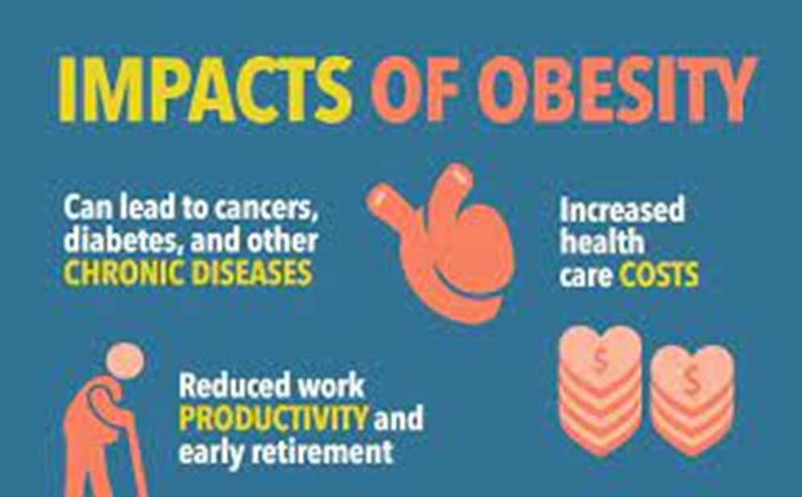
What are the consequences?
Cancer
Diabetes
Depression
Respiratory disease

Slide 6
Solutions for obesity
Build early relationships with healthy foods
Make sure ton get enough sleep
Focus on reducing daily stress
Learn how to food budget and meal prep
Eat more servings of vegetables

Slide 7
Links
Mayo Foundation for Medical Education and Research. (2021, September 2). Obesity. Mayo Clinic. https://www.mayoclinic.org/diseases-conditions/obesity/symptoms-causes/syc-20375742
Centers for Disease Control and Prevention. (2022, September 24). Health effects of overweight and obesity. Centers for Disease Control and Prevention. https://www.cdc.gov/healthyweight/effects/index.html#:~:text=High%20blood%20pressure%20(hypertension).,Coronary%20heart%20disease.
U.S. Department of Health and Human Services. (n.d.). What causes obesity & overweight?. Eunice Kennedy Shriver National Institute of Child Health and Human Development. https://www.nichd.nih.gov/health/topics/obesity/conditioninfo/cause
Writers, S. (2021, February 8). Obesity in America: What are the consequences?. PublicHealth.org. https://www.publichealth.org/public-awareness/obesity/consequences/
Obesity Prevention Strategies. Obesity Prevention Source. (2016a, April 12). https://www.hsph.harvard.edu/obesity-prevention-source/obesity-prevention/

