Slide 1
Obesity
By: Omar Fityani and Hisham al zaghmouri

Slide 2
What is obesity?

Slide 3
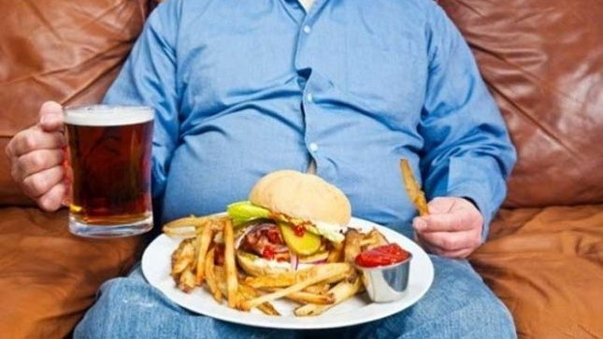
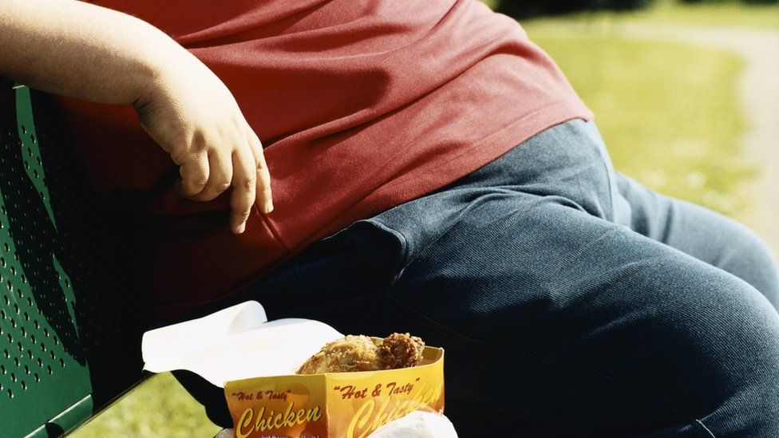
What are the causes of obesity?

Slide 4
BMI Scale

Slide 5
What are the Consequences / impacts of obesity?

Slide 6
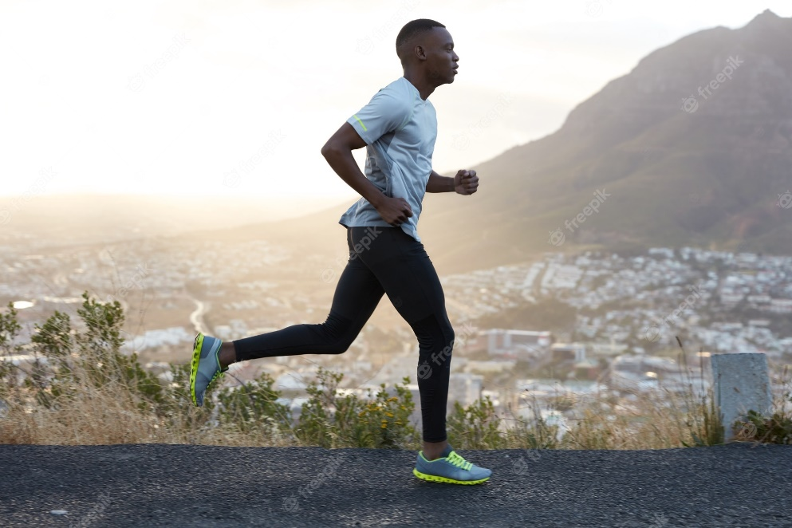
Obesity Solutions

Slide 7
Explanation video
https://www.youtube.com/watch?v=TsZlTe_4LTU

