Slide 1
obesity
By: Asim/Yazan/Sanad/Ghazi

Slide 2
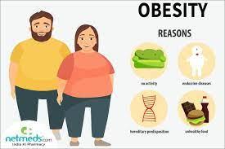
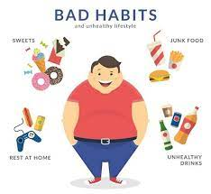

Slide 3
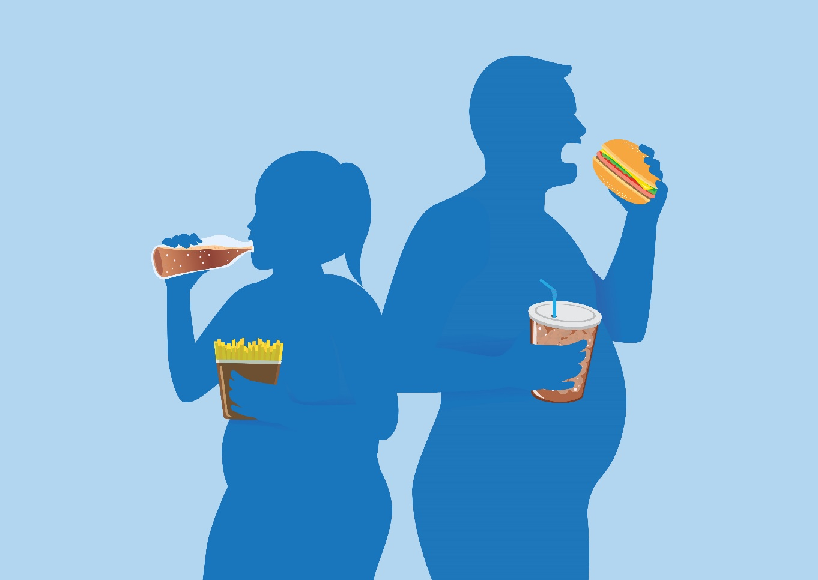
Video
link: https://www.youtube.com/watch?v=iQUJ1HV0PWc

Slide 4
obesity
What is obesity?
What are the causes of obesity?
What are the symptoms of obesity?
How does obesity affect you?
What are the treatments of obesity?

Slide 5
Game
Kahoot: https://create.kahoot.it/details/e2201629-2a5d-4940-9738-d1bd6c41b03d

