Slide 1
Obesity
By: Omar Fityani and Hisham al zaghmouri

Slide 2
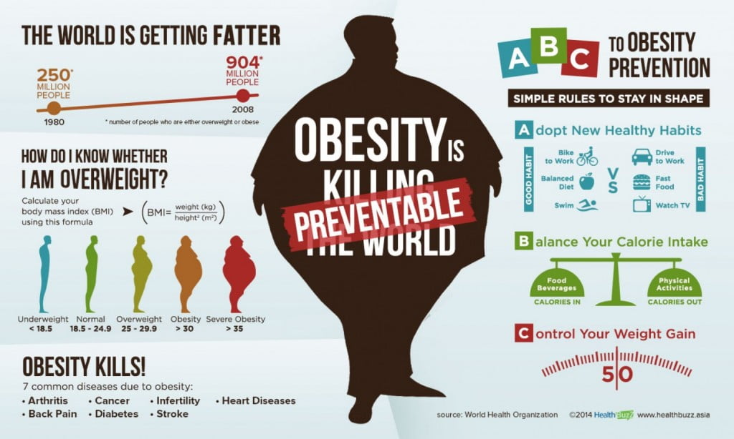
What is obesity?

Slide 3
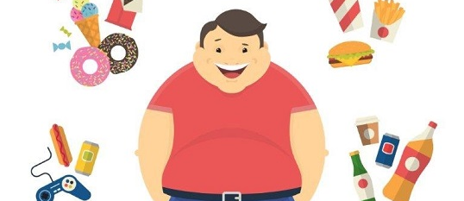
What are the causes of obesity?

Slide 4
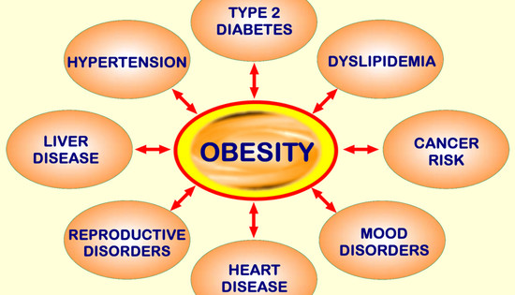
What are the Consequences / impacts of obesity?

Slide 5
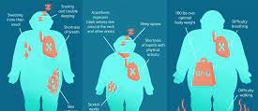
Obesity Solutions

