Slide 1
obesity
By: Shadi, Jad , Raad ,Nassar

Slide 2
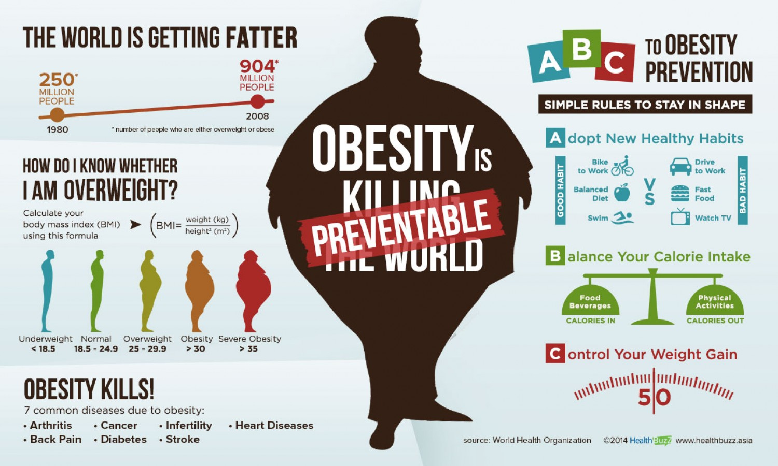
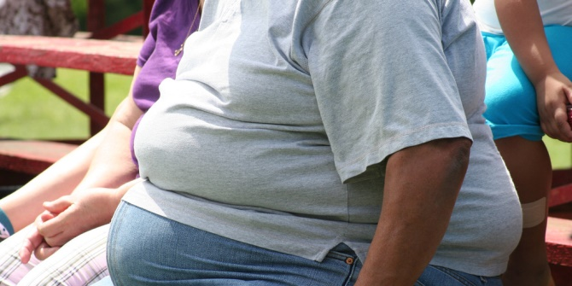
What does obesity mean?
Obesity is a complex disease involving an excessive amount of body fat It's a medical problem that increases the risk of other diseases and health problems.
This Photo by Unknown Author is licensed under CC BY

Slide 3
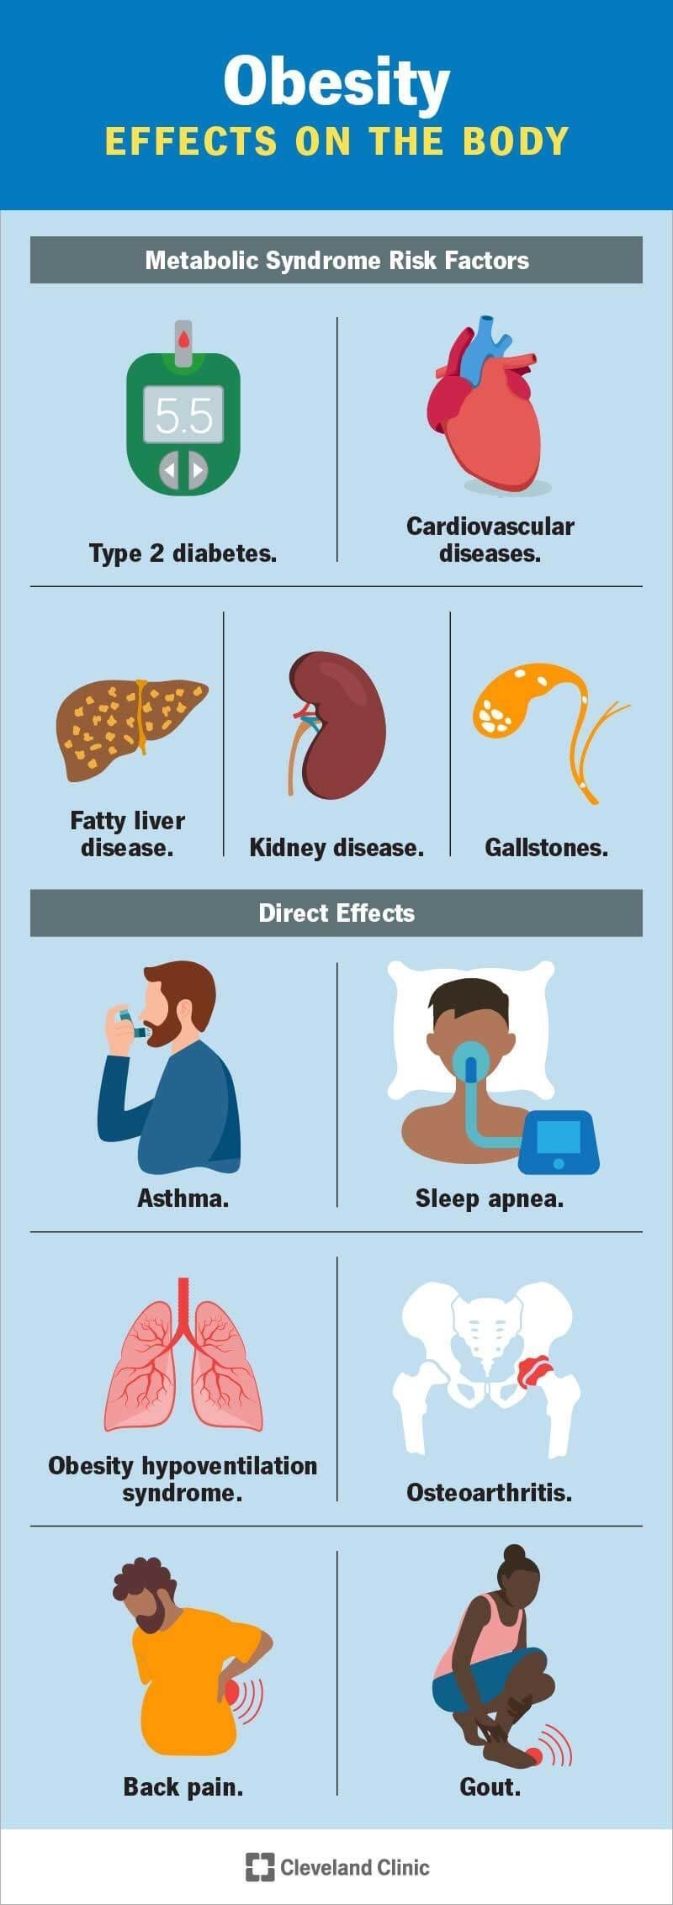
How can obesity affects your body?
Carrying extra fat leads to serious health consequences such as mainly heart disease and stroke, type 2 diabetes, and some cancers such breast and colon. These conditions can cause death and disability.

Slide 4

Causes of obesity.
People gain weight when they eat more calories than they burn through activity.
The world around us influences our ability to maintain a healthy weight.
Genetics.
Health Conditions and Medications.
Stress, Emotional Factors, and Poor Sleep.

Slide 5
Solutions for obesity
eat a balanced controlled diet as recommended by your weight loss management health professional (such as a dietitian)
join a local weight loss group
take up activities such as fast walking, jogging, swimming or padling for 3 hour to a 6 hours a week
eat slowly and avoid situations where you know you could be tempted to overeat

Slide 6

Questions.
1. What is obesity.
2. Describe how obesity can effect your body.
3. What are the causes of obesity.
4. How can you prevent obesity.

Slide 7

THANK YOU!

