Slide 1
Endothermic and exothermic substances
Done by: bashar, Abdullah, Rakan, Majed

Slide 2
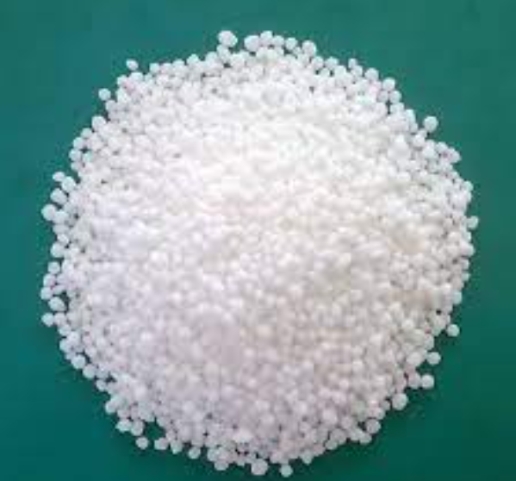
Endothermic substance
Ammonium Nitrate (NH4NO3)
Ammonium nitrate is a chemical compound with the chemical formula NH4NO3. it is a white crystalline salt consisting of ions of ammonium nitrate, it is highly soluble in water as a solid
starting temp of water: 25.4
Final temp of water: 22.1
Change in water temp: -3.3

Slide 3
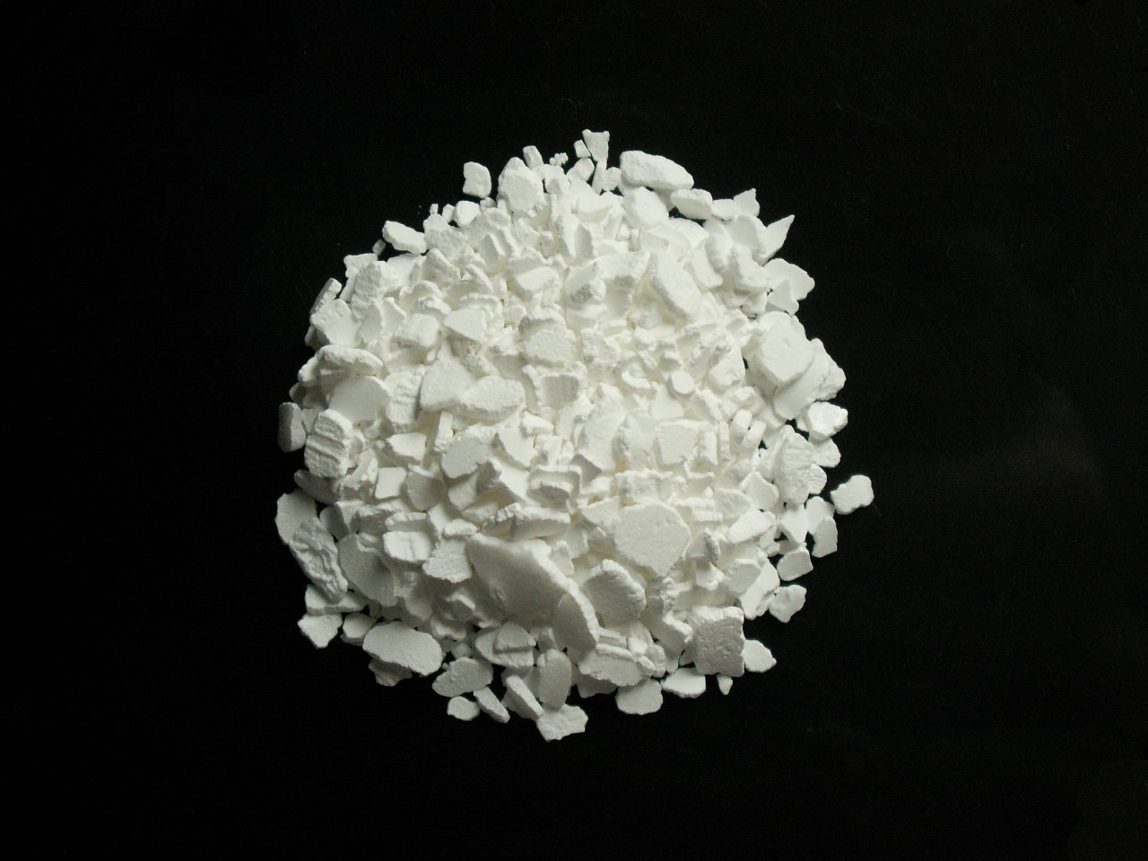
Exothermic substance
Calcium chloride (cacl2)
Calcium chloride is an ionic compound of calcium and chlorine. It is highly soluble in water and it is deliquescent. It is a salt that is solid at room temperature, and it behaves as a typical ionic halide.
Beginning water temp:25.4
Final water temp:28.9
Change in water temp:+3.5

Slide 4
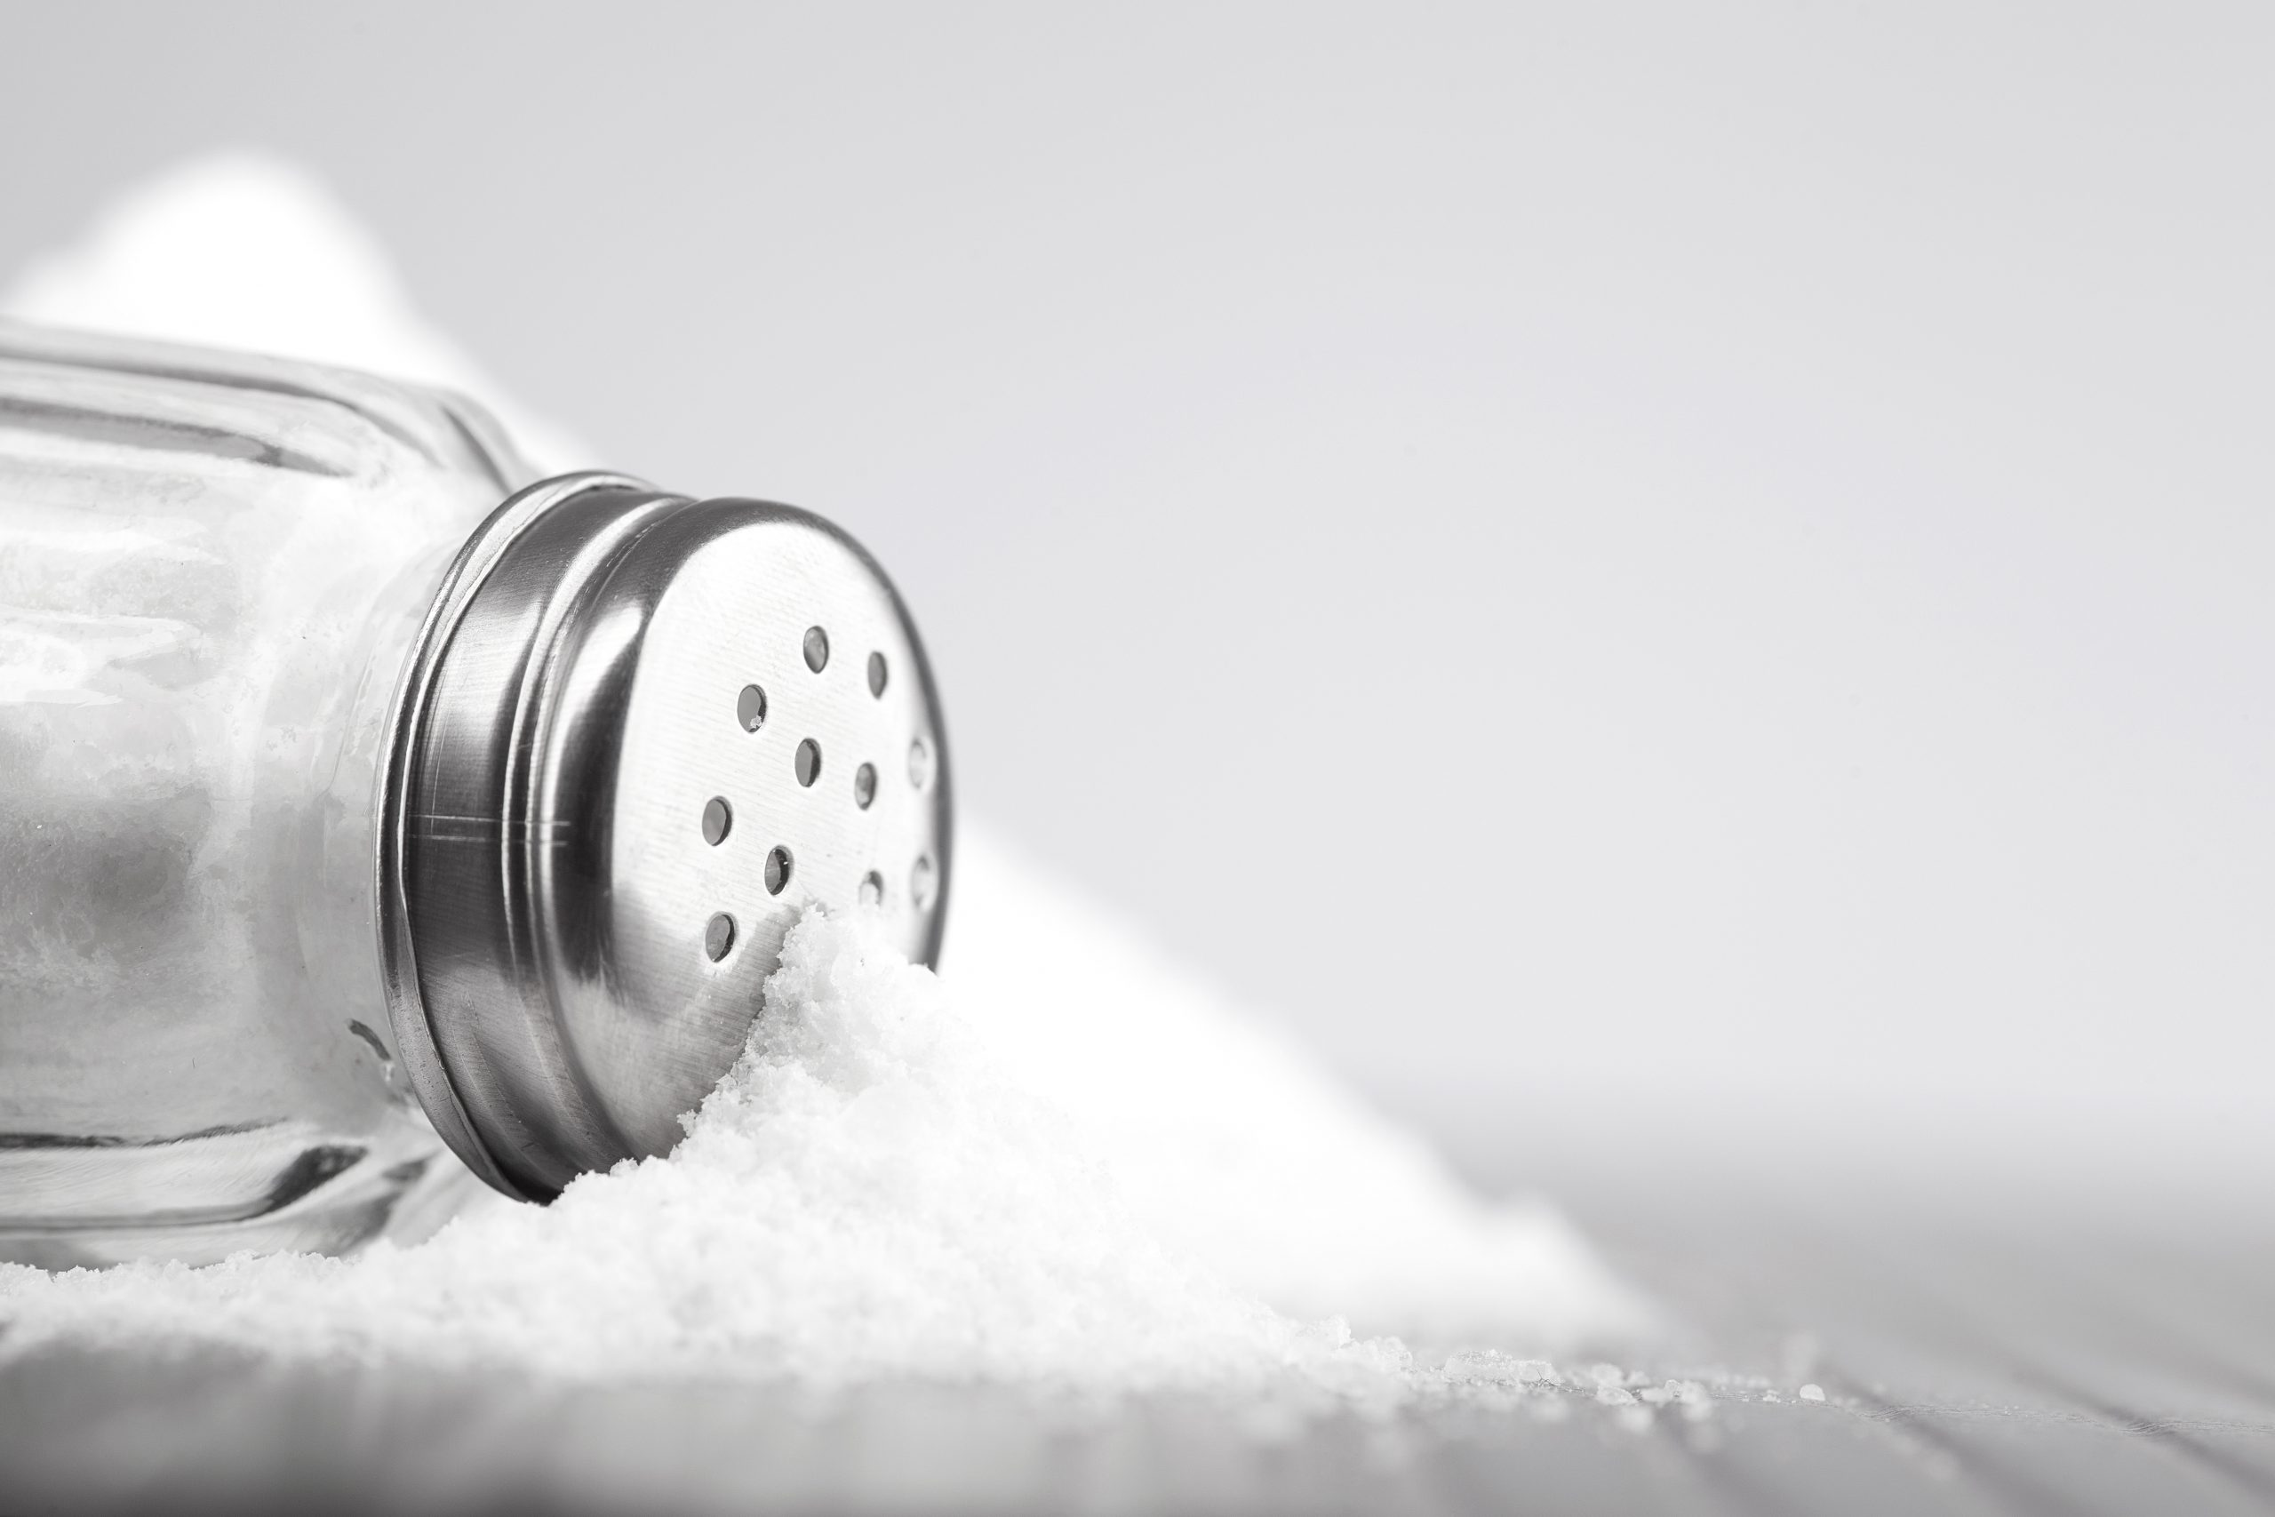
Endothermic substance
Sodium chloride (NaCl)
Sodium chloride (NaCl), commonly known as salt, is one of the most abundant minerals on Earth and an essential nutrient for many animals and plants. Sodium chloride is naturally found in seawater and in underground rock formations.
Beginning water temp:25.4
Final water temp:25.1
Change in water temp:-0.3

Slide 5
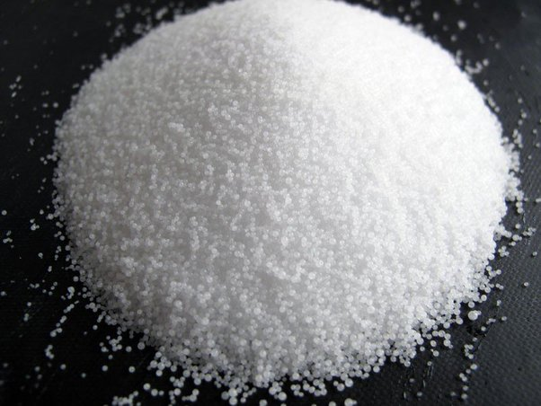
exothermic reaction
Sodium hydroxide(NaOH)
Sodium chloride is naturally found in seawater and in underground rock formations
Beginning water temp:25.4
Final water temp:29.5
Change in water temp:+4.1

