Slide 1
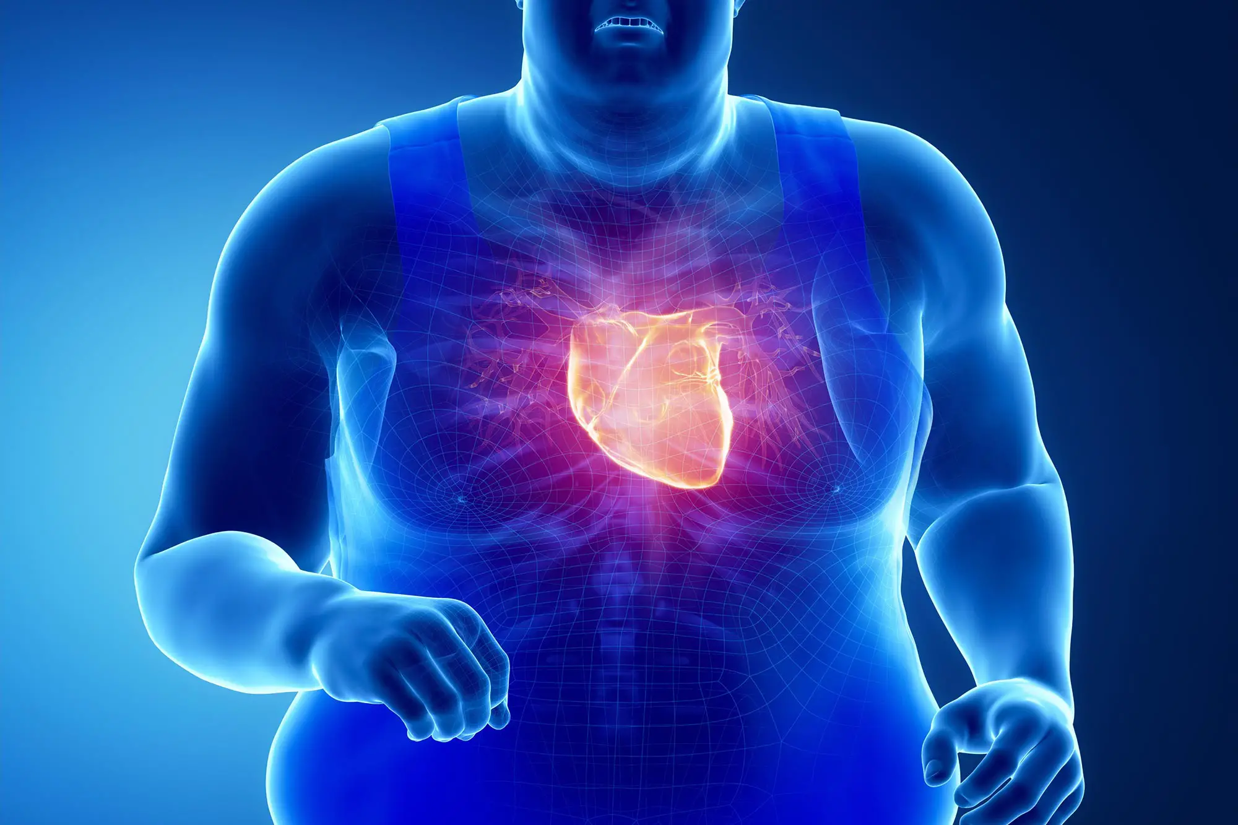
OBESITY

Slide 2
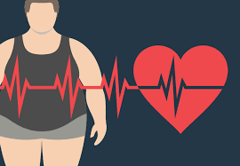
What is obesity
Obesity is characterized as abnormal or build up of excessive body fat. It is a growing heath concern world wide as people with obesity are more likely to develop a wide range of significant illnesses and medical disorders than people with a healthy weight, numerous psychological, social, and physical issues are among them.

Slide 3
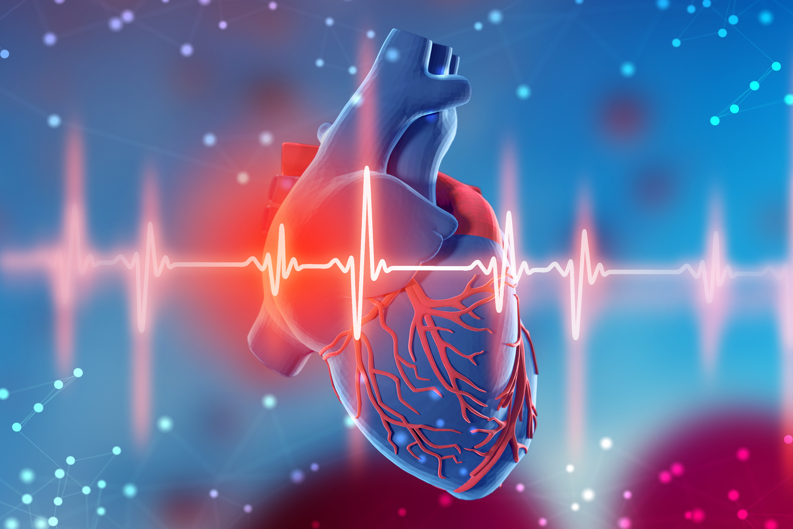
Causes of obesity
Obesity can be caused by a variety of factors, including genetics, lifestyle choices and environmental influences as living alone, poverty, low level of education and unemployment. These have all been linked to an increased rates of obesity.
Examples such as:
engineered junk foods
food addiction
aggressive marketing
Lack of physical activity

Slide 4

Consequences
Obesity can cause many problems, these problems fit into three main categories. Those categories are: physical, social, and psychological.
It can lead to:
High blood pressure\high cholesterol
Type 2 diabetes
Breathing problems, such as asthma
Lower self-esteem and quality of life
Anxiety, depression and bullying
Many types of cancers
Discrimination

Slide 5
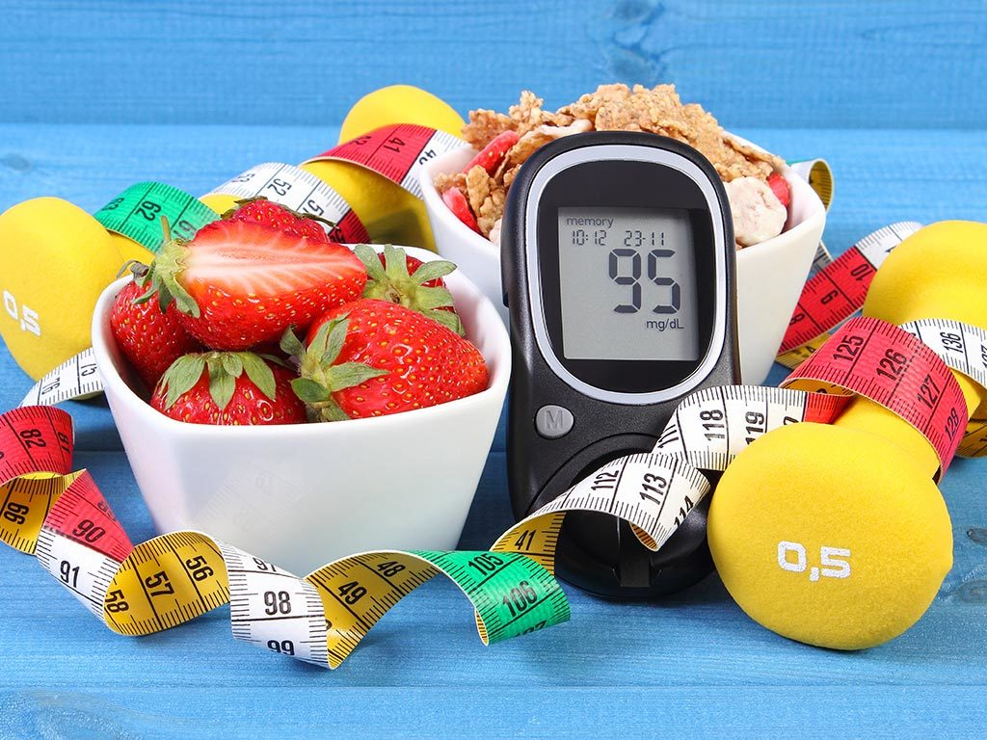
Solutions
There are many ways to control to obesity. One of the most effective ways is maintaining a balanced diet, exercise is also very helpful as it burns calories and speeds up weight loss. You can do this by running or walking for 10k steps a day which makes a big difference. Another way is to seek for medical advice which can help you to organize a treatment plan, medical advice will not only help you lose weight but motivate you mentally.
Here are some more treatments people go for:
Bariatric surgery ( type of surgery done for weight loss)
Weight-loss medicines
Fiber-rich foods help with weight loss

Slide 6
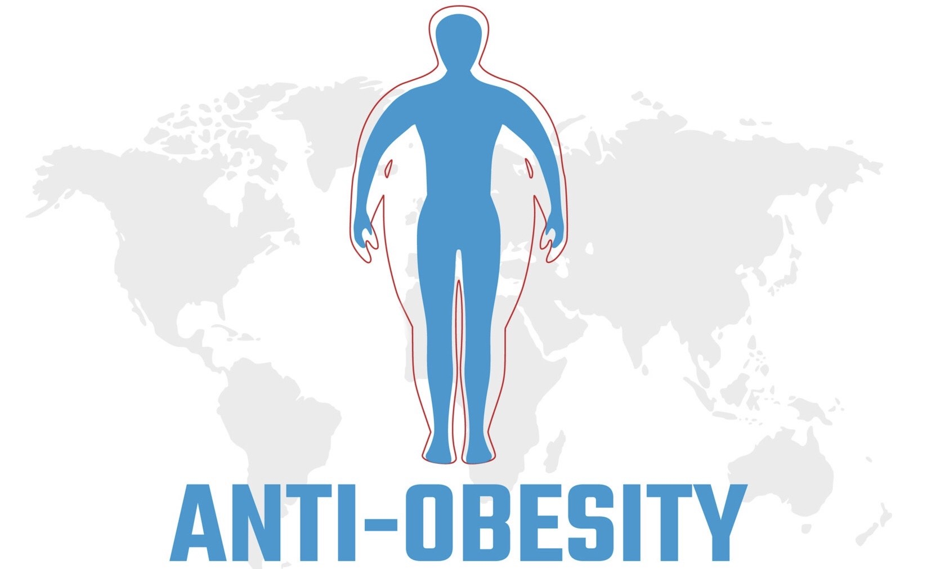
Conclusion
To sum up everything that has been stated so far, Obesity is a serious medical condition which can lead to major health problems. On the other hand Obesity can be controlled through various ways. However, It requires time, effort, patience and determination.

Slide 7
Citations
“Treatment for Overweight &amp; Obesity - Niddk.” National Institute of Diabetes and Digestive and Kidney Diseases, U.S. Department of Health and Human Services, www.niddk.nih.gov/health-information/weight-management/adult-overweight-obesity/treatment.
"Health Effects of Overweight and Obesity".Centers for Disease Control and Prevention www.cdc.gov/healthyweight/effects/index.html.
"Consequences of Obesity.” Centers for Disease Control and Prevention, 15 July 2022 www.cdc.gov/obesity/basics/consequences.html#:~:text=Adults%20with%20obesity%20have%20higher,as%20clinical%20depression%20and%20anxiety.
“Causes of Obesity.” Centers for Disease Control and Prevention, 21 Mar. 2022, www.cdc.gov/obesity/basics/causes.html#:~:text=Obesity%20is%20a%20complex%20disease,activity%20levels%2C%20and%20sleep%20routines.
“Treatment for Overweight &amp; Obesity - Niddk.” National Institute of Diabetes and Digestive and Kidney Diseases, U.S. Department of Health and Human Services, www.niddk.nih.gov/health-information/weight-management/adult-overweight-obesity/treatment.

Slide 8
Thank you

