Slide 1
Water Crisis in Jordan
By : Samia Yaghnam, Nadeen Theodory, Hind Al Shalabi
Class : 7A

Slide 2
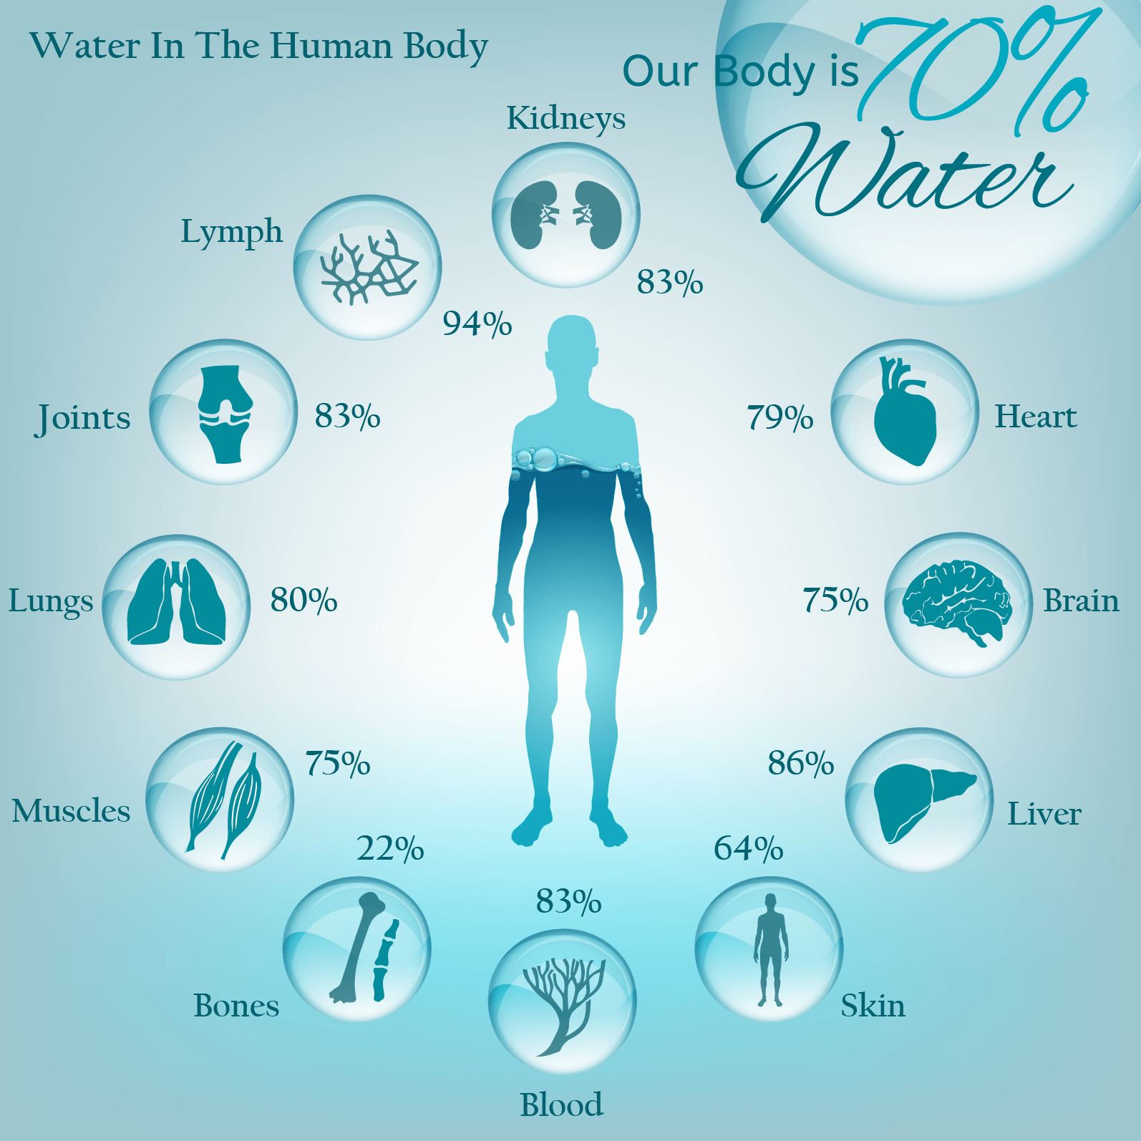
Why is water important ? :
Water makes up 60-75% of human body weight. A loss of just 4% of total body water leads to dehydration, and a loss of 15% can be fatal. Likewise, a person could survive a month without food but wouldn’t survive 3 days without water. This crucial dependence on water broadly governs all life forms. Clearly water is vital for survival.
Clean fresh water is necessary for drinking and sanitation, providing for our crops, livestock and industry, and creating and sustaining the ecosystems on which all life depends.

Slide 3

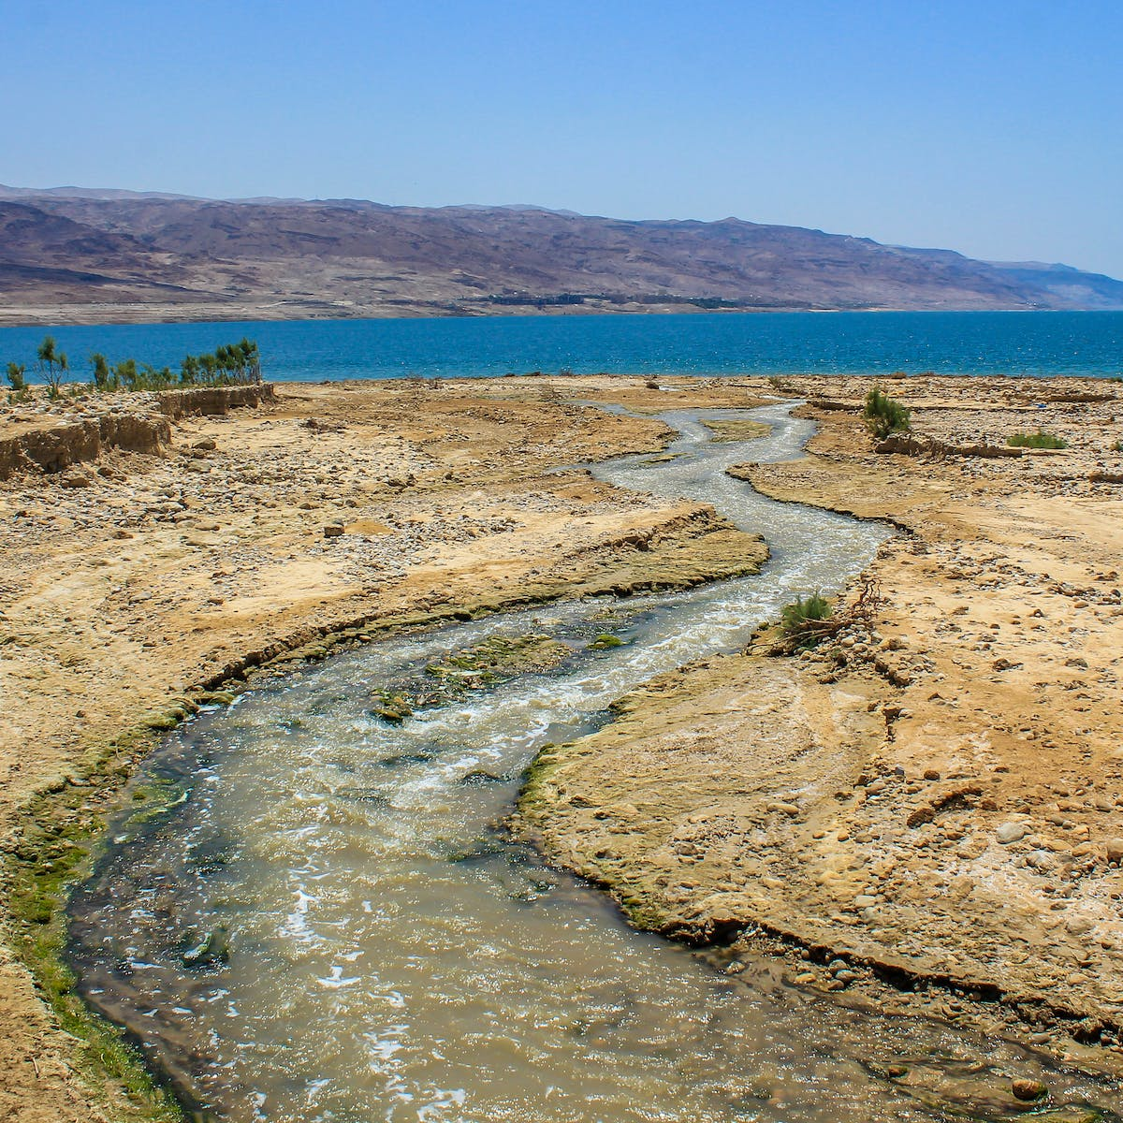
The current situation of water in Jordan :
Jordan is one of the most water-scarce countries in the world. The country's renewable water supply currently meets around two-thirds of the population's water demands, with groundwater being used twice as quickly as it can be replenished.

Slide 4
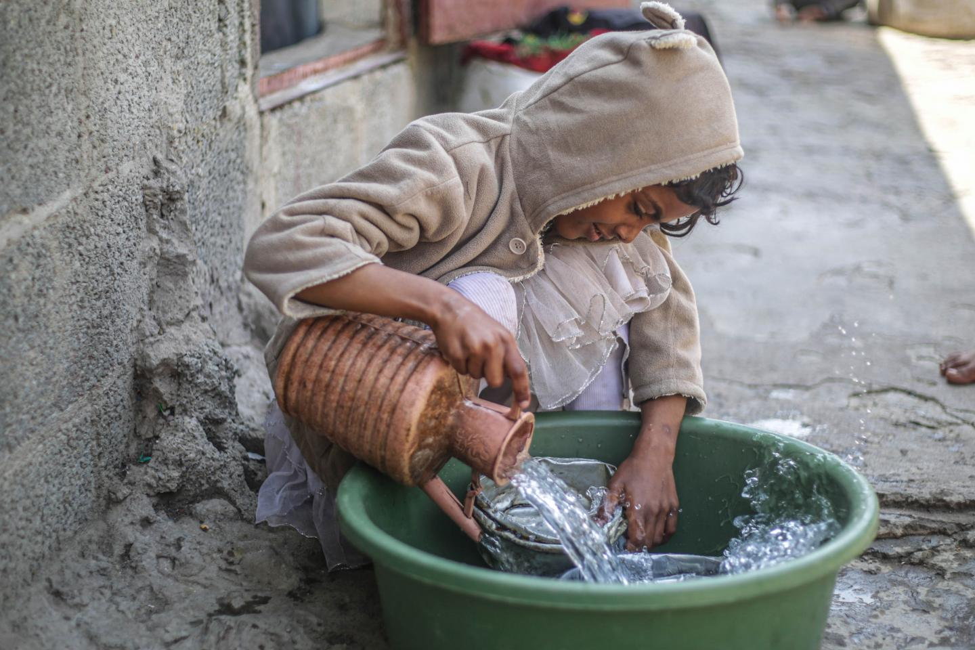
What are the main causes of water crisis in Jordan? :
The overflow of wastewater pumping stations, leaks from sewage systems and exposure to industrial and commercial waste are polluting Jordan's surface river sources.

Slide 5
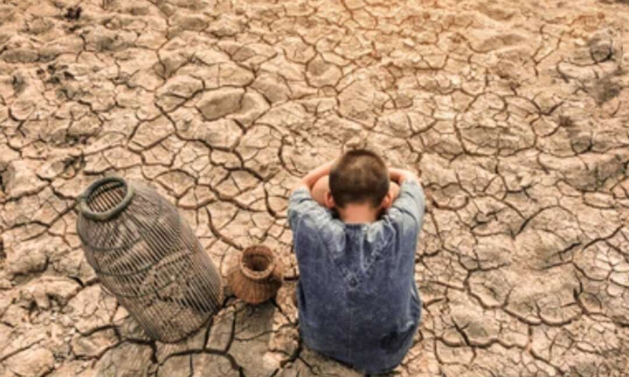
Consequences of water crisis in Jordan :
Increased operational costs and increased complexity in supply chains

Slide 6
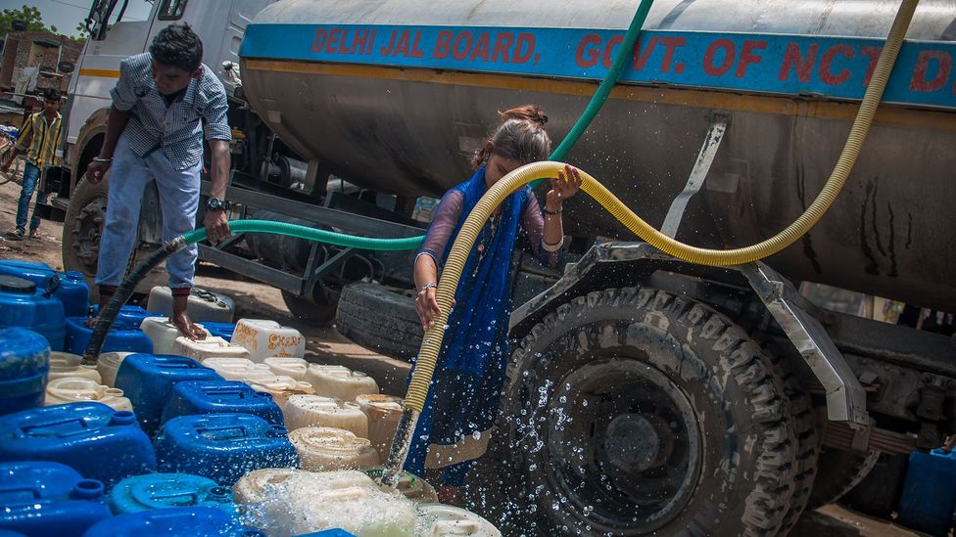
How can we solve water crisis in Jordan?:
Recycling and reuse of municipal wastewater which is an attractive method in terms of water savings. Infact, the reuse of the treated wastewater in Jordan has reached one of the highest levels in the world.

Slide 7

Organizations who can help solve water crisis in Jordan :
Mercy Corps Jordan focuses on water conservation efforts as well as reducing the negative impact of water scarcity on economic development and the most vulnerable people in society.

Slide 8
Citation :
1. SITNFlash. (2019a, September 26). Biological roles of water: Why is water necessary for life?. Science in the News. https://sitn.hms.harvard.edu/uncategorized/2019/biological-roles-of
SITNFlash. (2019b, September 26). Biological roles of water: Why is water necessary for life?. Science in the News. https://sitn.hms.harvard.edu/uncategorized/2019/biological-roles-of
2. Environment, U. (n.d.). Why does water matter?. UNEP. https://www.unep.org/explore-topics/water/why-does-water-matter
SITNFlash. (2019a, September 26). Biological roles of water: Why is water necessary for life?. Science in the News. https://sitn.hms.harvard.edu/uncategorized/2019/biological-roles-of
SITNFlash. (2019b, September 26). Biological roles of water: Why is water necessary for life?. Science in the News. https://sitn.hms.harvard.edu/uncategorized/2019/biological-roles-of
3. Environment, U. (n.d.). Why does water matter?. UNEP. https://www.unep.org/explore-topics/water/why-does-water-matter
SITNFlash. (2019a, September 26). Biological roles of water: Why is water necessary for life?. Science in the News. https://sitn.hms.harvard.edu/uncategorized/2019/biological-roles-of
SITNFlash. (2019b, September 26). Biological roles of water: Why is water necessary for life?. Science in the News. https://sitn.hms.harvard.edu/uncategorized/2019/biological-roles-of
Water Resources &amp; Environment: Basic page: Jordan. U.S. Agency for International Development. (2022, August 16). https://www.usaid.gov/jordan/water-resources-environment#:~:text=Jordan%20is%20one%20of%20the,as%20it%20

Slide 9
4. Environment, U. (n.d.). Why does water matter?. UNEP. https://www.unep.org/explore-topics/water/why-does-water-matter Saiesha. (2022a, April 14). 7 facts about water scarcity in Jordan. The Borgen Project. https://borgenproject.org/water-scarcity-in-jordan/ Saiesha. (2022b, April 14). 7 facts about water scarcity in Jordan. The Borgen Project. https://borgenproject.org/water-scarcity-in-jordan/ SITNFlash. (2019a, September 26). Biological roles of water: Why is water necessary for life?. Science in the News. https://sitn.hms.harvard.edu/uncategorized/2019/biological-roles-of SITNFlash. (2019b, September 26). Biological roles of water: Why is water necessary for life?. Science in the News. https://sitn.hms.harvard.edu/uncategorized/2019/biological-roles-of Water Resources &amp; Environment: Basic page: Jordan. U.S. Agency for International Development. (2022, August 16). https://www.usaid.gov/jordan/water-resources-environment#:~:text=Jordan%20is%20one%20of%20the,as%20it%20 Water stress in Jordan - Executive Summary. UNICEF Jordan. (n.d.). https://www.unicef.org/jordan/water-stress-jordan-executive-summary | N. A. A. (2023, February 6). Ways to counter water scarcity in Jordan. EcoMENA. https://www.ecomena.org/water-scarcity-jordan/#:~text=The%20other%20way%20to%20counter,highest%20le vels%20in %20the %20world.
5. Environment, U. (n.d.). Why does water matter?. UNEP. https://www.unep.org/explore-topics/water/why-does-water-matter Saiesha. (2022a, April 14). 7 facts about water scarcity in Jordan. The Borgen Project. https://borgenproject.org/water-scarcity-in-jordan/ Saiesha. (2022b, April 14). 7 facts about water scarcity in Jordan. The Borgen Project. https://borgenproject.org/water-scarcity-in-jordan/ SITNFlash. (2019a, September 26). Biological roles of water: Why is water necessary for life?. Science in the News. https://sitn.hms.harvard.edu/uncategorized/2019/biological-roles-of SITNFlash. (2019b, September 26). Biological roles of water: Why is water necessary for life?. Science in the News. https://sitn.hms.harvard.edu/uncategorized/2019/biological-roles-of Water Resources &amp; Environment: Basic page: Jordan. U.S. Agency for International Development. (2022, August 16). https://www.usaid.gov/jordan/water-resources-environment#:~:text=Jordan%20is%20one%20of%20the,as%20it%20 Water stress in Jordan - Executive Summary. UNICEF Jordan. (n.d.). https://www.unicef.org/jordan/water-stress-jordan-executive-summary | N. A. A. (2023, February 6). Ways to counter water scarcity in Jordan. EcoMENA. https://www.ecomena.org/water-scarcity-jordan/#:~text=The%20other%20way%20to%20counter,highest%20le vels%20in %20the %20world.

Slide 10
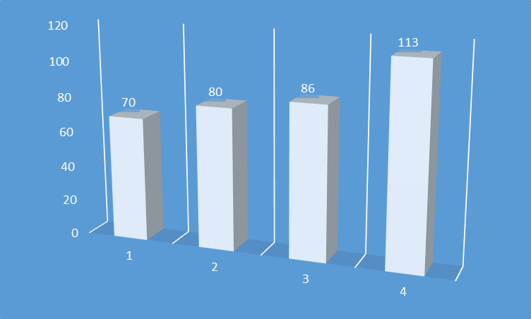
رياضيات
كسرعادي بأبسط صورة | كسرعشري | النسبة المئوية | عام
7 10 | 0.7 | 70% | 2000
4 5 | 0.8 | 80% | 2005
43 50 | 0.86 | 86% | 2010
113 100 | 1.13 | 113% | 2015

Slide 11
https://sitn.hms.harvard.edu/uncategorized/2019/biological-roles-of-water-why-is-water-necessary-for-life/ https://www.unep.org/explore-topics/water/why-does-water-matter#:~:text=Water%20is%20vital%20for%20life,on%20which%20all%20life%20depends. https://www.usaid.gov/jordan/water-resources-environment#:~:text=Jordan%20is%20one%20of%20the,as%20it%20can%20be%20replenished. https://borgenproject.org/water-scarcity-in-jordan/#:~:text=The%20overflow%20of%20wastewater%20pumping,polluting%20Jordan's%20surface%20river%20sources. https://www.unicef.org/jordan/water-stress-jordan-executive-summary#:~:text=Water%20shortages%20could%20have%20a,GDP%20and%2070%25%20of%20employment. https://www.ecomena.org/water-scarcity-jordan/#:~:text=The%20other%20way%20to%20counter,highest%20levels%20in%20the%20world.
Links:

Slide 12
Thank you !

