Slide 1
obesity
By: Shadi, Jad , Raad ,Nassar

Slide 2
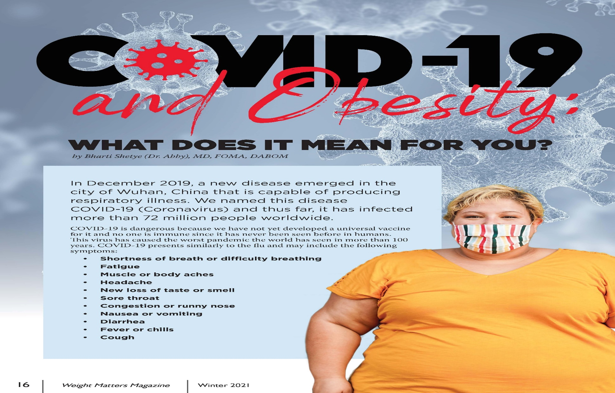
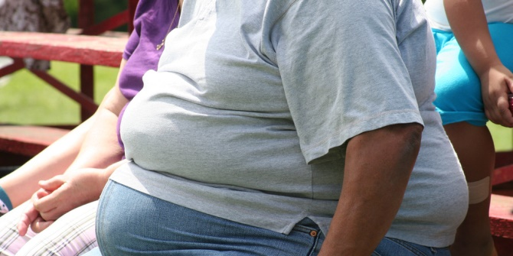
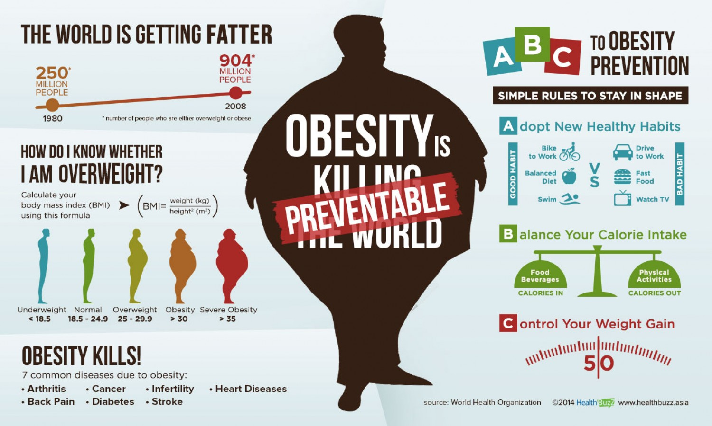
What does obesity mean?
This Photo by Unknown Author is licensed under CC BY

Slide 3
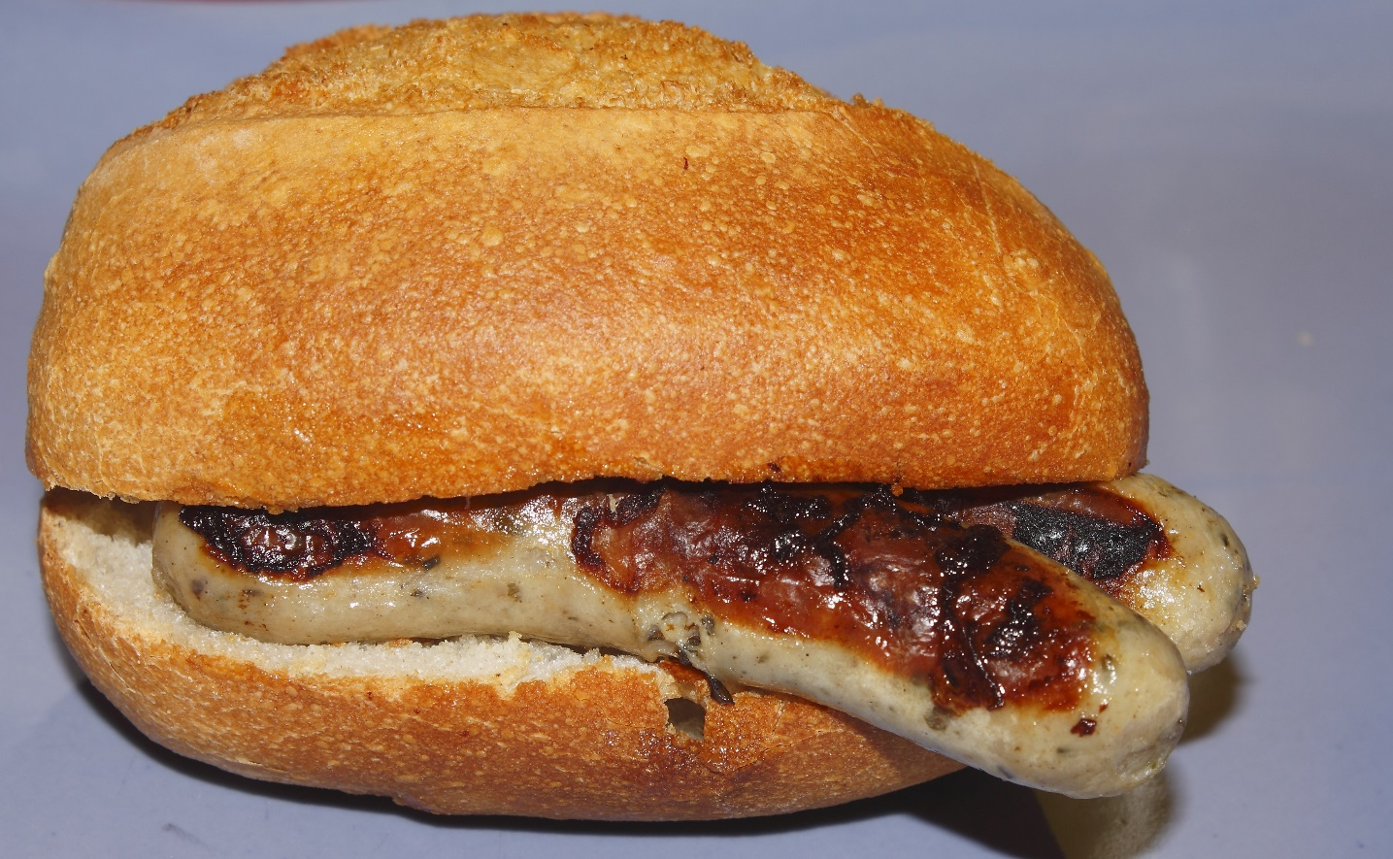
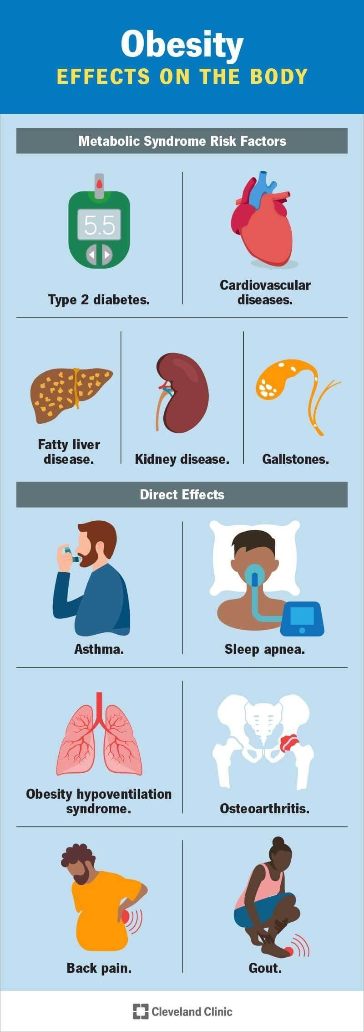
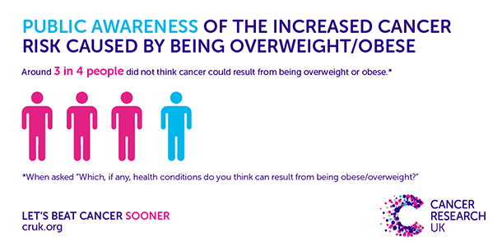
How can obesity affects your body?

Slide 4
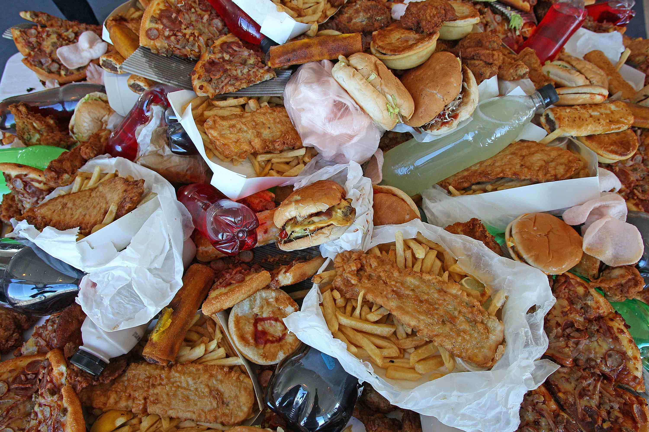
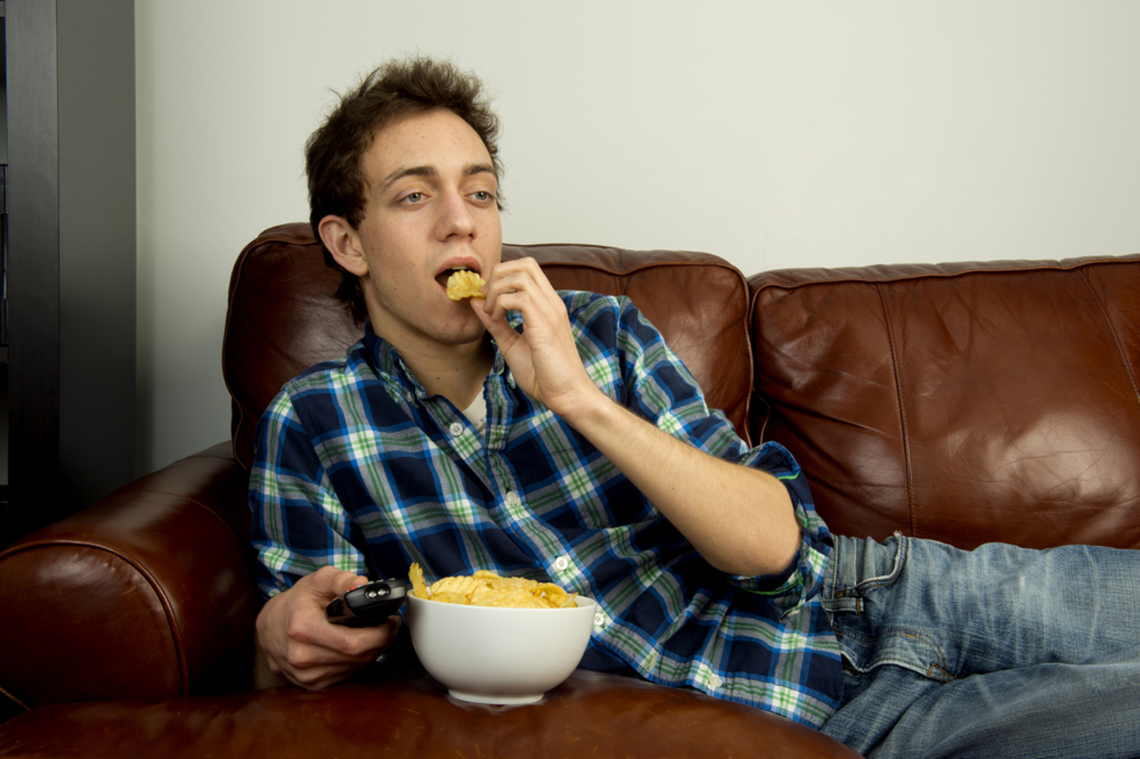
Causes of obesity
This Photo by Unknown Author is licensed under CC BY

Slide 5
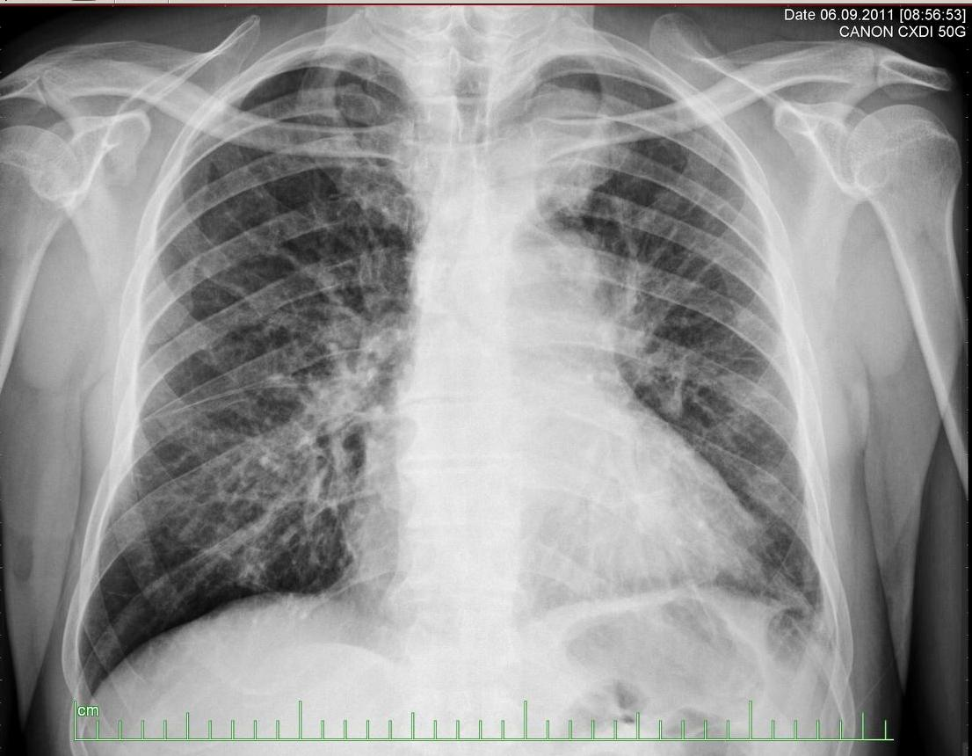

Consequences of obesity

Slide 6
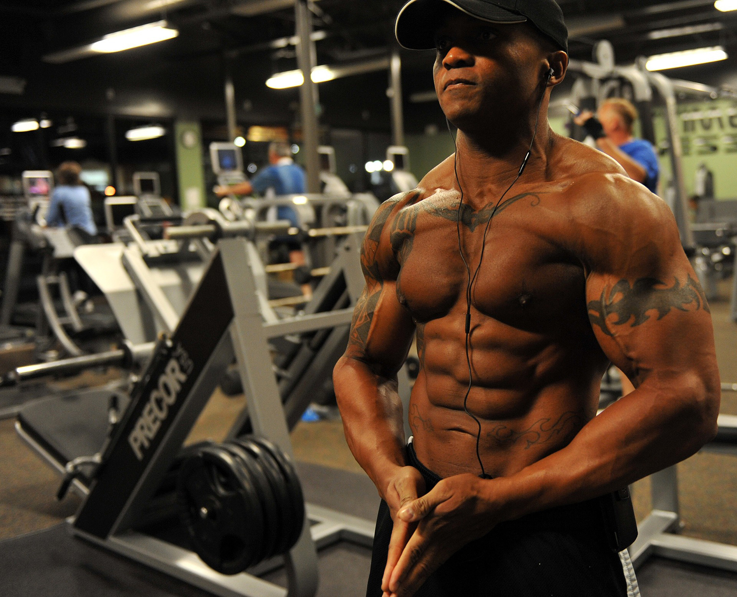

Solutions for obesity

Slide 7

Questions.
1. What is obesity.
2. Describe how obesity can effect your body.
3. What are the causes of obesity.
4. How can you prevent obesity.

