Slide 1
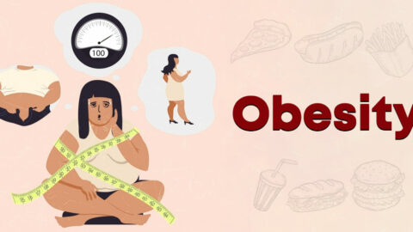
OBESITY
ENGLISH PROJECT
DALIA – MEERA

Slide 2
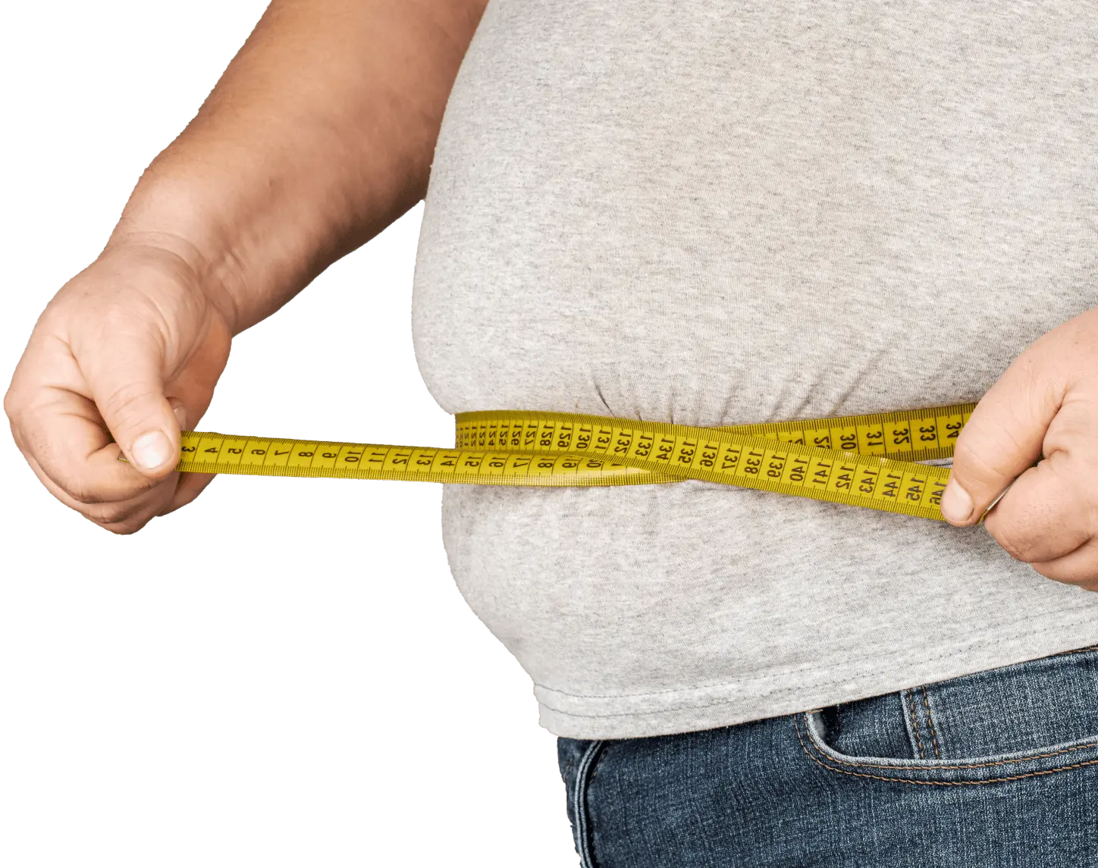
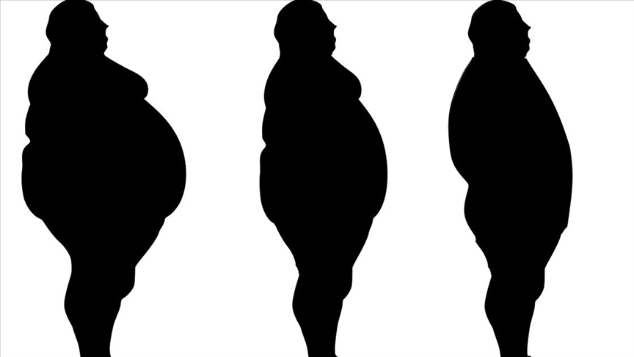
WHAT IS OBESITY?

Slide 3
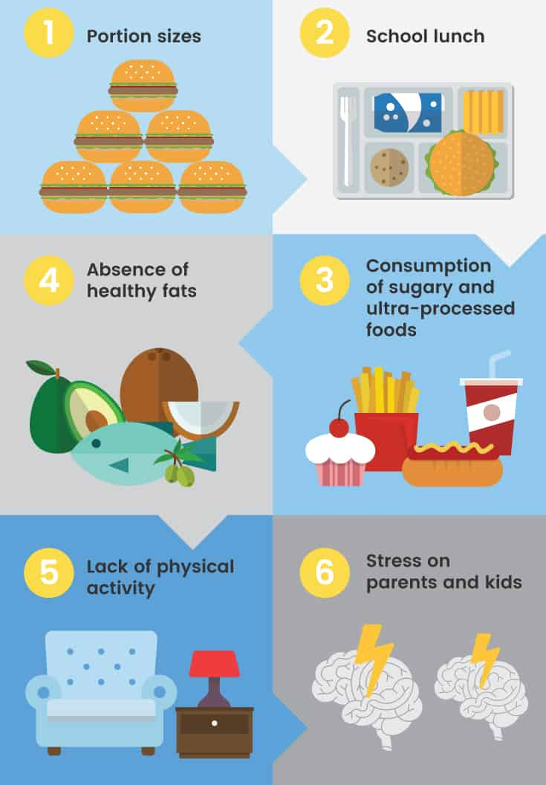
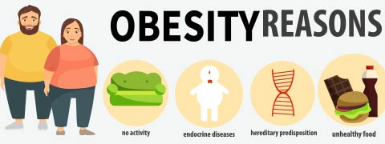
What causes obesity & overweight?

Slide 4
Obesity symptoms

Slide 5
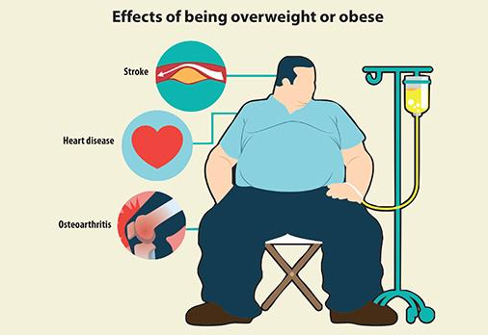
What are the consequences of obesity

Slide 6
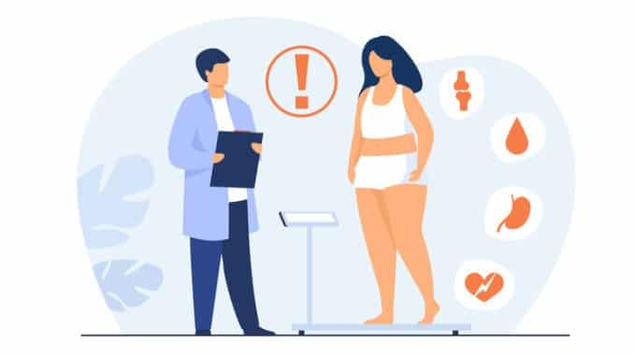
Solutions for obesity

Slide 7
https://www.youtube.com/watch?v=TsZlTe_4LTU
Thank you for listening

