Slide 1

Water crisis in Jordan
By Tia, Sami, Salma and Katia

Slide 2
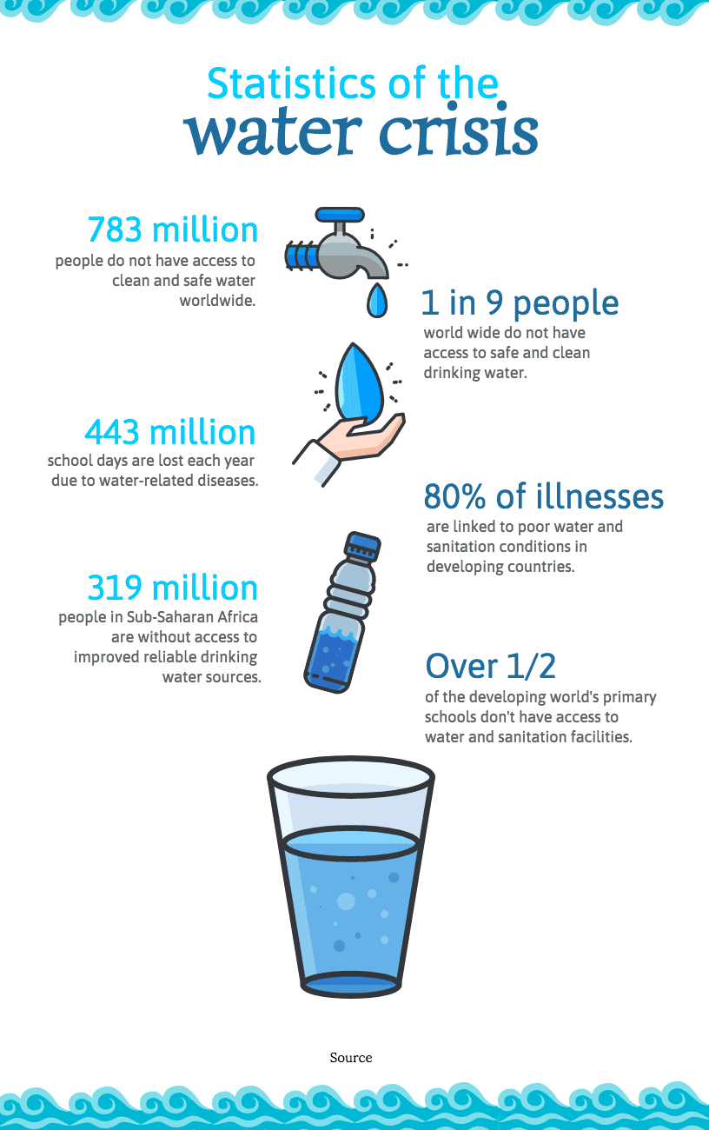
Water crisis nationally and locally in Jordan
Jordan’s water resources are rapidly depleting without significant interventions, the situation is most likely to deteriorate further and get worse, in addition, Jordan is known as one of the most water scarcest countries in the world, moreover, Jordan’s renewable water supply currently meets about two-thirds of the population’s water demands, with groundwater being used twice as fast as it can be replenished.

Slide 3
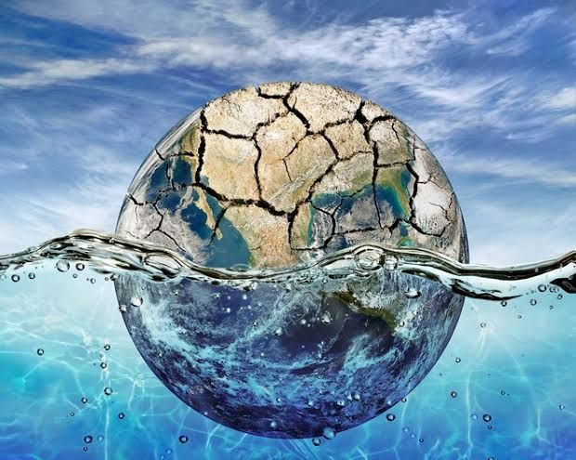
issues of water crisis in Jordan:
Water loss, water loss is mainly because of infiltration, seepage and leakage.
water theft, defined as any taking of water in violation of existing regulations.
causes of water crisis in Jordan:
Increasing stress on water resources in Jordan, occurs when the demand of water exceeds the available amount during a certain period.
water demand rising exponentially, it follows population growth, economic development and changing consumption patterns.

Slide 4
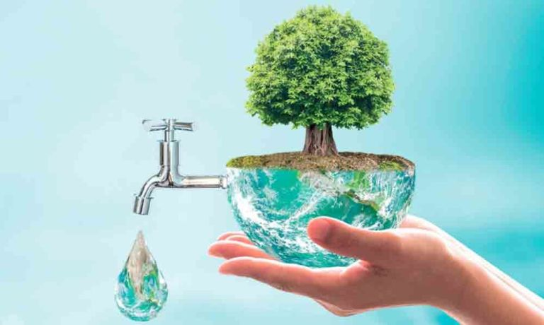
Consequences of water crisis in Jordan:
Increased operational costs, some affects of increasing operational costs are the size of water supply system, the population density of the service area, and lastly, the source of water supplies and water quality.
Increased complexity in supply chains, water is used in the supply chain for extracting materials, growing crops, fabricating , processing, washing, diluting, cooling, transporting and many more.
Solutions for water crisis In Jordan:
Red sea- dead sea water conveyance, it is considered a solution for water crisis in Jordan to provide portable water to Jordan and Palestine territories, bringing water with a high concentration of salts resulting (reject brine) to stabilise the dead sea water level.
Desalination and gaining access to unusually deep aquifers, desalination facilities can further export waste brine is decomposed into simpler substances through electric currents.

Slide 5
Sources:
https://borgenproject.org/water-scarcity-in-jordan/#:~:text=The%20overflow%20of%20wastewater%20pumping,polluting%20Jordan's%20surface%20river%20sources.
https://www.ecomena.org/water-jordan/
https://www.unicef.org/jordan/water-stress-jordan-executive-summary#:~:text=Shortage%20of%20water%20in%20schools,proper%20disposal%20of%20menstruation%20products
https://www.usaid.gov/jordan/water-resources-environment#:~:text=Jordan%20is%20one%20of%20the,as%20it%20can%20be%20replenished
https://news.stanford.edu/2021/03/29/jordans-worsening-water-crisis-warning-world/

Slide 6
Thank you for listening

