Slide 1
English project
By: Fawaz/Faris Saadeh/Yousef/Elias

Slide 2
Overview of water crisis
Water covers 70% of our planet, and it is easy to think that it will always be plentiful. However, freshwater—the stuff we drink, bathe in, irrigate our farm fields with—is incredibly rare. Only 3% of the world’s water is fresh water, and two-thirds of that is tucked away in frozen glaciers or otherwise unavailable for our use.

Slide 3
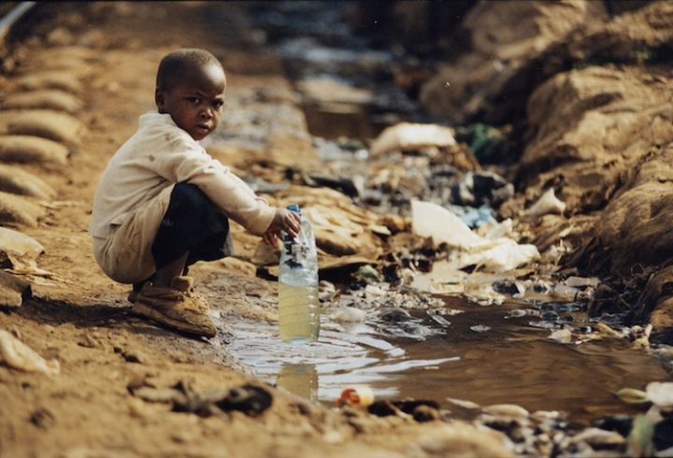
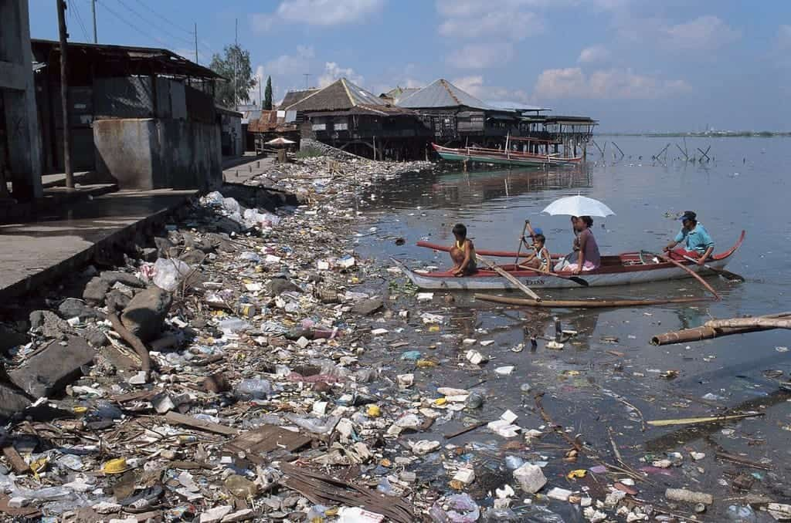
Issues of water crisis
Water pollution
Water shortage

Slide 4
Consequences of water crisis
Water pollution
Water shortage
It causes illnesses
It affects ecosystems
Lack of Access to Clean Water
Increased Global Conflict

Slide 5
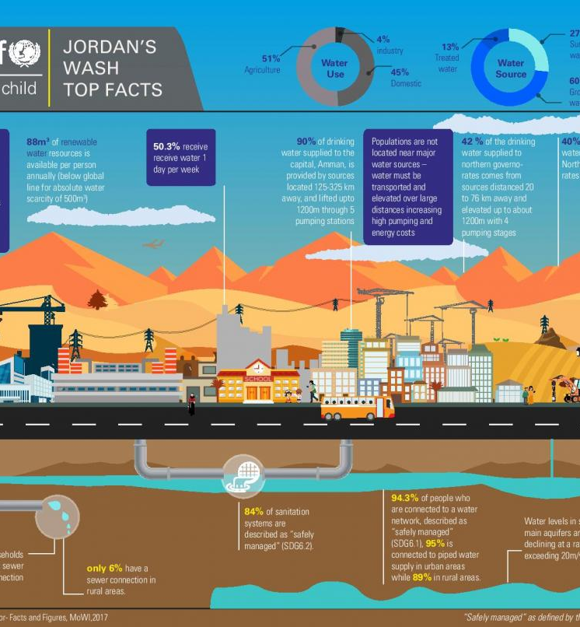
Causes of water crisis
1. CLIMATE CHANGE
2. NATURAL DISASTERS
3. WAR AND CONFLICT
4. WASTEWATER
5. WATER WASTE
6. INEQUALITY AND AN IMBALANCE OF POWER

Slide 6
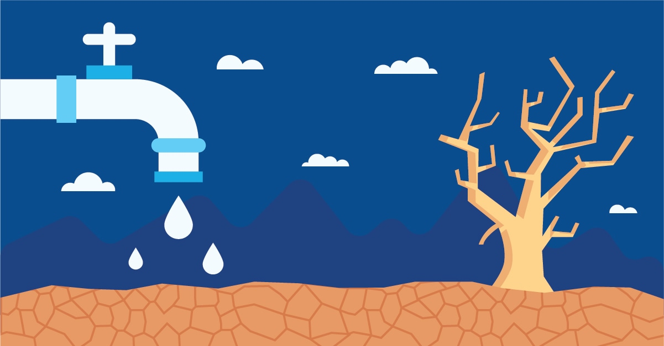
solutions for water crisis
Supporting vulnerable families in host communities with improved water systems and wastewater infrastructure that are sustainable and climate resilient and expanding coverage to unreached areas;
Improving WASH facilities

Slide 7
https://www.citationmachine.net/bibliographies/3a390b37-83ba-482e-b5ea-0954830a5c14
https://www.citationmachine.net/bibliographies/3a390b37-83ba-482e-b5ea-0954830a5c14
https://www.citationmachine.net/bibliographies/1915fcb7-5dad-4e85-8849-42e8bc8ac578
https://www.citationmachine.net/bibliographies/1915fcb7-5dad-4e85-8849-42e8bc8ac578
https://www.citationmachine.net/bibliographies/3a390b37-83ba-482e-b5ea-0954830a5c14

Slide 8
Thank you for listening

