Slide 1

Obesity
By:Lara taani ,Andre Kakish ,Leen ghosheh

Slide 2
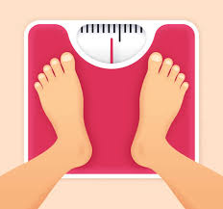
What is obesity?
Obesity is a condition that is associated with having an excess amount of body fat, it is a serious health epidemic that affects more than 93 million people with rates that continue to rise.

Slide 3
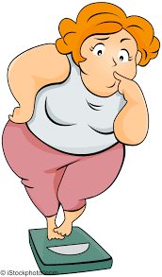
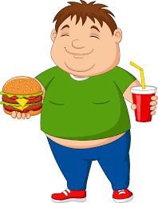
Why obesity occurs ?
Warming up in cold weather and sweating in hot weather are all examples of the metabolic processes our body uses, But when our food calories amount is exceeded, they will be stored in the body as fat.
Our body needs daily activities to burn the calories that we get from food, and its not just the activities that need to burn calories.

Slide 4
Causes of obesity
When our food calories amount is exceeded, they will be stored in the body as fat.
The causes of obesity is a combination of states and risk factors that work together to store fat in our bodies.

Slide 5
Causes of obesity
Diets: some bad eating habits
like skipping a healthy
breakfast, and replace it by junk
fast food, all of that increases the
body fat.
Lack of sleep: this causes disturbances
in the body hormones, and increases the
appetite. You may also crave a lot of high
calorie foods.
Inactivity:
Without activity you don’t burn as much calories, you need to have more exercises to burn the excessive calories.
Family lifestyle: not because of the genes we find that obesity
runs in the families, it is also because of their lifestyle and the food
they eat.
Genetics: genes affects the amount of body fat we store and
where to store.

Slide 6
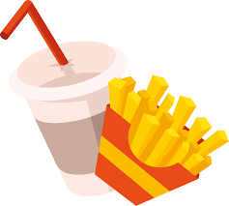
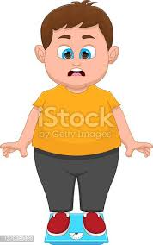
Risks of being Obese
People who have obesity, compared to those with a healthy weight, are at risk for many serious diseases and health conditions.
Obesity and its associated health problems have a significant impact on the health of its victims.

Slide 7
consequences of obesity
High blood pressure and high cholesterol which are risk factors for heart disease.
Gallstones and gallbladder disease
Type 2 diabetes
Breathing problems, such as asthma and sleep apnea.

Slide 8
How to prevent obesity
Limiting unhealthy food
Getting enough sleep hours
Increasing physcal activity
Decrasing stress
Limiting screen time

Slide 9
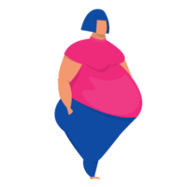
How to overcome obesity?
At its most basic, of course, obesity results when someone regularly takes in more calories than needed. The body stores these excess calories as body fat, and over time the extra pounds add up. eat fewer calories than the body burns, weight goes down.

Slide 10

Recourses
https://www.cdc.gov/obesity/basics/consequences.html
https://www.hsph.harvard.edu/obesity-prevention-source/obesity-prevention/#:~:text=Choosing%20healthier%20foods%20(whole%20grains,%2C%20and%20other%20%E2%80%9Csit%20time%E2%80%9D
https://www.who.int/health-topics/obesity#tab=tab_1

Slide 11
Thank you

