Slide 1
Water crisis in jordan
By:abdullah,bashar,majed,rakan

Slide 2
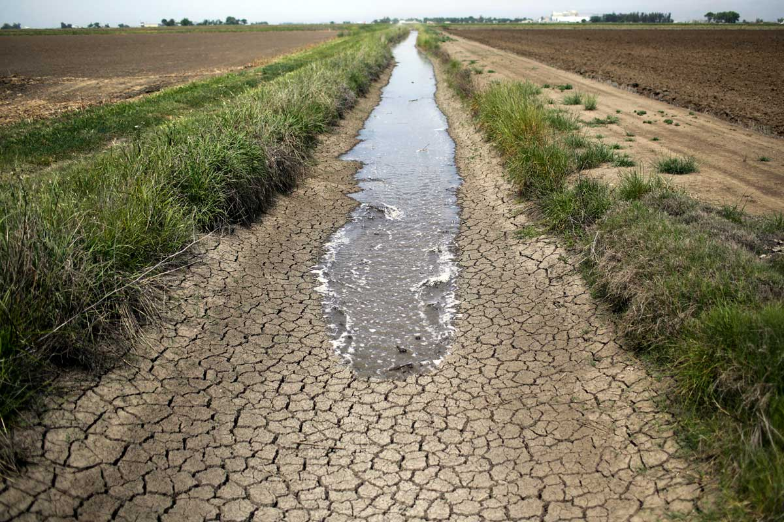
Water crisis in jordan
Jordan is the second most country that has water crisis , the country currently has around two thirds of its population's water needs met by water from renewable sources.
The most probable consequence of climate change is that it will contribute to rising temperatures in Jordan.

Slide 3
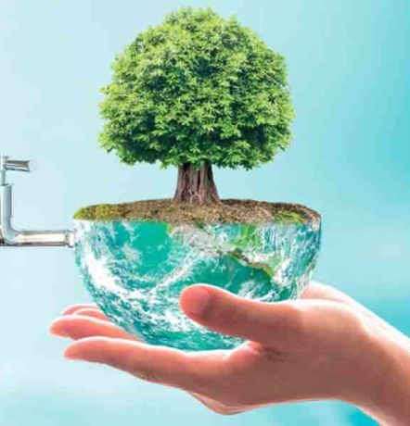
causes
Compared to its neighbors in the Middle East, Jordan has a moderate degree of stability despite regional turmoil. But this stable situation could be jeopardised by the Kingdom's protracted problem of water scarcity, which ranked 2nd in the world. Current system problems such as poverty and public health crises that Jordan is currently facing are exacerbated by water scarcity. In November 2021, the Kingdom's youth employment rate reached an unprecedented 48.1%, yet it remains unable to meet this challenge . Public health demands caused by pandemics. The impact of the lack of water in Jordan over the next ten years could be felt more and more Jordanians, as further environmental changes take place.

Slide 4
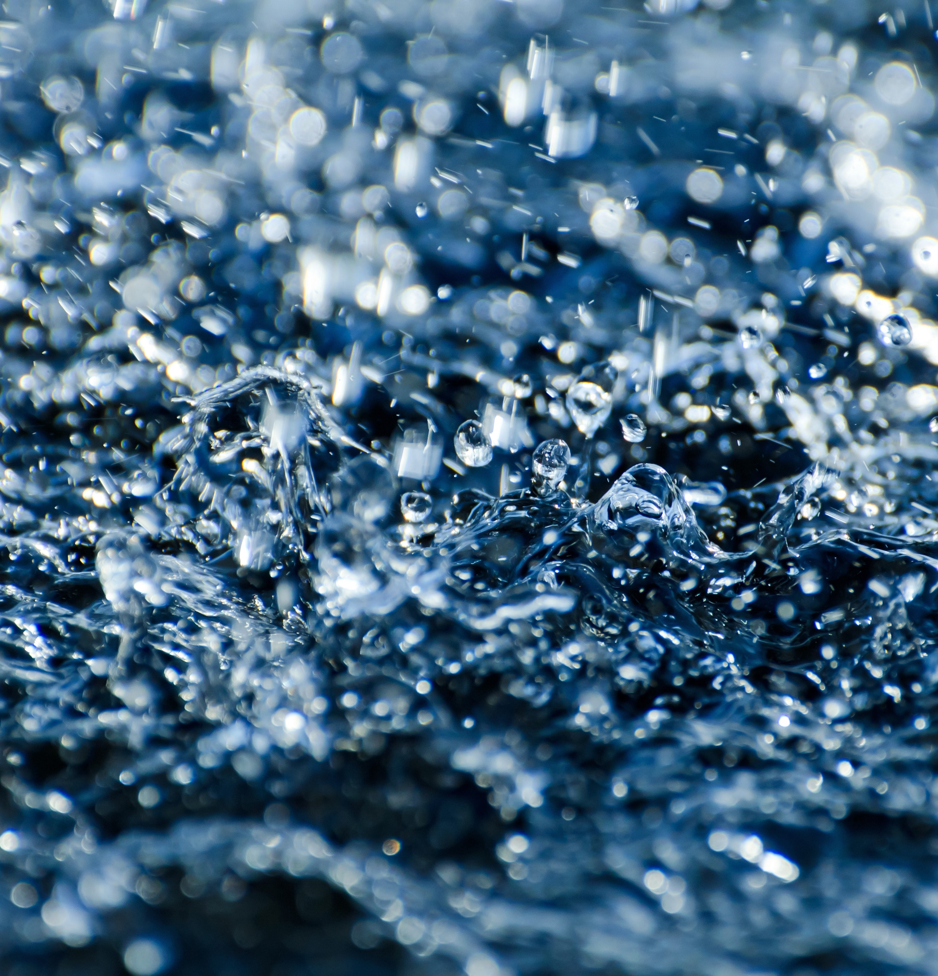
consequences
The new research, which shows that if Jordan does not undertake a complete reform such as the replacement of leaky pipelines and desalinization seawater, it will continue to face prolonged and potentially destabilizing water shortages by 2100. As a consequence of climate change and high population growth, Jordan's water crisis is symptomatic of the problems that are likely to arise across the world.

Slide 5
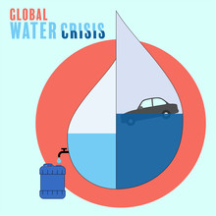
solutions
In Jordan we have several options to increase the water supply from alternative sources, namely seawater desalination and recycling of wastewater. Desalination can help alleviate the water scarcity in areas where there is an urgent need for drinking water, and also could be helpful to resolve a conflict between urban and agricultural water needs by providing new independent sources of water.

Slide 6
Conclusion of water crisis
Water supply and sanitation in Jordan is characterized by severe water scarcity, which has been exacerbated by forced immigration as a result of the 1948 Arab–Israeli War, the Six-Day War in 1967, the Gulf War of 1990, the Iraq War of 2003 and the Syrian Civil War since 2011. Jordan's a country with one of the worst water shortages in the world. Adequate population growth, in order to address the funding shortage which is aggravated by climate change and population growth.

Slide 7
Citation machine
Saiesha. (2022, April 14). 7 facts about water scarcity in Jordan. The Borgen Project. https://borgenproject.org/water-scarcity-in-jordan/
University, S. (2021, March 29). Jordan’s worsening water crisis a warning for the world. Stanford News. https://news.stanford.edu/2021/03/29/jordans-worsening-water-crisis-warning-world/
Water Resources & Environment: Basic page: Jordan. U.S. Agency for International Development. (2022, August 16). https://www.usaid.gov/jordan/water-resources-environment
| N. A. A. (2023, February 6). Ways to counter water scarcity in Jordan. EcoMENA. https://www.ecomena.org/water-scarcity-jordan/

