Slide 1
OBESITY
Made by:Joelle Samaan,michel alqsous,faiz aluzaizi

Slide 2
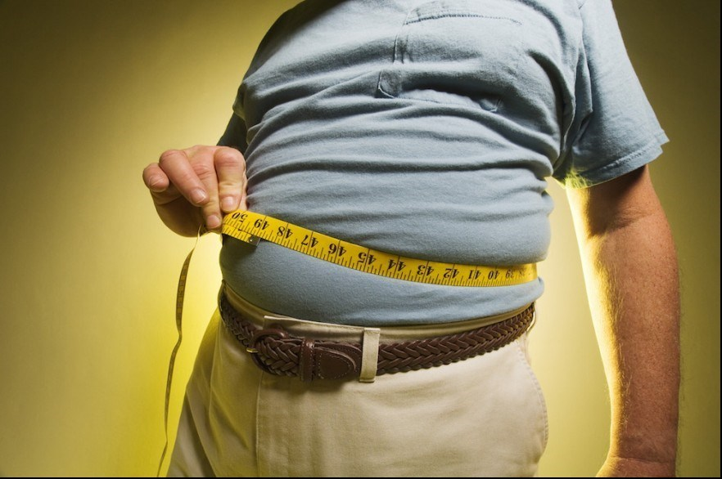
WHAT'S OBESITY?
Obesity is known as excessive fat accumulation that might present danger to your health, when your body mass index(BMI) is over 25 its known as being overweight, if your BMI is over 30 its known as being obese.

Slide 3
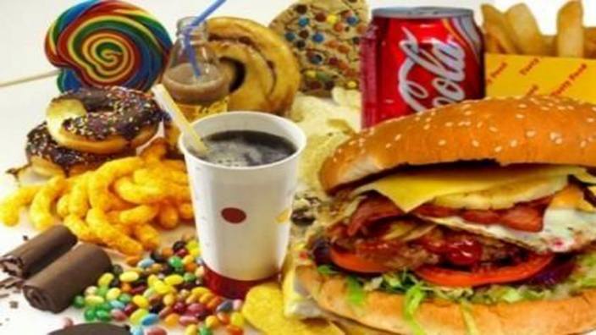
WHAT ARE THE CAUSES OF OBESITY?
Many factors can cause obesity , it can be because of :
Diet: it can increase appetite in hormones which cause you to gain weight.
Lack of exercise: eating too much and lack of exercising and movement can cause you to gain weight.
Enviroment: The world around us influences our ability to maintain a healthy weight.
Genetics : some people are born overweight as a gene from the bloodline.

Slide 4
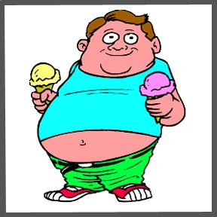
WHAT ARE THE EFFECTS OF OBESITY?
There are many effects for obesity some of them are:
High blood pressure: which decreases the flow of blood and oxygen to your heart and leads to heart disease.
Stroke
Type 2 diabetes: Heart and blood vessel disease.
Mental illness: being obese might cause anxiety and depression caused by not being happy with the way you look and appear to yourself and other people

Slide 5
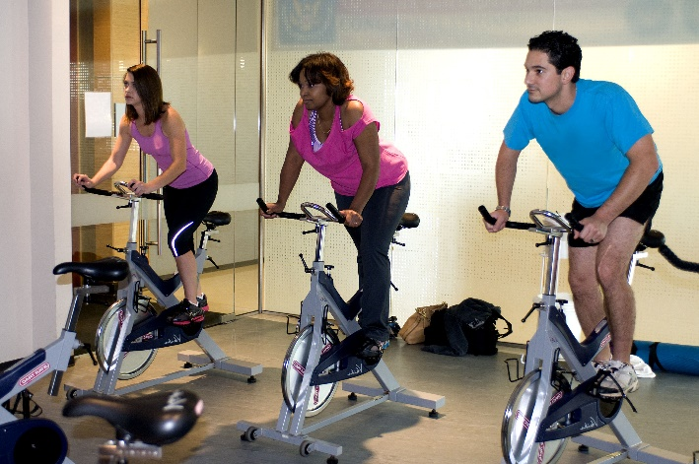
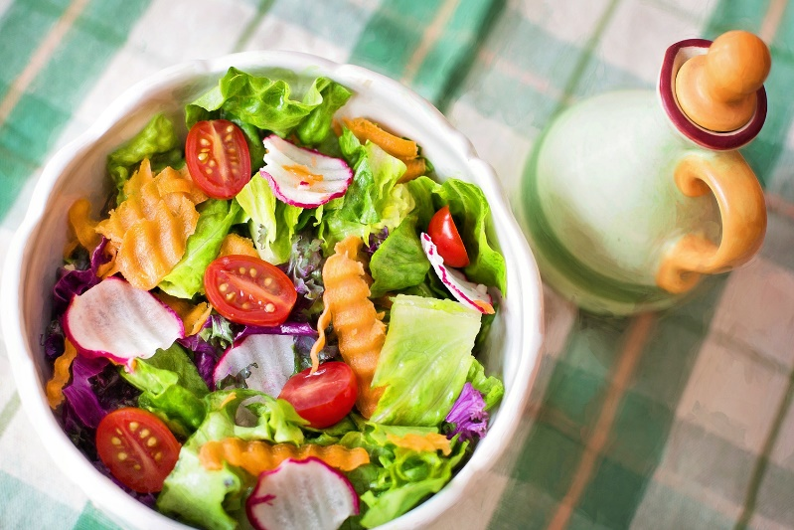
WAYS TO TRY AND PREVENT OR GET RID OF OBESITY:
Choose a healthier diet: start by eating and choosing healthier food options.
Exercising: moving and exercising more can help with loosing calories.
Improving sleep.
Reducing stress: when having stress or anxiety can cause to eating a lot and that may cause obesity.

Slide 6
citations
https://www.who.int/news-room/fact-sheets/detail/obesity-and-overweight
https://www.cdc.gov/healthyweight/effects/index.html
https://www.hsph.harvard.edu/obesity-prevention-source/obesity-prevention/#:~:text=Choosing%20healthier%20foods%20

Slide 7
THANK YOU FOR LISTENING!

