Slide 1
obesity
Natalie Bouri
Tala Alfarah
Mariana Hourani

Slide 2
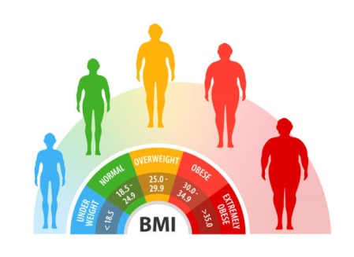

Slide 4
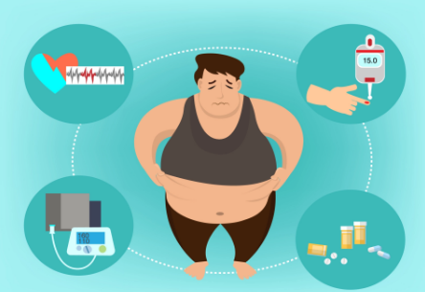
https://www.youtube.com/watch?v=D--AtATgfyM

Slide 6
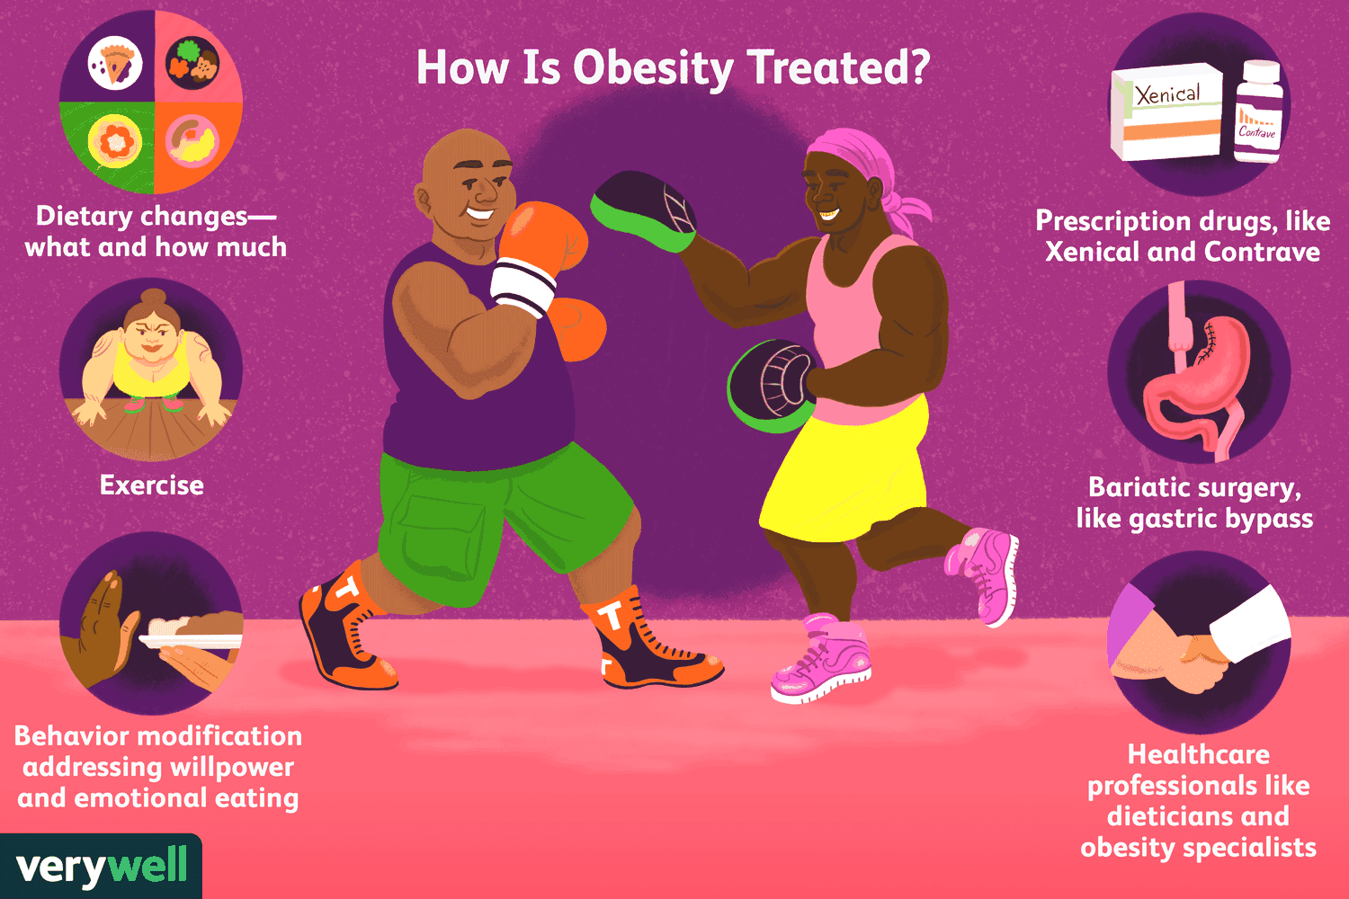

Slide 7
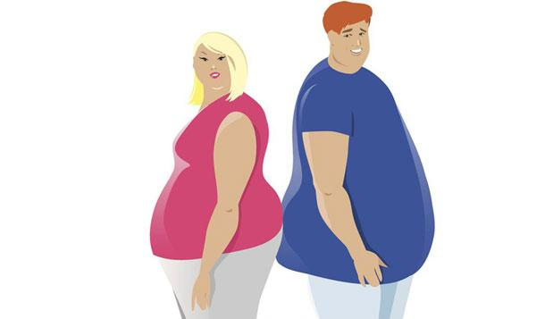

Slide 9
any questions?

Slide 10
THANK YOU!

