Slide 1
Chemistry Project
Created By: Malath Nawaf, Elizabeth Stephan, Jorie Azzam, Taleen Dajani

Slide 2
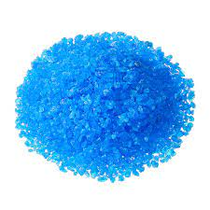
Copper Sulfate
Atomic Structure:CuSO4
Properties: Anhydrous CuSO₄ has a grey-white, powdery appearance whereas the pentahydrate has a bright blue colour
Melting Point:200C
Boiling Point:150C
Daily Uses: Additive for fertilizers and foods, an animal supplement, and for several industrial applications such as textiles, leather, wood, etc.

Slide 3
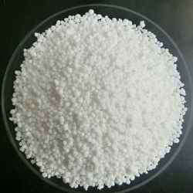
Ammonium Nitrate
Atomic Structure: NH4NO3
Properties: colourless crystalline substance
Melting Point:169.6C
Boiling Point:210C
Daily Uses: Fertilizers, and in the manufacture of nitrous oxide

Slide 4
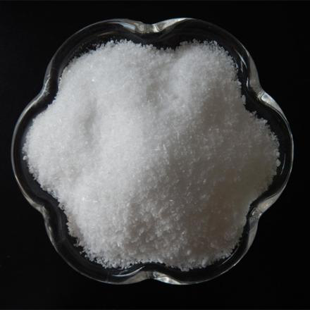
Ammonium Chloride
Atomic Structure: NH4CI
Properties: a white crystalline solid that has no smell
Melting Point:338C
Boiling Point:520C
Daily Uses: as a nitrogen supply in fertilizers and as an electrolyte in dry cells.

Slide 5
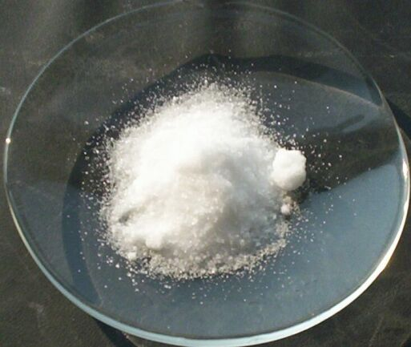
Potassium Nitrate
Atomic Structure: KNO3
Properties: molar mass of 101.10 grams per mole
Melting Point:334C
Boiling Point: 400C
Daily Uses: Fertilizers, pesticides, glass, fireworks, explosives, and rocket fuels.

