Slide 1
obesity
By: Asim/Yazan/Sanad/Ghazi

Slide 2
obesity
What is obesity?
What are the consequences of obesity?
What are the causes of obesity?

Slide 3
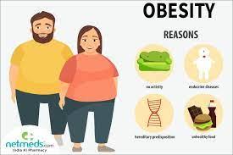
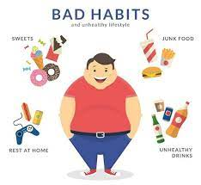

Slide 4
Game
Kahoot: https://create.kahoot.it/details/e2201629-2a5d-4940-9738-d1bd6c41b03d

