Slide 1
Chemistry
By: Ammar Abubaker , Kareem Abusalik , Sami Gammoh

Slide 2
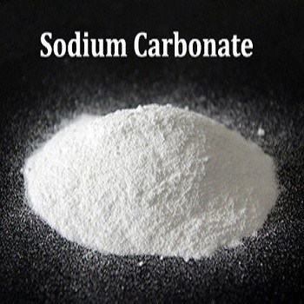
Sodium carbonate (Na2CO3)
Sodium Carbonate has an endothermic reaction when dissolved in water and when it dissolves in water it forms carbonic acid and sodium hydroxide. it has an atomic structure of Two Sodium atoms, three oxygen atoms, and one carbon atom and has a density of 2.54g/cm³
^{Boiling Point:1600}
^{Melting Point:815}
^{Change in temp: -2.5}
Uses in Our daily life: sodium carbonate is really helpful as it is used in toothpaste moisturizer and bath salts

Slide 3
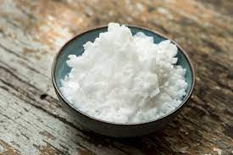
Potassium Hydroxide (KOH)
Potassium Hydroxide has an exothermic reaction when dissolved in water. It has a boiling point of 1,327 °C and melting point of 360 °C. When Potassium hydroxide dissolves in water Hydrogen Gas is produced and it has a molar mass of 56.11 g/mol And its atomic structure is 1 potassium atom one oxygen atom and one hydrogen atom
Change in tempreture:11.7
Uses in our daily life: Actually potassium hydroxide is used in arguably the most important invention right now which is soap and it is used in paint so probably your room has potassium hydroxide in it as we speak

Slide 4
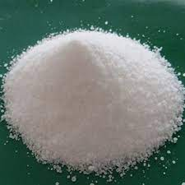
Ammonium Chloride (NH4Cl)
Ammonium Chloride is a white solid with no smell and it has an endothermic reaction when dissolved in water. it has a density of approximately 1.5274 g mL⁻¹ ,it has a boiling point of 520 ℃, and melting point of 338 ℃. and it has a molar mass of 53.490 g mol-1 and its atomic mass is one nitrogen atom, 4 hydrogen atoms and one chlorine atom.
Uses of ammonium chloride in our daily life: ammonium chloride is used In fire works and it is also used in fertilizers to make our plants strong and healthy

Slide 5
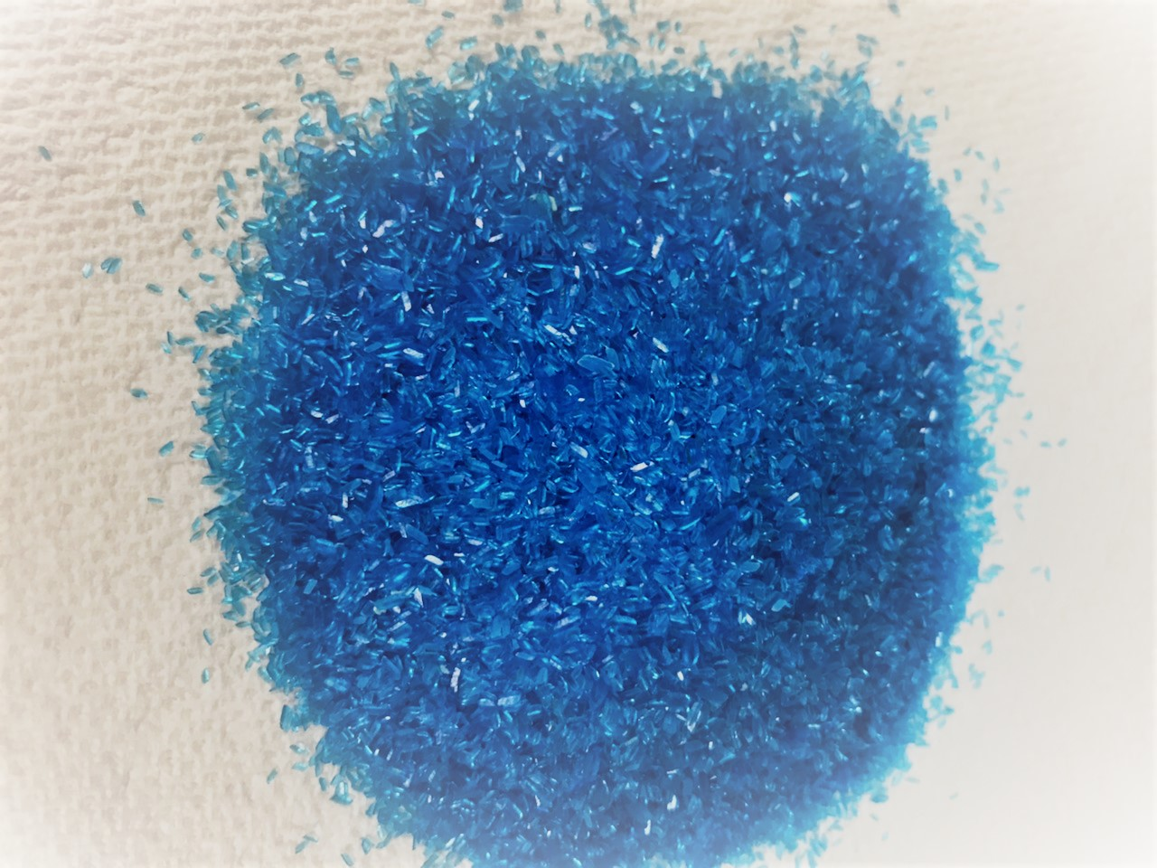
Copper sulfate ( CuSO4)
Copper sulfate is an inorganic salt that is highly soluble in water that has an exothermic reaction when dissolved in water. Its atomic mass is One copper atom one sulfur atom and 4 oxygen atoms it has a molar mass of 159.609 g/Mo it has a boiling point of 150 °C and a melting point of 110 °C
Uses in our daily life: Copper sulfate is used in drying agent batteries and ink so we can solve our exams

Slide 6
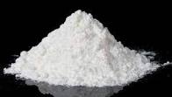
Sodium Sulfate (Na2SO4)
Sodium sulfate is an odorless White crystalline solid. It has an atomic structure of two sodium atoms one sulfur atom and 4 oxygen atoms with a molar wight of 142.04 g/mol it has a melting point of 884° C and a melting point of a whopping 1,429° C
Change in temp:32.28
Uses in our daily life: it is used as a filer in laundry detergents to keep our clothes clean

