Slide 1
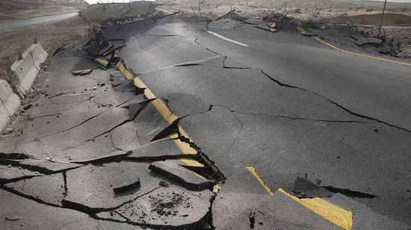
Earthquakes
By: Yazan Halaseh, Rayan Makhamreh, Bishara Petro, Aoun Qsous

Slide 2
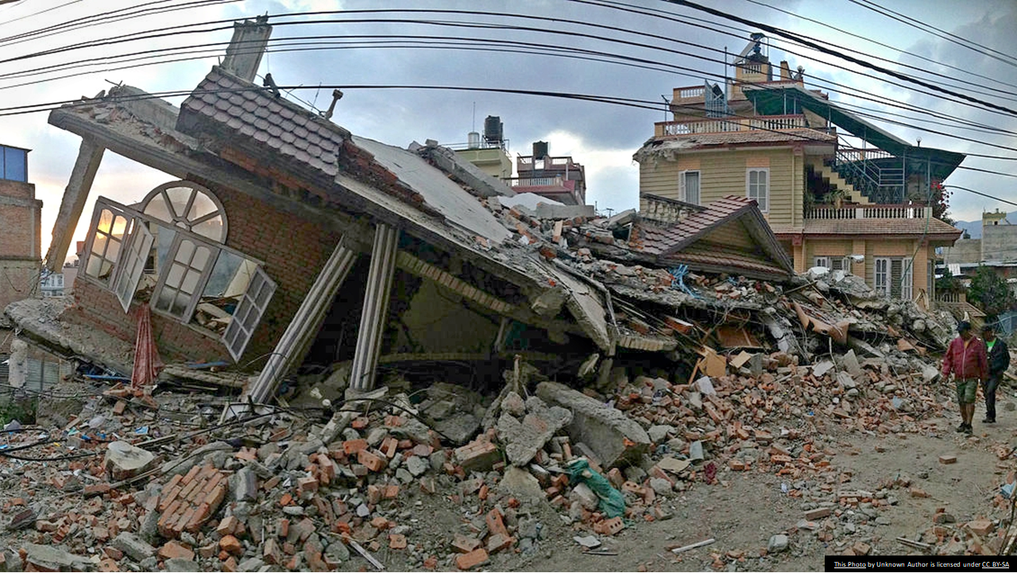
Content
Introduction of Earthquakes & Issues Related to Earthquakes.
The Causes & Effects of Earthquakes.
Methods Used to Detect, Measure & Predict Earthquakes.
The Impacts of Earthquakes on the Natural Environment & Ecosystem.
The Factors that Affect the Intensity & Frequency of Earthquakes.
Course of Actions.
Conclusion.
Resources.

Slide 3
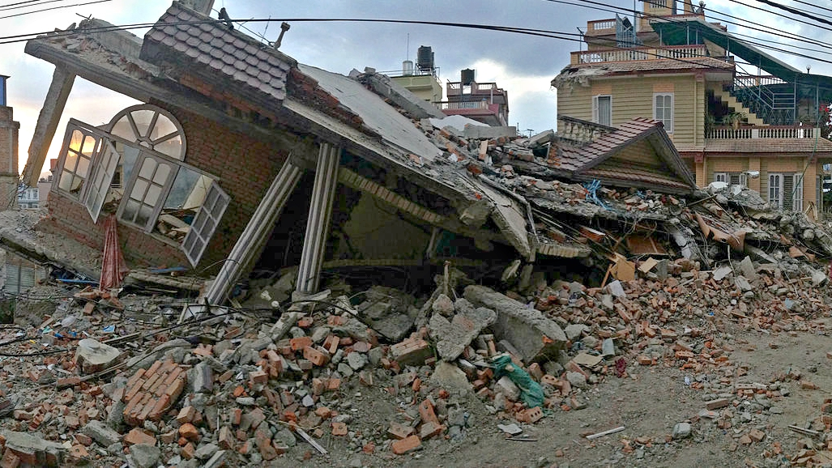
What Is An Earthquake & Issues
Watch: Newsroom in Japan Experiences 7.3-Magnitude Earthquake - YouTube
Notes:
An earthquake is an intense shaking of Earth’s surface. The shaking is caused by movements in Earth’s outermost layer.
The issues of earthquakes are Ground Shaking, Surface Faulting, Ground Failure, Flow Failures, Land Slides and Tsunamis.

Slide 4
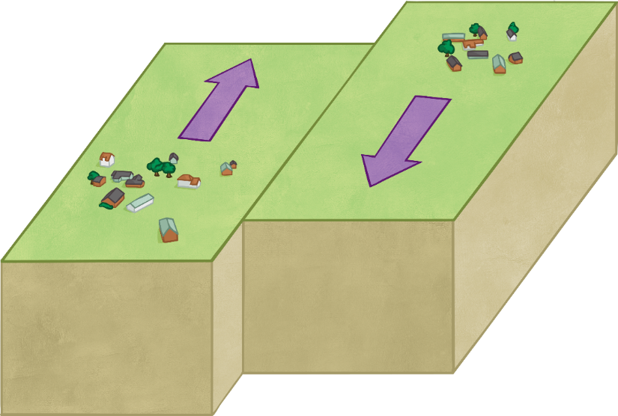
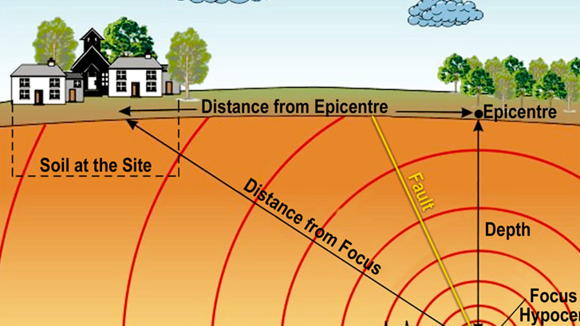
Plate movement
Pressure builds up between plates
Causes & Affects of Earthquakes
Notes:
An earthquake is caused by a sudden slip on a fault. The tectonic plates are always slowly moving, but they get stuck at their edges due to friction. When the stress on the edge overcomes the friction, there is an earthquake that releases energy in waves that travel through the earth's crust and cause the shaking that we feel.

Slide 5
Methods Used to Detect, Measure & Predict Earthquakes
Notes:
Earthquakes can be detected by using Seismometers, it respond to ground noises and shaking and convert vibrations waves into electrical signals, which we can then display as seismograms on a computer screen. Seismologists study earthquakes and can use this data to determine where and how big a particular earthquake is.

Slide 6
The Impacts of Earthquakes on the Natural Environment & Ecosystem
Notes:
Some studies showed that earthquakes severely damaged the structure and function of grassland ecosystems, which causes biomass decrease, diversity decline, and soil erosion.

Slide 7
The Factors that Affect the Intensity & Frequency of Earthquakes
https://www.aljazeera.com/news/2023/2/8/infographic-how-big-were-the-earthquakes-in-turkey-Syria
Notes:
The factors that affect the intensity, and frequency of earthquakes are:
Magnitude for instance typically you will feel more intense shaking from a big earthquake than from a small one.
Ddistance, for Demonstration Earthquake waves diminish in intensity as they travel through the ground, so earthquake shaking is less intense farther from the fault.

Slide 8
Course of Actions
Notes:
Stay away from outer walls, windows, fireplaces, and hanging objects.
If you are unable to move from a bed or chair, protect yourself from falling objects by covering up with blankets and pillows.
If you are outside, go to an open area away from trees, telephone poles, and buildings, and stay there.

Slide 9
Conclusion
Notes:
Earthquakes are caused by sudden movements on a fault between tectonic plates, creating intense shaking on the Earth's surface. To stay safe, build safer structures, educate on earthquake safety, and avoid outer walls, windows, and hanging objects.

Slide 10
Resources
Notes:
https://www.usgs.gov/
2. https://www.who.int/
3. https://www.open.ac.uk/
4. https://www.frontiersin.org/
5. https://www.nasa.gov/

