Slide 1
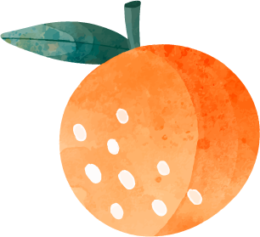
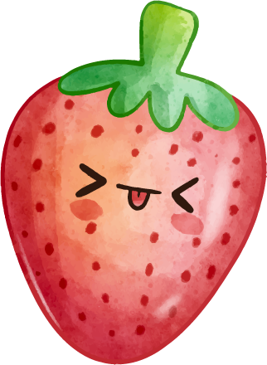
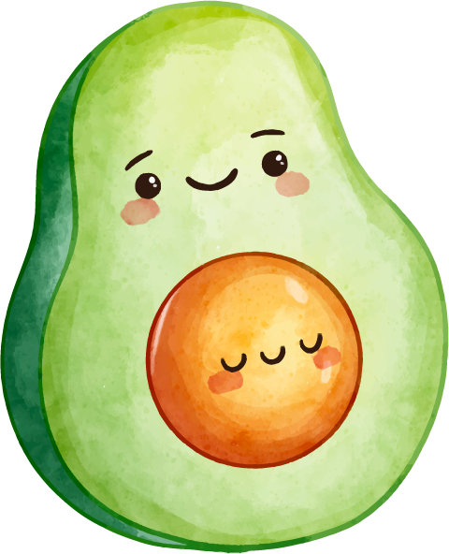
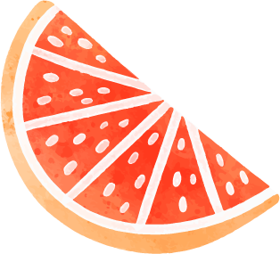


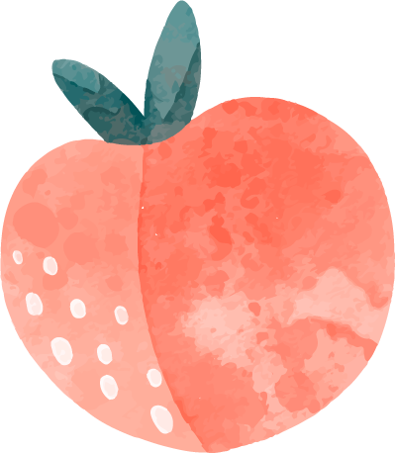
Health-mania
By: Tala, Carol, Sarah z and Christina

Slide 2
Health is wealth!
This PowerPoint is to raise awareness and address the problem of obesity and how to avoid it.

Slide 3
TABLE OF CONTENTS
01
02
03
04
05
06
introduction
Causes of obesity
Possible symptoms
What is obesity?
How can you tell you are obese?
How bad does it affect you?
Lets stop it!
Fun facts
The consequences.
Our solutions.

Slide 4
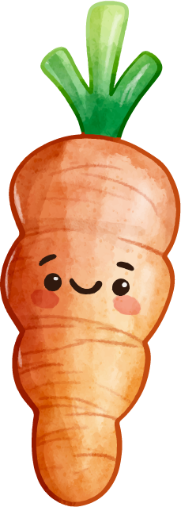
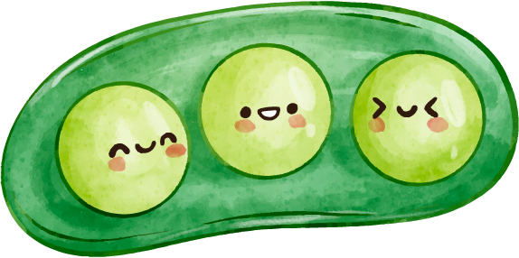
01
introduction
Obesity is a difficult disease to have to deal with, that includes an excessive amount of body fat. Not only is it a cosmetic concern, it is a medical concern that increases risks of deadly and terrifying diseases

Slide 5

1,000,000,000
More than
People are obese in the world
650 million adults, 340 million adolescents and 39 million children, according to WHO(World health organization)

Slide 6
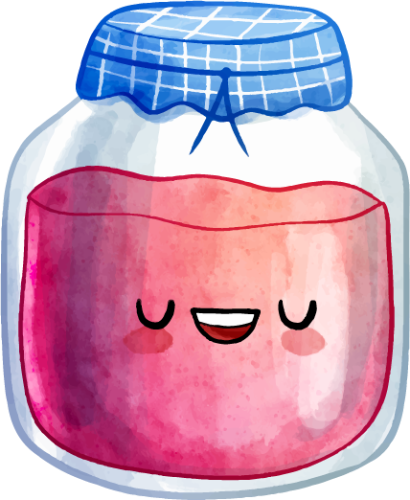

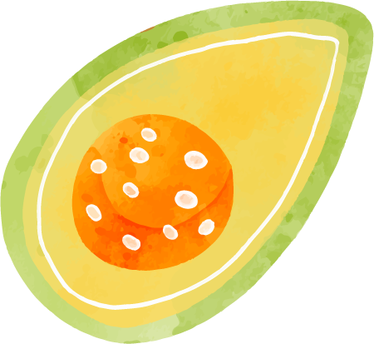
The causes of obesity
02
How can you get obese? From what is it initiated?
Genetics
Medications
Stress, emotional factors and poor sleep
Lack of physical activity
Eating disorders
Smoking
And the most common, overeating.

Slide 7
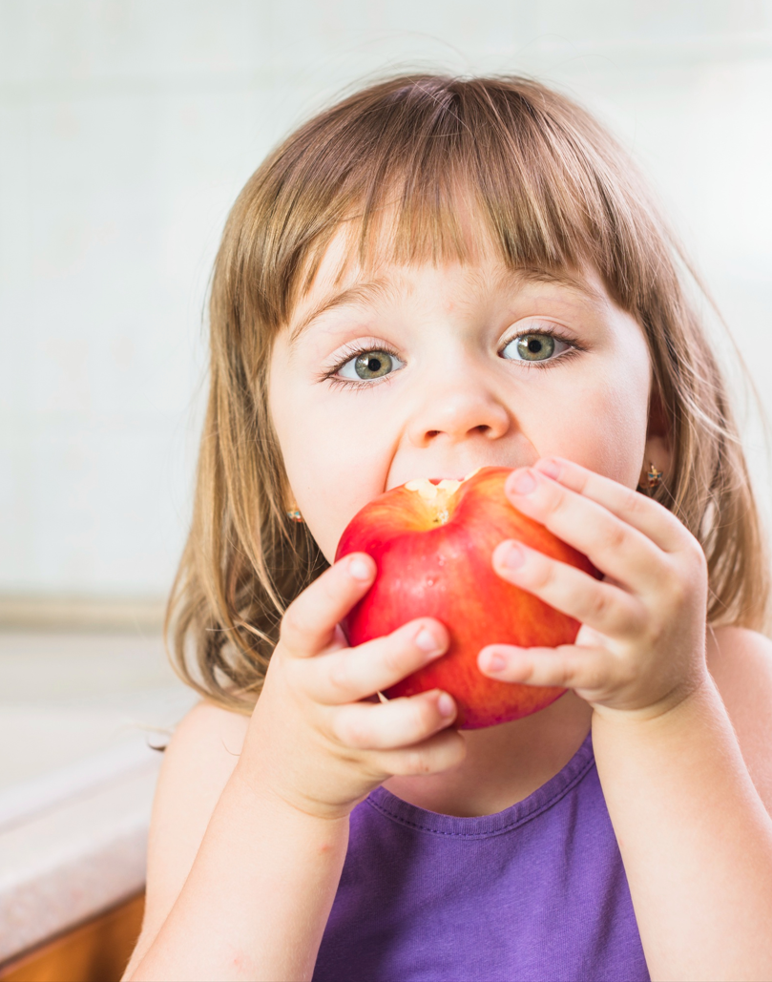
POSSIBLE SYMTOMS
03
How can you tell that you are obese?
Excess body fat, particularly around the waist.
Shortness of breath
Sweating more than usual.
Snoring.
Trouble sleeping.
Skin problems from moisture accumulating in the folds.

Slide 8
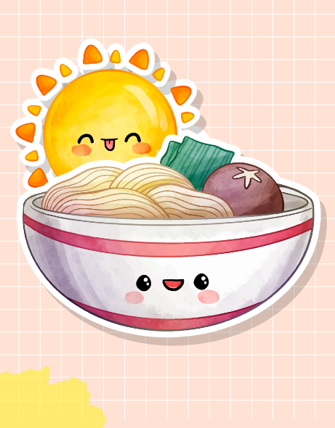
How bad does it affect you?
The consequences.
Cardiovascular diseases,
musculoskeletal disorders
Cancer of many sorts.
High blood pressure (hypertension).
High LDL cholesterol, low HDL cholesterol, or high levels of triglycerides (dyslipidemia).
Type 2 diabetes.
Stroke.
Gallbladder disease.

Slide 9


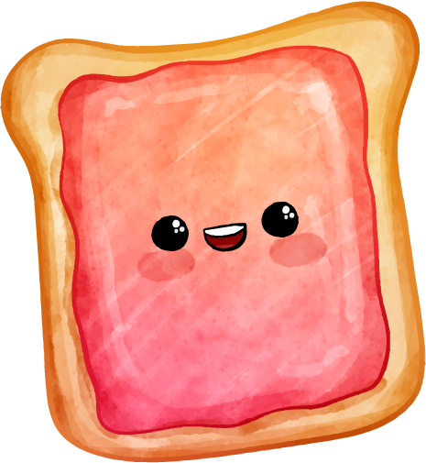
Lets stop it!
Our solutions.
Healthy eating plan
Regular physical activity
Changing your habits
Weight-manage programs
Reduced sedentary activity
Your last resort would be bariatric surgery

Slide 10
Improve your diet!

Slide 11
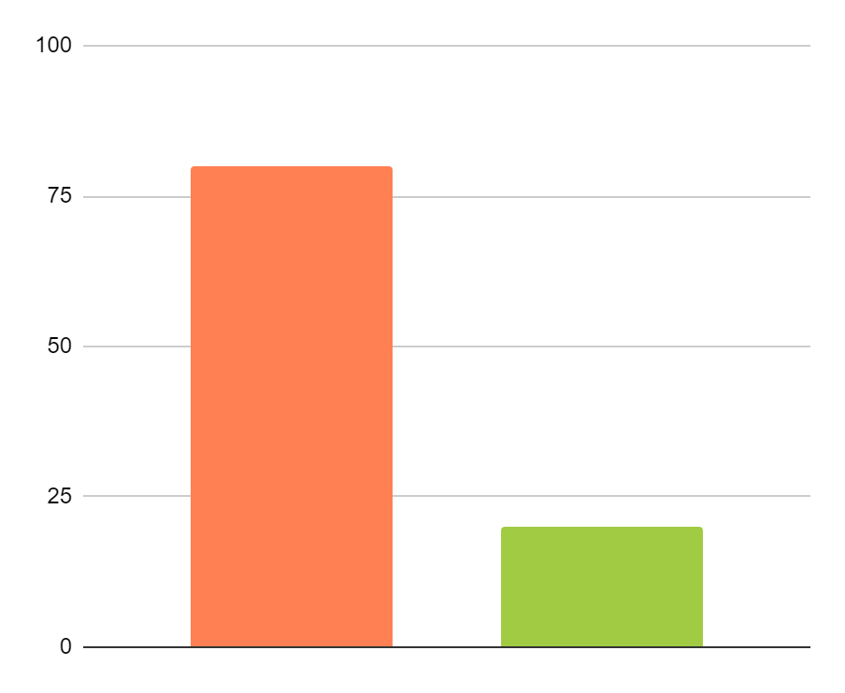
HEALTHY OR “SOMETIMES” FOOD
We have added a chart to help show how much healthy food is needed to avoid being obese.
80%
HEALTHY FOOD
Mostly, you should consume 80% of healthy food in your diet.
20%
“SOMETIMES” FOOD
You should only consume 20% of un-healthy food in your diet.

Slide 12
WHAT SHOULD I EAT DAILY?
20%
30%
50%
FATS
PROTEINS
VEGETABLES

Slide 13
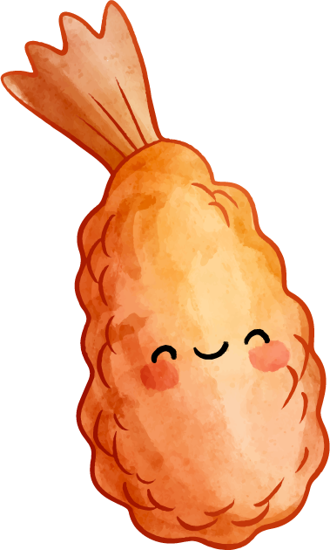
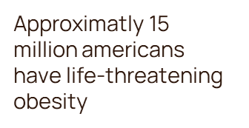
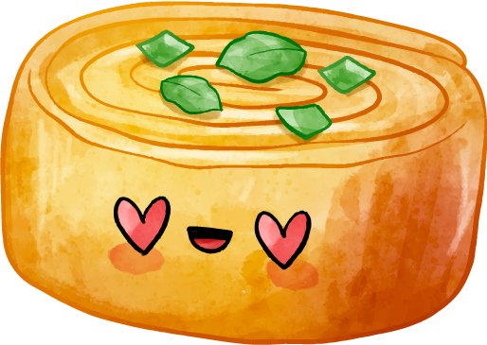
Fun facts!
Fact number 1
Fact number 2
America is the heaviest nation in the world
Fact number 3
Life-threatening obesity is defined as 100 pounds above ideal body weight or a BMI (body mass index) greater than 40.
Fact number 4
25% of U.S children are overweight.

Slide 14
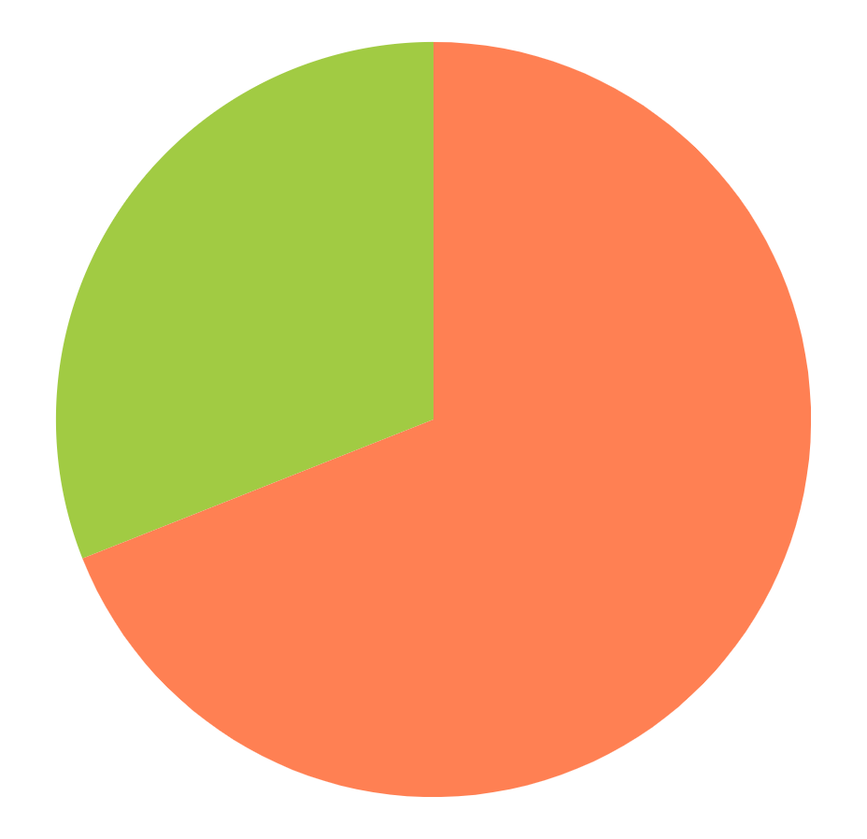
How many people are obese?
69%
Obese
This is the percentage of obese people.
31%
NON-OBESE
This is the percetage of non-obese people.
The information on this graph is from the website https://htsp.Harvard.edu

Slide 15
HEALTHY EATING QUIZ
Is this food healthy or not?
apples
fish
Burger
YES
YES
NO
YES
YES
NO
YES
NO
no
chocolate
eggs
milk
YES
no
YES
NO
YES
NO
YES
YES
NO

Slide 16
Resources:
https://hsph.Harvard.edu
https://www.mayoclinic.org
https://www.dignity.health.org
https://www.who.int

Slide 17

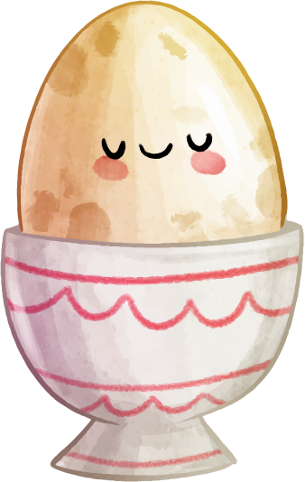
THANKS!
DO YOU HAVE ANY QUESTIONS?
Healthmania.gmail.com
+91 620 421 838
Healthmania.com
Thank you for listening!!

