Slide 1
Reactions
Endothermic & exothermic
Dissolving in water
Done By: Naser Sunna , Majed Abo Barham , Laith Khoury , Nadeem Wakileh

Slide 2
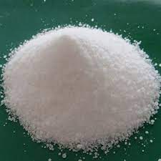
Ammonium chloride
Formula :NH4CL
Ammonium chloride is a white solid that has no smell.
the melting and boiling points are 338 ºC and 520 ºC
It is endothermic (initial temperature22.3 ∘ C and final temperature 20.6 ∘ C )
Ammonium chloride is used as a nitrogen supply in fertilizers and as an electrolyte in dry cells

Slide 3
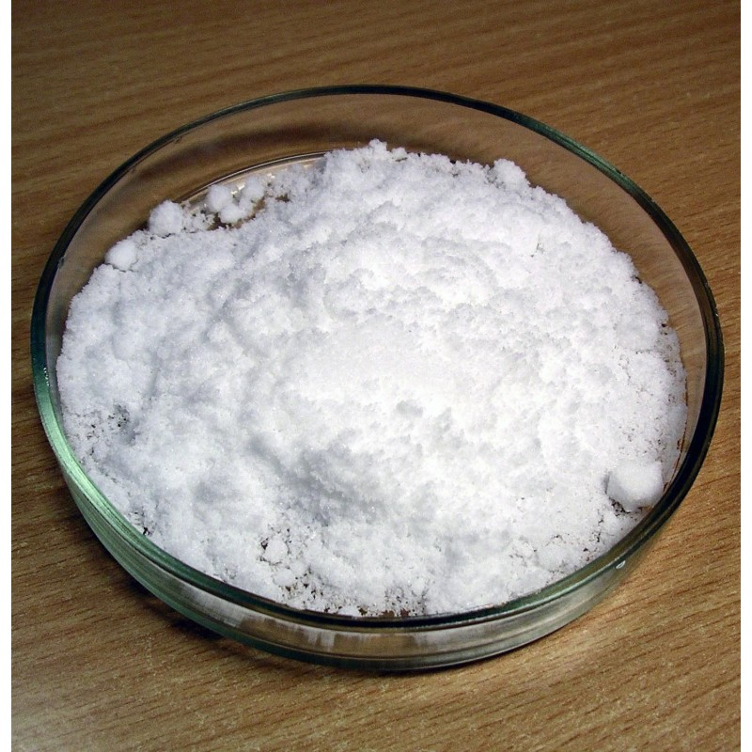
Potassium bromide
Formula :KBr
It is a white powder which has a melting point of 730*C and boiling point of 1435*C .
it is endothermic: because When 10.0 g of potassium bromide is dissolved in 50.0 g of water in a coffee-cup calorimeter, the temperature drops from 18.0∘C to 9.5∘C.
KBr is a salt which is widely used as a sedative and as an anticonvulsant with the chemical name Potassium Bromide.

Slide 4
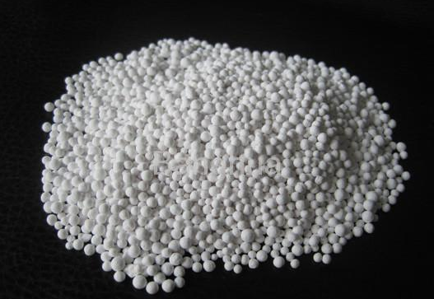
Calcium chloride
Formula :Cacl2
It is exothermic: initial temperature is 25.8 °C, final temperature is 29.9 °C when dissolved in water.
Properties :Boiling Point 1,935°C
Melting Point 772°C
White, no smell, crystalline solid compound
Uses: Calcium chloride is an ionic compound used for the treatment of hypocalcemia and hyperkalemia, and as an antidote to magnesium intoxication due to overdosage of magnesium sulfate.

Slide 5
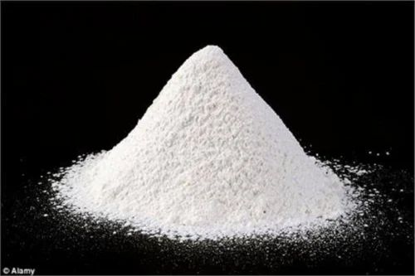
Lithium nitrate
Formula:LiNO3
Lithium Nitrate is a colorless or white, crystalline (sand-like) powder or granule. which has a melting point of 255*C and a boiling point 600*C
It is exothermic: the temperature of the solution is initially 23.5C and the final temperature is 28.3C when dissolved in water.
It is used as a laboratory reagent and heat- exchange media, and in rocket propellants, pyrotechnics, and ceramics.

Slide 6
potassium citation
Take online courses. earn college credit. Research Schools, Degrees & Careers. Study.com. (n.d.). Retrieved May 7, 2023, from https://homework.study.com/explanation/when-10-0-g-of-potassium-bromide-is-dissolved-in-50-0-g-of-water-in-a-coffee-cup-calorimeter-the-temperature-drops-from-18-0-degrees-c-to-9-5-degrees-c-assume-that-all-the-heat-is-absorbed-in-the-solution-process-comes-from-the-water-specific-heat-of.html

Slide 7
Ammonium chloride citation
Predict the nature of following changes whether exothermic or endothermic?dissolution oammonium chloride in water. byju. (n.d.). Retrieved May 7, 2023, from https://byjus.com/question-answer/predict-the-nature-of-following-changes-whether-exothermic-or-endothermic-dissolution-of-ammonium-chloride-in/
Ammonium chloride formula: Properties, uses and examples - TOPPR. (n.d.). Retrieved May 7,
2023, from https://www.toppr.com/guides/chemistry-formulas/ammonium-chloride-formula/
Team, E. B. I. W. (n.d.). Chebi. ammonium chloride (CHEBI:31206). Retrieved May 7, 2023,from https://www.ebi.ac.uk/chebi/searchId.do?chebiId=CHEBI%3A31206#:~:text=Ammonium%20chloride%20is%20an%20inorganic,is%20highly%20soluble%20in%20water
Encyclopædia Britannica, inc. (n.d.). Ammonium chloride. Encyclopædia Britannica. RetrievedMay 7, 2023, from https://www.britannica.com/science/ammonium-chloride
Take online courses. earn college credit. Research Schools, Degrees & Careers. Study.com. (n.d.). Retrieved May 7, 2023, from https://homework.study.com/explanation/the-heat-of-solution-of-ammonium-chloride-is-15-2-kj-mol-if-a-6-134-g-sample-of-nh4cl-is-added-to-65-0-ml-of-water-in-a-calorimeter-at-24-5degree-c-what-is-the-minimum-temperature-reached-by-the-sol.html
Take online courses. earn college credit. Research Schools, Degrees &amp; Careers. Study.com.(n.d.). Retrieved May 7, 2023, from https://homework.study.com/explanation/the-heat-of-solution-of-ammonium-chloride-is-15-2-kj-mol-if-a-6-134-g-sample-of-nh4cl-is-added-to-65-0-ml-of-water-in-a-calorimeter-at-24-5degree-c-what-is-the-minimum-temperature-reached-by-the-sol.html

Slide 8
Calcium chloride citation
Calcium chloride. Uses, Interactions, Mechanism of Action | DrugBank Online. (n.d.). Retrieved May 7, 2023, from https://go.drugbank.com/drugs/DB01164#

Slide 9
Lithium nitrate citation
Take online courses. earn college credit. Research Schools, Degrees &amp; Careers. Study.com. (n.d.). Retrieved May 7, 2023, from https://homework.study.com/explanation/a-coffee-cup-calorimetry-experiment-is-run-for-the-dissolution-of-2-5-g-of-lithium-nitrate-placed-into-97-2-ml-of-water-the-temperature-of-the-solution-is-initially-at-23-5-c-after-the-reaction-takes-place-the-temperature-of-the-solution-is-28-3-c.html
Right to know hazardous substance fact sheet - government of New Jersey. (n.d.). Retrieved May 7, 2023, from https://nj.gov/health/eoh/rtkweb/documents/fs/1130.pdf

