Slide 1
The journey of obesity
Eat light, but right.
By: Kareem Al Abdallat, Melissa Kilani, Farah ayed

Slide 2
01
What is obesity?

Slide 3
Obesity
A condition known as obesity involves having too much body fat. Obesity is more than simply a visual issue. It is a medical condition that raises the chance of various illnesses and conditions, including heart disease, diabetes, high blood pressure, and some malignancies.

Slide 4
02
Reasons why people are obese

Slide 5
Reasons why people are obese
Genetics
Environmental Factors
Low metabolism
Eating disorders
Stress
Poor sleep
They inherit this disease.
By eating huge amounts of calories.
By lowering your calorie intake very fast you lose the weight then eventually gain it back.
Some eating disorders such as binge eating make you keep eat food.
A lot of stress can cause weight gain.
Your body wouldn't rest properly.

Slide 6
03
How to prevent obesity

Slide 7
Ways to prevent Obesity:
Having a balanced diet
Working out
Nutritious foods
Cutting calories is a good way to start, but slowly. Eat food in smaller portions.
Working out while being a calorie deficit burns fat. Strength training works the best.
Increase your protein intake. Eat more fruits and veggies.

Slide 8
04
Foods for fat loss:

Slide 9
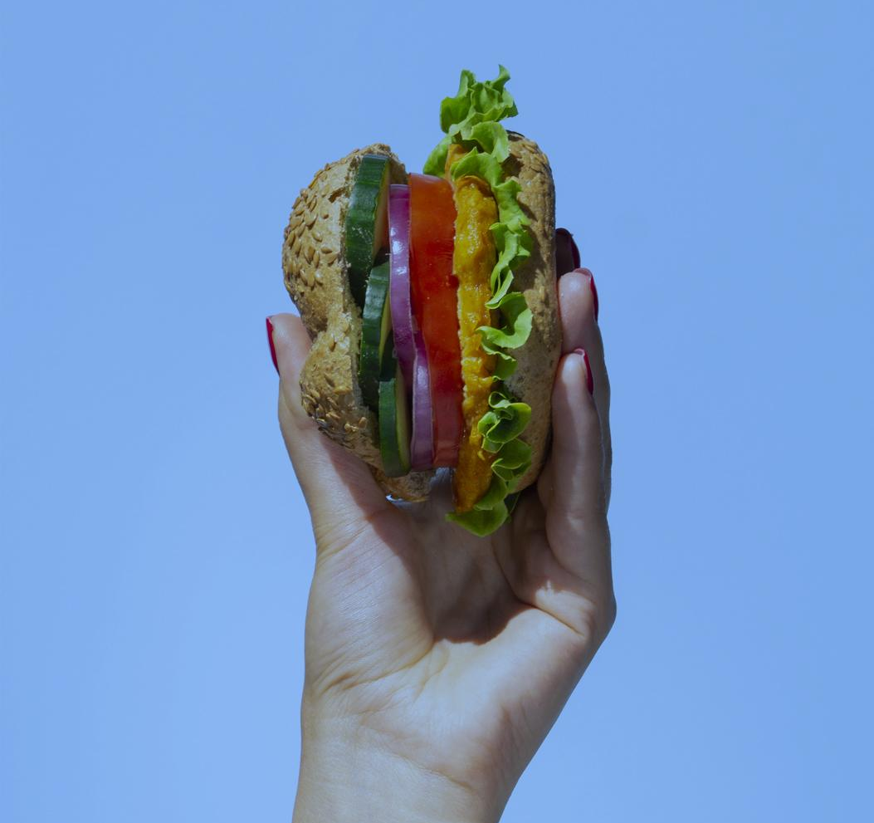
Foods for fat loss
High protein foods such as protein bars.
Fruits and veggies.
Low calorie filling foods.
Sugar alternatives such as stevia.

Slide 10
05
Factors to consider

Slide 11
Factors to Consider
Heart Problems
Doing Sports
Type 2 Diabetes
Avoiding Fast Food
Consequences of Obesity
Remedies for Obesity
Heart failure, cardiac arrest.
Moving more decreases the risk of heart problems.
Your body doesn't use insulin properly.
Fast food is insanely packed with calories

Slide 12
Thank you for listening
Any questions?

