Slide 1
Endothermic and exothermic
By: Sanad Darwish, Karam Maraqah, Zeid Nino, Issa Nino

Slide 3
Exothermic
When an exothermic reaction happens energy is transferred to the surroundings during the reaction, which makes the temperature of the surroundings increase.

Slide 4
Endothermic
An endothermic reaction is any chemical reaction that absorbs heat from its environment, which will make the temperature of the surrounding substance decrease.

Slide 5
Substances that dissolve in water:
substance | Endothermic or exothermic | Initial temperature | Final temperature | Temperature change
Calcium chloride | exothermic | 22 | 56 | +34
Magnesium sulfate | exothermic | 24 | 72 | +48
Ammonium nitrate | Endothermic | 24 | 15 | -9
Sodium chloride | endothermic | 23 | 10 | -13

Slide 6
Procedure:
1.Use the balance to measure the mass of the chemical used (example 5g)
2.Add specific volume of water using a measuring cylinder.( EX, 1OO ML)
3. transfer the water into an insulating cup
4. Use the thermometer to measure the initial temperature.
5. Add the salt , stir to ensure complete dissolving .
6. measure the final temperature after specific time interval .
7. repeat the same experiment for the rest of the salts
8. collect the data in a table

Slide 7
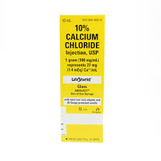
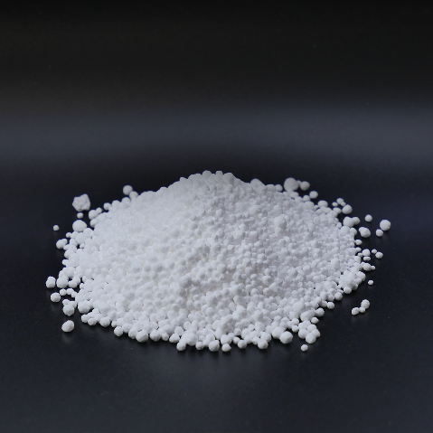
Calcium Chloride
Calcium chloride is a compound of calcium and chlorine.
It is highly soluble in water.
It is a salt that is solid at room temperature.
Calcium chloride has many common uses such as: dust control on roads, and in cement.
GO BACK

Slide 8
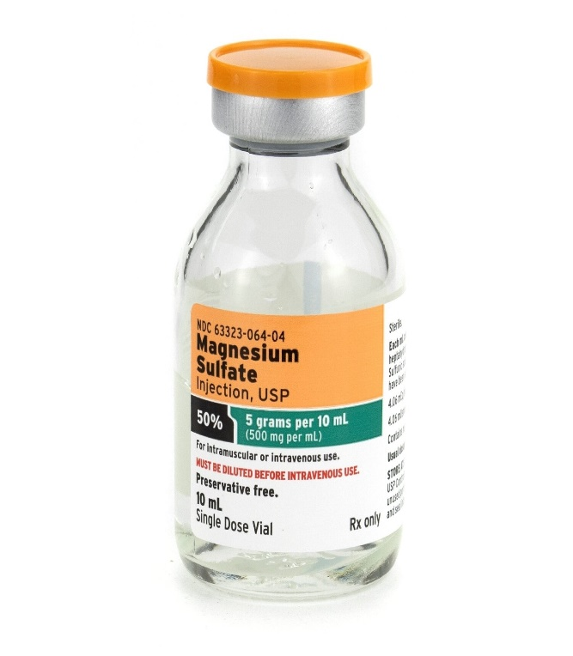
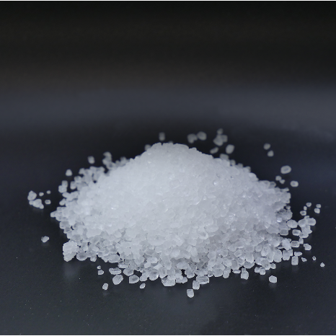
Magnesium Sulfate
Magnesium sulfate is a salt which is also known as sulfuric acid magnesium.
It has high solubility and it can also be noted that the solubility of magnesium sulfate will increase as the temperature of the water increases too.
Magnesium sulfate is used for short term relief of constipation. It is also used as a solution for minor sprains, bruises, discomforts, stiffness, and muscle aches.
It is considered a laxative medicine.
GO BACK

Slide 9
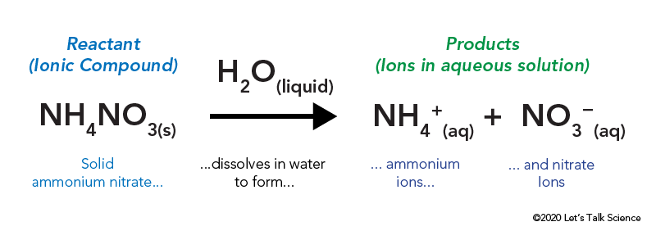
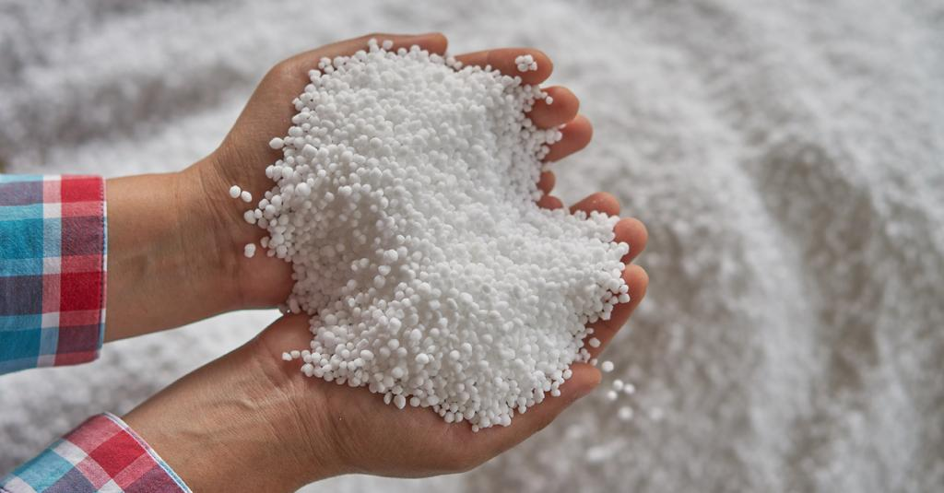
Ammonium Nitrate
Ammonium nitrate is a colorless crystalline substance which has a melting point of 169 degrees Celsius.
It is a substance that is highly soluble in water.
Heating the solution in water dissolves the salt into nitrous oxide
Ammonium nitrate is used to make explosives, matches, fertilizers, and antibiotics
GO BACK

Slide 10
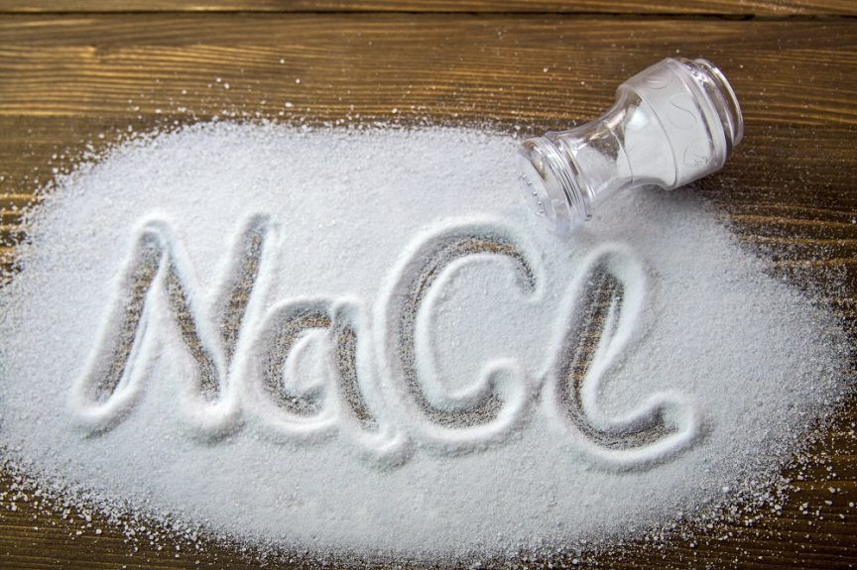
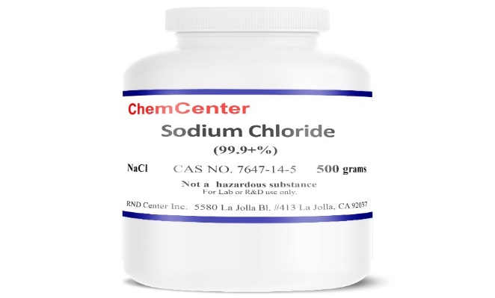
Sodium Chloride
Sodium chloride is a white crystalline white solid (a salt) that contains a density of 2.16 g\ml.
It also contains a melting point as high as 801 degrees Celsius
The boiling point is approximately 1413 degrees Celsius.
Sodium chloride is used as a food preservative and as a seasoning to enhance flavor.
Sodium chloride is also used in manufacturing to make plastic and other products, and to de-ice roads and sidewalks.
GO BACK

