Slide 1
Earthquakes
BY : Nouf, Natalia, Noor, Maryam, Sadeen

Slide 2
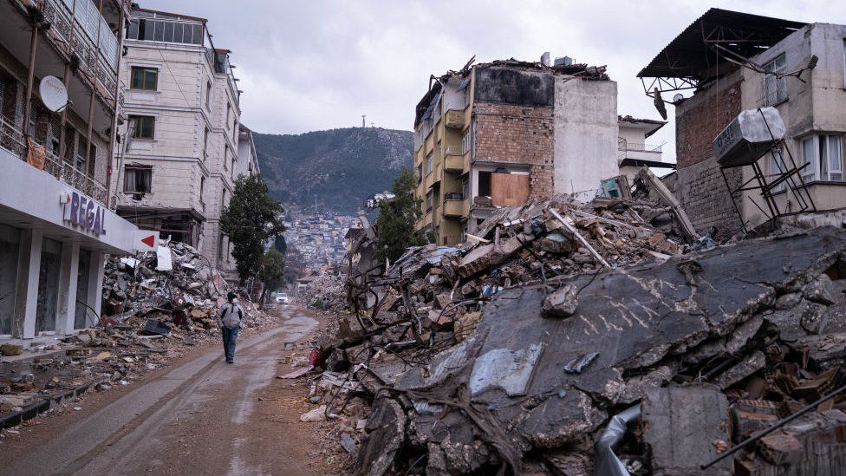
What are earthquakes?
Notes:
An earthquake is an extreme shaking of Earth’s surface. The shaking is caused by movements in Earth’s outer layer. (MARYAM)

Slide 3
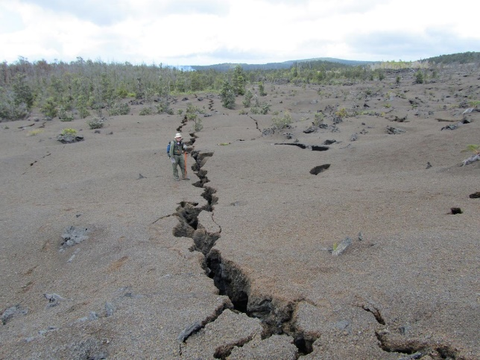
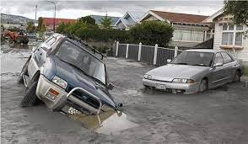
Issues and causes of earthquakes
issues
causes
Ground shaking
Fires and tsunami
Fissure
soil liquefaction
An earthquake occurs when the stress on the edge exceeds the friction, releasing energy in waves that flow through the earth's crust and produce the shaking we experience.
Notes:
Fissure is when a long, narrow crack or linear opening in the Earth's crust appears. (NOOR)
Soil liquefaction happens when the ground surface lose their strength in response to strong ground shaking. (NOUF)
When the stress on the edge overcomes the friction, there is an earthquake that releases energy in waves that travel through the earth's crust and cause the shaking that we feel. (SADEEN)

Slide 4
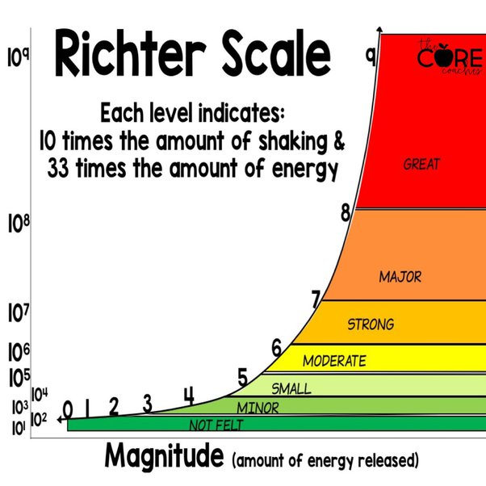
The factors that affect the intensity and frequency of earthquakes
Notes:
The extent of damage depends on how violently the ground shakes when an earthquake occurs. The depth of the earthquake, the distance from the fault, the underlying soil, and the characteristics of the buildings, particularly their height, are the subsequent main factors affecting earthquake shaking intensity. (NOOR,NOUF, SADEEN)

Slide 5
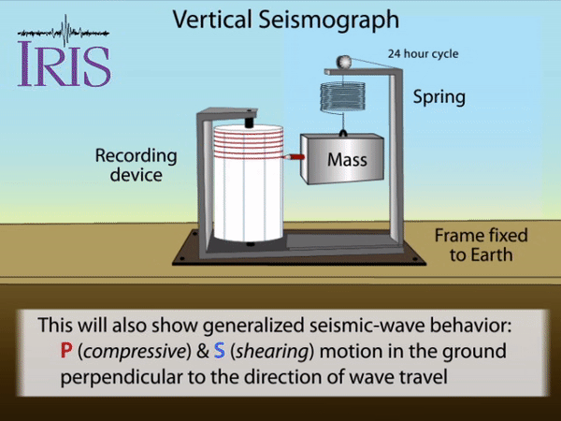
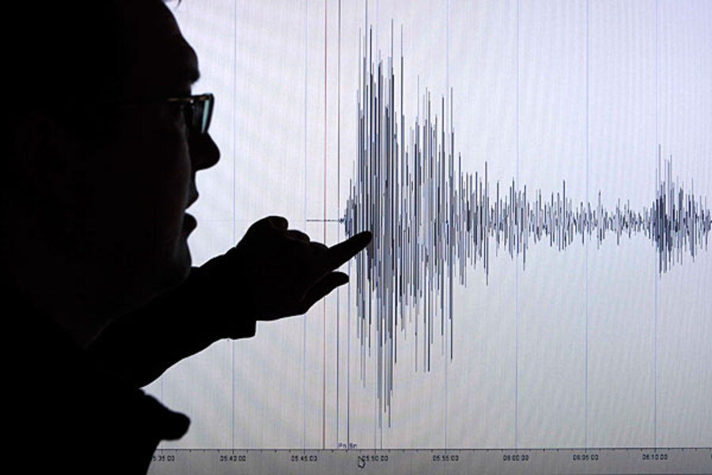
Methods used to detect, measure and predict earthquakes
Notes:
By turning the vibrations caused by seismic waves into electrical impulses that can then be displayed as seismograms on a computer screen, seismometers enable us to detect and monitor earthquakes. (NATALIA)
by studying the history of large earthquakes in a specific area and the rate at which strain accumulates in the rock. (MARYAM)

Slide 6
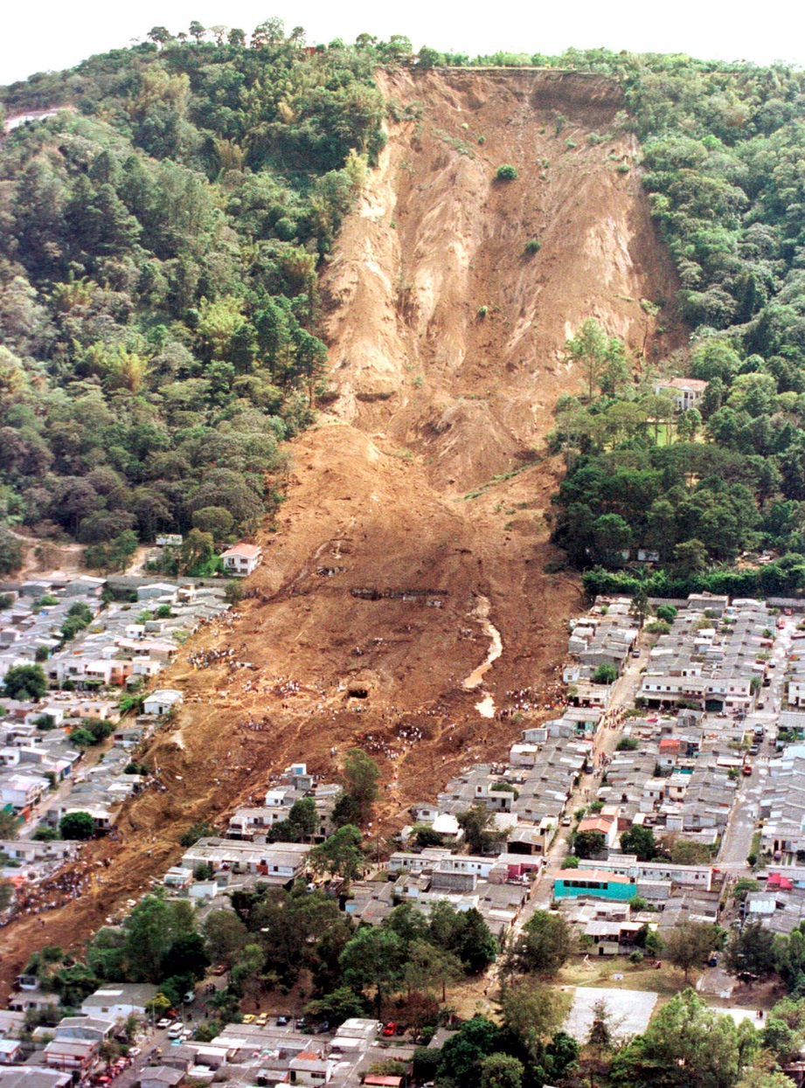
the impacts of earthquakes on the natural environment and ecosystem.
Notes:
Building structural damage, fires, damage to bridges and highways, failures of slopes, liquefaction, and tsunami are some of the frequent effects of earthquakes. The type of place where the earthquake occurs will have a significant impact on the impacts' nature. (SADEEN)

Slide 7
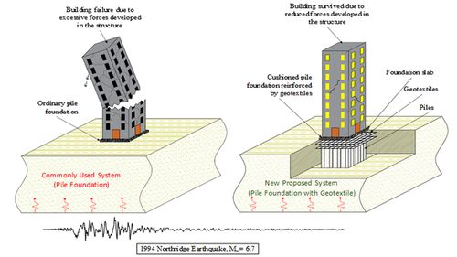
Solutions for earthquakes
Notes:
locating risks, building safer structures, and spreading earthquake safety knowledge. We can reduce the risk of earthquakes caused by humans by being prepared for natural quakes. (NATALIA)

Slide 8
Resources
https://spaceplace.nasa.gov/earthquakes/en/
https://pubs.usgs.gov
https://spaceplace.nasa.gov/earthquakes/en/
https://www.ready.gov/earthquakes
https://www.whoi.edu/

Slide 9
Thank you!!!

