Slide 1
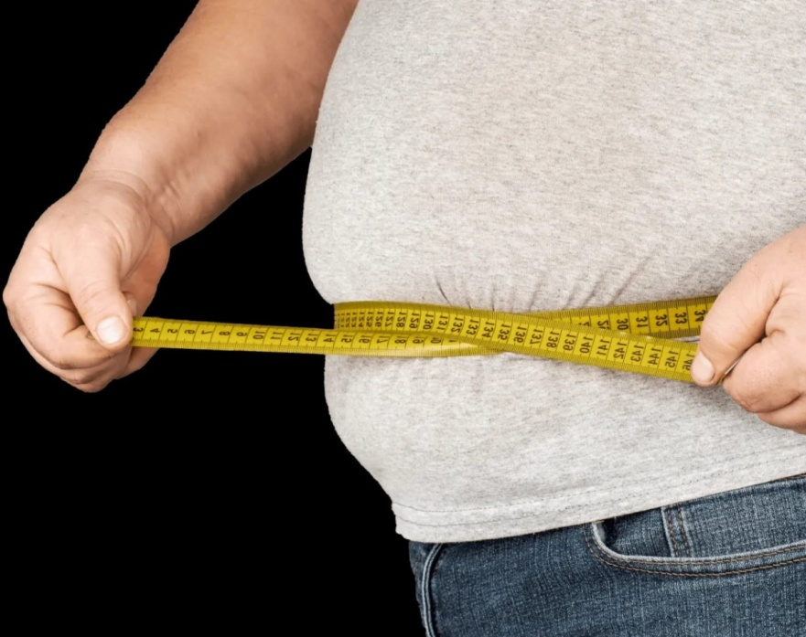
Global project obesity
Done by: Jessica Azrai
Natalie zabaneh
Maya fityani
Obesity
Done by: Jessica Azrai
Natalie zabaneh
Maya fityani

Slide 2
Explanation video
Short video about obesity:
https://www.youtube.com/watch?app=desktop&v=D--AtATgfyM

Slide 3
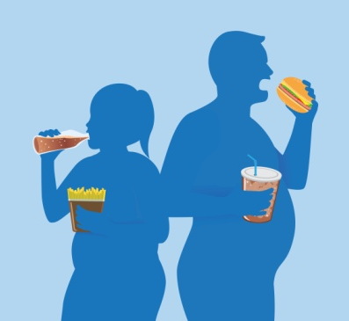
What is obesity?
Notes:
What do you see in these photos?(students answer)
Basically our project in about obesity but do you know what is obesity?(students answer) Obesity is abdominal or excessive fat accumulation that can cause health risks to a human body. Obesity doesn’t mean more weight in the body but more fat.

Slide 4
BMI
names | height | weight | BMI
Ahmad | 184m | 105 kg | 31 | obese
Dina | 150m | 60 kg | 26 | overweight
Sarah | 163m | 68 kg | 25 | overweight
Maha | 158m | 58 kg | 23 | normal
Samir | 163m | 63 kg | 23 | normal
Amir | 160m | 76 kg | 29 | overweight
Lama | 155m | 43.3 kg | 18.2 | underweight
Zaid | 173m | 73 kg | 24 | normal
Goerge | 170m | 85 kg | 29 | overweight
Layla | 145m | 37.7 kg | 17.9 | underweight
Marah | 160m | 65 kg | 25 | overweight

Slide 6
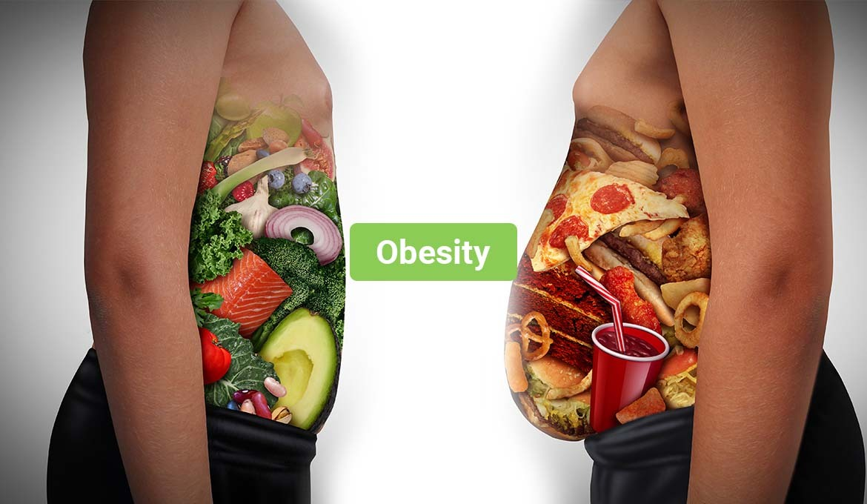
Causes of obesity
Notes:
In your knowledge, what are the causes of obesity?(students answer)- Food and activity: people gain weight when they
eat more calories than they burn through activity.-Stress and emotional eating: some people eat more than usual when they are angry, depressed or bored, also studies showed that people with less sleep are likely to be overweight because that hormones which help control the appetite are released during sleep.
-Diet: the food lifestyle is an important factor that can contribute to development of obesity. For example if someone eats more portions of food than needed or drinks to much alcohol or to much sugary drinks that can cause obesity.
Stress and emotional eating: some people eat more than usual when they are angry, depressed or bored, also studies showed that people with less sleep are likely to be overweight because that hormones which help control the appetite are released during sleep.

Slide 7
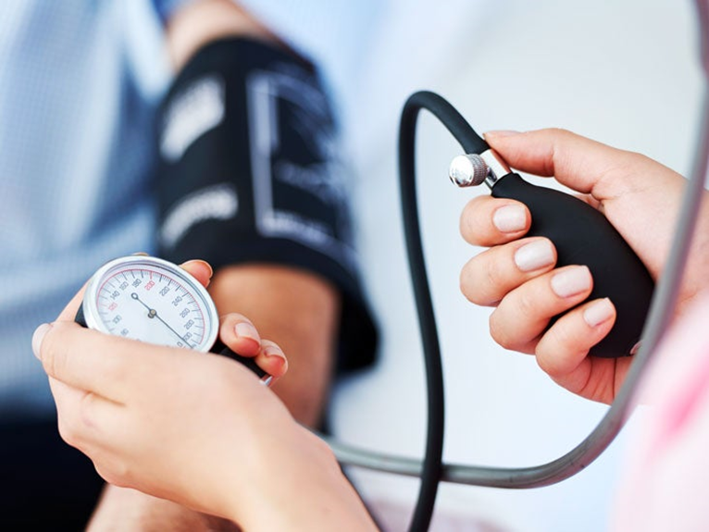
Consequences of obesity
Notes:
------------()there are a lot of consequences but these are more common -Diabetes: is when the sugar in the blood is higher than normal.
-sleep apnea: is a disorder in which someone may stop breathing during sleep.
-High blood pressure : extra fat tissue in the body requires more oxygen and nutrients, so the blood vessels will need to work harder which means the heart must work double the work to pump blood all around the body.

Slide 8
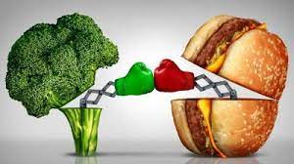
solutions
Notes:
-Put a healthy plan: participate in a gym or type of sports or activity to help in your movement problem.
-Visit a therapist to help you with emotional eating disorder and fix you sleep schedule so you can sleep enough hours.
-Try to avoid fast food and food that contains a big amount of sugar and follow a healthy diet that supports you life style.

