Slide 1
Exothermic and Endothermic Reactions
By: Natali Nijmeh, Tina Bqaeen and Yasmina Alam

Slide 2
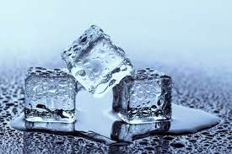
What are exothermic and endothermic reactions?
When two substances react and the temperature decreases, the reaction will be endothermic as it absorbs heat from its surrounding. While when two substances react and the temperature increases, the reaction will be exothermic as it releases heat into its surrounding.
Examples of endothermic Examples of exothermic
reactions: reactions:
1- Melting Ice 1- Neutralization
2- Evaporation 2- Burning
3- Photosynthesis 3- Freezing

Slide 3
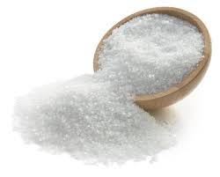
Potassium Chloride
Its chemical formula is: KCl
It’s used in medicine
It has an endothermic reaction when it dissolves in water
Its chemical properties include:
It promptly dissolves in water
The solution that forms is a good conductor of electricity
It produces a lilac or pale violet color when it reacts
Its boiling point is 1,420°C and its melting point is 770°C

Slide 4
Magnesium sulfate
Its chemical formula is: MgSO4
It’s used in detergents processing and cosmetics
It has an exothermic reaction when it dissolves in water
Its chemical properties include:
It has a high solubility in water
The solubility of it in water increases as the temperature increases
It is an ionic salt ( which means it breaks up into ions when it dissolves in water)
Its boiling point is 330°C and its melting point is 1,124°C

Slide 5
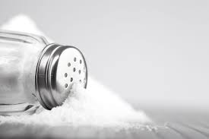
Sodium Chloride
Its chemical formula is: NaCl
It’s used as a seasoning in food (table salt)
It has an endothermic reaction when it dissolves in water
Its chemical properties include:
It is highly soluble in water
It cracks when heated
Its boiling point is 1,413°C and its melting points is 801°C

Slide 6
Potassium Nitrate
Its chemical formula is: KNO3
It’s used in explosives, matches, fertilizer, glass and rocket fuel
It has an endothermic reaction when it dissolves in water
Its chemical properties include:
It is moderately soluble in water
Its solubility increases as the temperature increases
It boiling point is 400°C and its melting point is 334°C

Slide 7
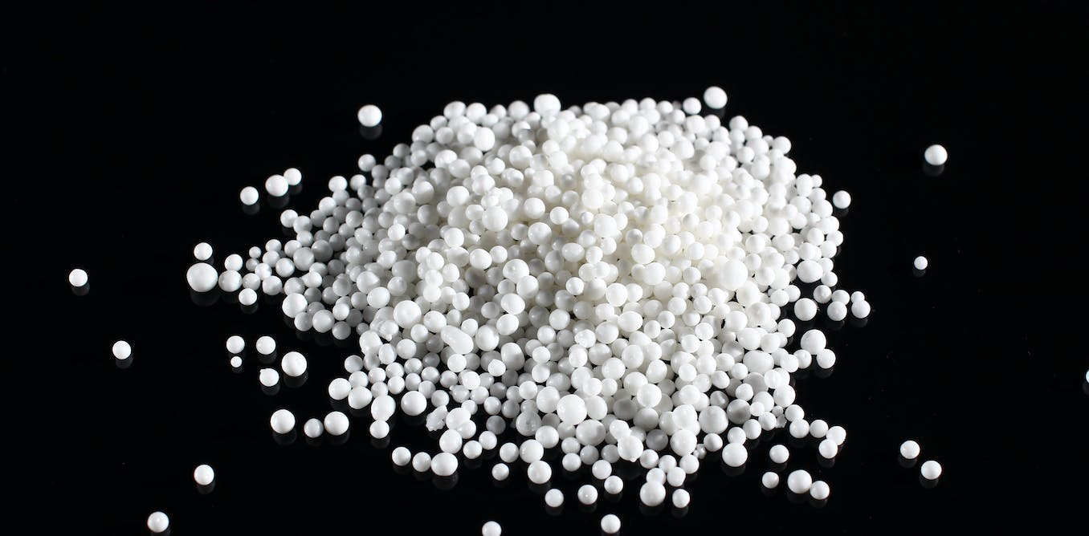
Ammonium Nitrate
Its chemical formula is: NH4NO3
It’s used in fertilizers and in many types of mining explosives
It has an endothermic reaction when it dissolves in water
Its chemical properties include:
It is promptly (without hesitation) soluble
It absorbs the water surrounding it from the atmosphere
It is not very reactive
Its boiling point is 210°C and its melting point is 169.6°C

Slide 8
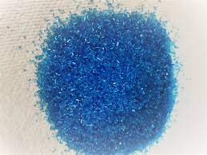
Copper Sulfate
Its chemical formula is: CuSO4
It’s used in fertilizers, foods, textiles, leather, batteries and ink.
It has an exothermic reaction when it dissolves in water
Its chemical properties include:
It is highly soluble
Its boiling point is 650°C and its melting point is 110°C

Slide 9
Interesting facts about each salt:
Potassium chloride can be extracted from ancient dried river remains
Magnesium sulfate can sometimes be used to treat heartburn
Sodium chloride can usually be used to de-ice roads and sidewalks
Potassium nitrate makes up 5% of the ingredient content of toothpaste
Ammonium nitrate is made by mixing nitric acid and ammonia salt and it is considered to be an explosive
Copper sulfate is a powerful oxidizing substance and the effects of getting poisoned by it can be seen on red blood cells, gastrointestinal systems, kidneys and cardiovascular system.

