Slide 1
Obesity
Life Is A Journey, Make It A Healthy One

Slide 2
01
Introduction
Your health is wealth.

Slide 3
What Is Obesity?
Obesity is a complex disease involving an excessive amount of body fat. Obesity isn't just a cosmetic concern. It's a medical problem that increases the risk of other diseases and health problems, such as heart disease, diabetes, high blood pressure and certain cancers.

Slide 4
Obesity Rate
55%
This is the percentage of the increase in obesity globally in the last five years. No activity is the new normal.

Slide 5
02
Causes & Triggers
You are in control, take charge of your health.

Slide 6
Physical Causes
Poor Diet
Sleep Deprivation
Genetics
Inactivity
Certain Medications
Misinformation
Too much sugar, saturated fats, alcohol, etc. gets stored in the body as excess fat that affects vital organs.
Affects the function of a region of the brain, the hypothalamus, which regulates appetite and the expenditure of energy
Genes can affect how their bodies change food into energy and store fat. Genes can also affect people's lifestyle choices.
A sedentary lifestyle can easily take in more calories every day than burn through exercise and routine daily activities. Engaging with any electronics is a sedentary activity.
Many pharmaceutical drugs can cause weight gain as a side effect
Many websites spread inaccurate information about health and nutrition.

Slide 7
Mental Causes
Chronic Stress
Depression
Mental Disorders
This leads to stress-eating more calories than needed, which get stored in the body as fat.
Leads to neglecting your body, by overfeeding to satisfy yourself and activity deprivation.
Like bipolar disorder, leads to making poor dietary choices.

Slide 8
03
Consequences
Be the change you want to see.

Slide 9
Consequences
Impacts brain volume, executive function skills, and cognitive development and can lead to a higher risk of dementia and Alzheimer's disease.
Heart Attacks, High blood pressure
May cause NAFLD (nonalcoholic fatty liver disease)
Substantial changes to the mechanics of the lungs and chest wall, these mechanical changes cause asthma
Affects how the bones do remodeling, weakening their structure.

Slide 10
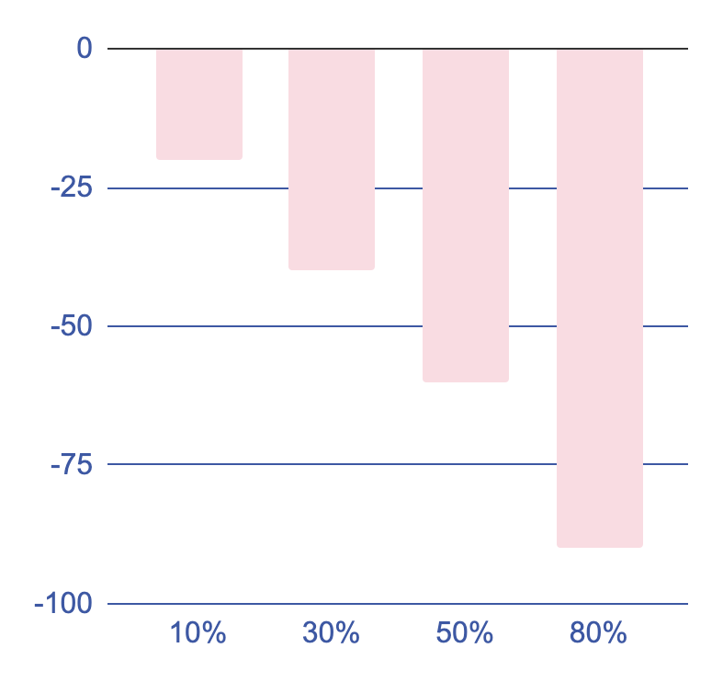
What may happen if you become obese
Energy levels in proportion to excess weight
The Conclusion
Weight Loss
In 6 Months
Even with bad genetics, or a bad mentality, you should try your absolute best to avoid this.
As excess weight increases, your body’s energy level will decrease.
In 6 Months
Your confidence will be boosted, and both your mental and physical health would be better than ever.
Your energy levels become too low, you lose the ability to do basic movements.

Slide 11
04
Reduction, Prevention & Restriction
Life is short, don’t let obesity shorten it.

Slide 12
How to prevent obesity
Keep a food diary
Reduce portion sizes
Exercise each week
Build activity into your day
Write down what you eat, where you eat, and how you feel before and after you eat.
Using a smaller plate can help you do this.
Aim for at least 150 minutes of medium to intense physical activity per week. For instance, this can be 30 minutes of exercise 5 days a week
Make sure to get at least 15 minutes of activity every day. You can do achieve this by enrolling in a gym or powerwalking if you have a busy schedule.

Slide 13
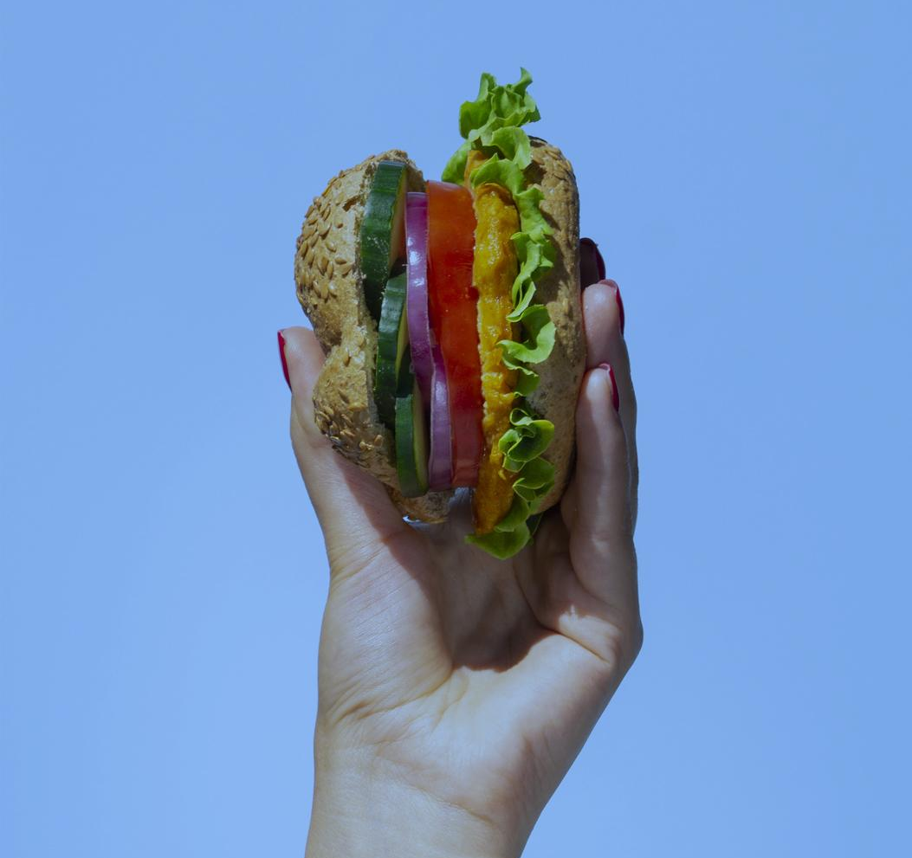
No Restrictions
Healthy ideas
Kale chips for potato chips
If you love munching crispy Potato Chips, switch to Kale Chips! They are crunchier than the potato ones and have very less fat.
Yogurt Fruit Pops for Ice Cream
Substituting regular ice cream for frozen yogurt and berries is an easy way to get through cravings while staying healthy.
Homemade Smoothies for Milkshakes
Making your own homemade smoothies contains much fewer calories than those you buy.

Slide 14
05
Conclusions
Don’t let obesity become your identity.

Slide 15
Conclusions
Conclusion A
Conclusion B
Obesity is one of the most common diseases in the modern world. As such, it is important to find out what factors both contribute to and reduce the risk of becoming overweight or obese.
Taking into consideration that obesity is in genetics and often can’t be controlled, it is recommended to find alternatives like surgeries to help you lose this torturous weight in your body.

Slide 16
Resources
https://www.mayoclinic.org/diseases-conditions/obesity/symptoms-causes/syc-20375742
https://www.nhs.uk/conditions/obesity/
https://www.healthline.com/nutrition/10-causes-of-weight-gain#TOC_TITLE_HDR_12
https://www.ncoa.org/article/how-excess-weight-impacts-our-mental-and-emotional-health

