Slide 1
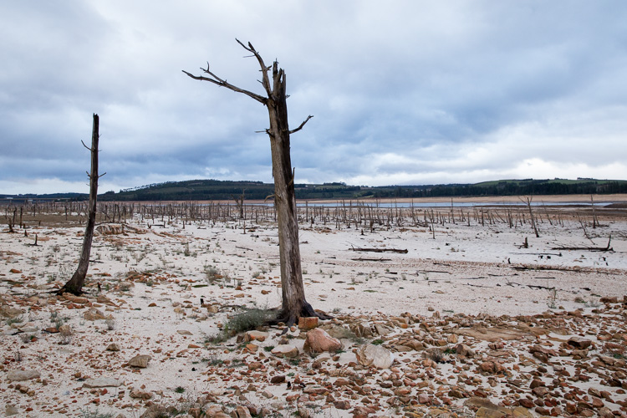
Water crisis in Jordan
By:cristiano,issa,omar,michel

Slide 2
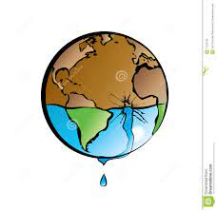
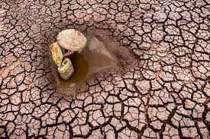
WHAT is water crisis in Jordan?
Jordan is the second most water scarce country in the world. Jordan's annual renewable water resources are less than 100 m³ per person, significantly below the threshold of 500 m³ per person which defines severe water scarcity.

Slide 3
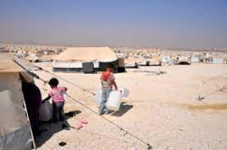
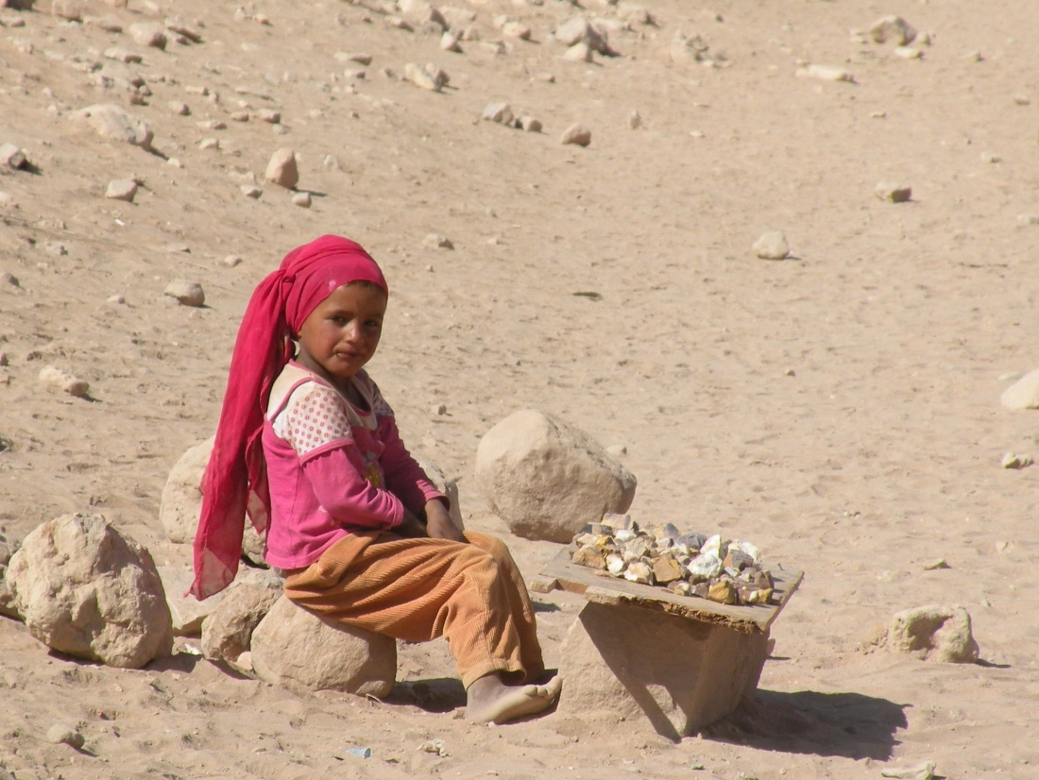
what are the issues of water crisis in Jordan?
The overflow of wastewater pumping stations, leaks from sewage systems and exposure to industrial and commercial waste are polluting Jordan's surface river.

Slide 4
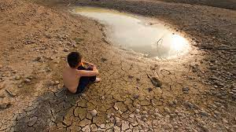
What are the causes of water crisis issues in Jordan?
The country's namesake river is nearly running dry. The flow in the Jordan River is less than 10 percent of its historical average, and the Yarmouk River, a major tributary, is greatly diminished. The Jordan's once-rushing waters feed into the Dead Sea, a saltwater lake that is disappearing.

Slide 5
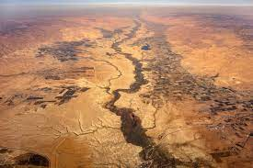
what are the consequences of water crisis in jordan?
Limited access to water results in children and young adults being unable to practice important hygiene behaviour like hand-washing and proper disposal of menstruation products. According to estimates, only around a third of schools in Jordan have adequate WASH facilities.

Slide 6
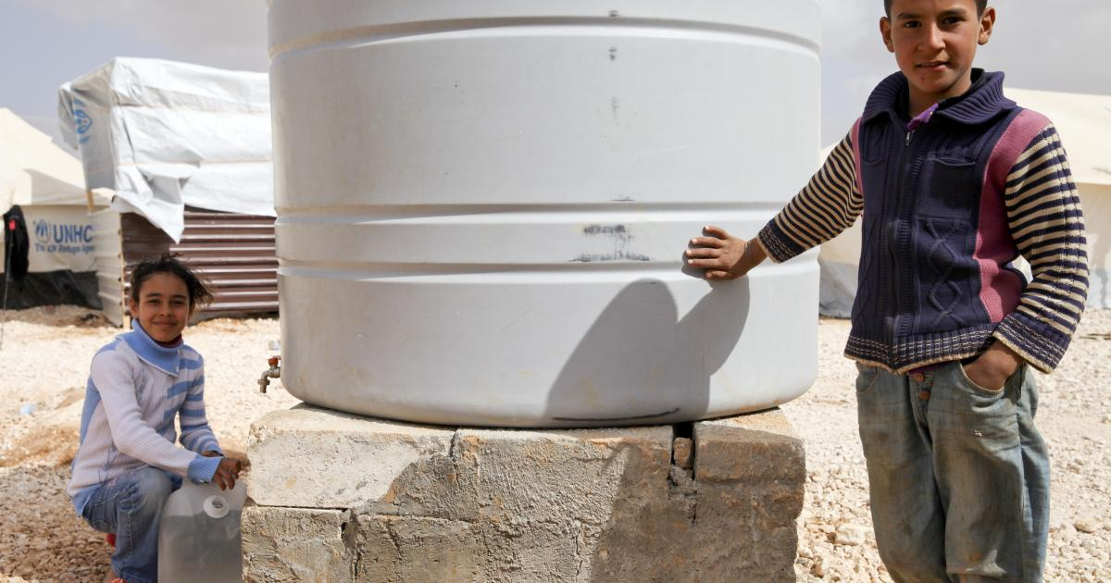
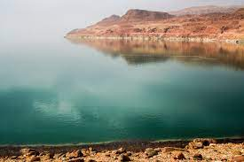
What are the solutions to water crisis in Jordan?
The cornerstone of developing sustainable water solutions in Jordan is the Red Sea-Dead Sea Water Conveyance Project. Alongside desalination and gaining access to unusually deep aquifers, the Read-Dead project, as it is commonly known, is hailed as a “perpetual” solution to water supply in Jordan.

Slide 7
citation
Water, sanitation and hygiene. UNICEF Jordan. (2020, November 4). https://www.unicef.org/jordan/water-sanitation-and-hygiene#:~:text=Challenges,which%20defines%20severe%20water%20scarcity.
Saiesha. (2022, April 14). 7 facts about water scarcity in Jordan. The Borgen Project. https://borgenproject.org/water-scarcity-in-jordan/#:~:text=The%20overflow%20of%20wastewater%20pumping,polluting%20Jordan’s%20surface%20river%20sources.
Zraick, K. (2022, November 9). Jordan is running out of water, a grim glimpse of the future. The New York Times. https://www.nytimes.com/2022/11/09/world/middleeast/jordan-water-cop-27.html#:~:text=The%20country’s%20namesake%20river%20is,saltwater%20lake%20that%20is%20disappearing.
Water stress in Jordan - Executive Summary. UNICEF Jordan. (n.d.). https://www.unicef.org/jordan/water-stress-jordan-executive-summary#:~:text=Limited%20access%20to%20water%20results,Jordan%20have%20adequate%20WASH%20facilities.
Project, B. (2019, December 18). Sustainable water solutions in Jordan also fuel diplomatic progress. The Borgen Project. https://borgenproject.org/sustainable-water-solutions-in-jordan/#:~:text=The%20cornerstone%20of%20developing%20sustainable,to%20water%20supply%20in%20Jordan.

