Slide 1
Endothermic And Endothermic
By: Bandar Al-Omari, Eyad Jumaian, Faris Dabit , Sanad Qusous

Slide 2
The difference between endothermic and exothermic reactions
Endothermic
Endothermic take in heat
There is a temperature increase
Exothermic
Exothermic release heat to the surroundings
There is a temperature decrease

Slide 3
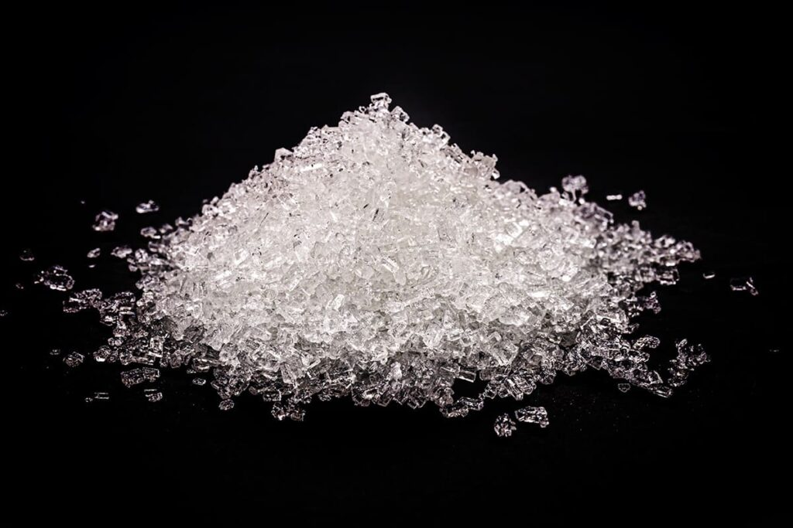
Ammonium chloride
Potassium nitrate
Ammonium chloride is an inorganic compound with the formula NH₄Cl and a white crystalline salt that is highly soluble in water.
Potassium nitrate is a medication used to cauterize small wounds, remove granulation tissue, warts, and verrucae, and treat tooth sensitivity. Potassium nitrate is an inorganic salt with a chemical formula of KNO3.

Slide 4
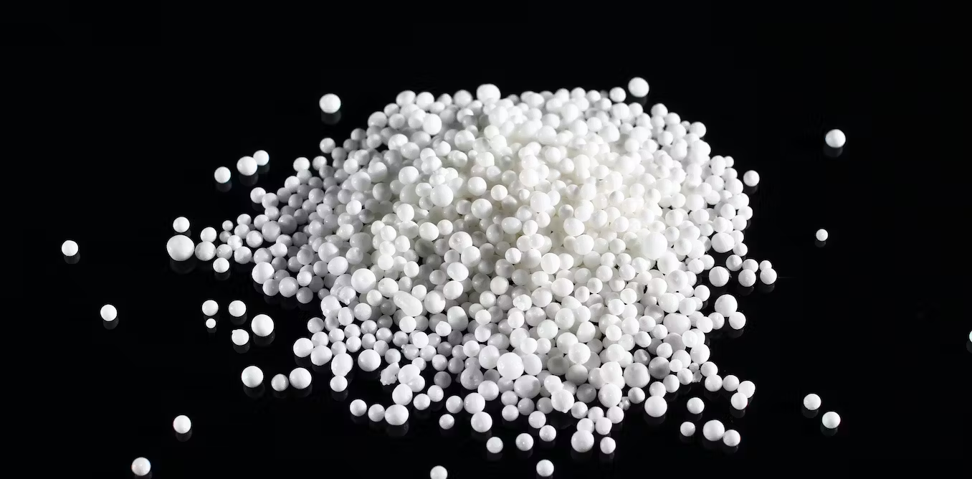
Copper sulfate
Ammonium nitrate
Copper sulfate is used as a drying agent in the anhydrous form, as an additive for fertilizers and foods, and several industrial applications such as textiles, leather, wood, batteries, ink, petroleum, paint, and metal, among others. It is used also as an animal nutritional supplement.
Ammonium Nitrate is an odorless, colorless, white to gray crystalline (sand-like) flake, bead or granule. It is used to make explosives, matches, fertilizers, and antibiotics. Substance List because it is cited by DOT and NFPA.

Slide 5
substance | Initial temperature | Change in temperature | Final temperature | Endothermic or Exothermic
Ammonium chloride | 22°C | -3 | 19°C | Endothermic
Potassium nitrate | 23°C | -9 | 14°C | Endothermic
Copper sulfate | 16°C | +7 | 23°C | Exothermic
Ammonium nitrate | 26°C | -6 | 20°C | Endothermic

