Slide 1
Different substances dissolved in water
By:Omar Alsumrain , Carol Alamat Salma Alesamy

Slide 2
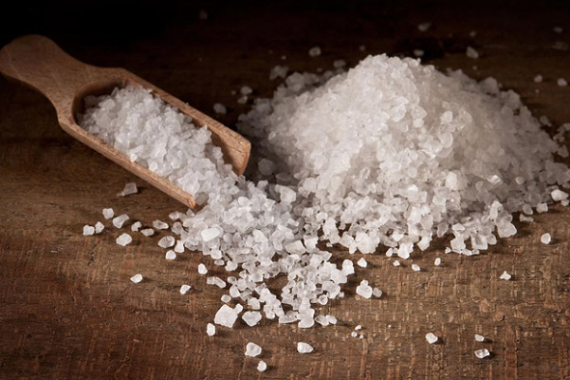
Ammonium Chloride
Ammonium chloride is a white crystalline solid its chemical structure is NH4Cl and it has an endothermic reaction when it dissolves in water ,a Melting Point of 338°C(64O"F) and Boiling Point: 520"C (968°F) also a density of 1.53 g/cm³

Slide 3
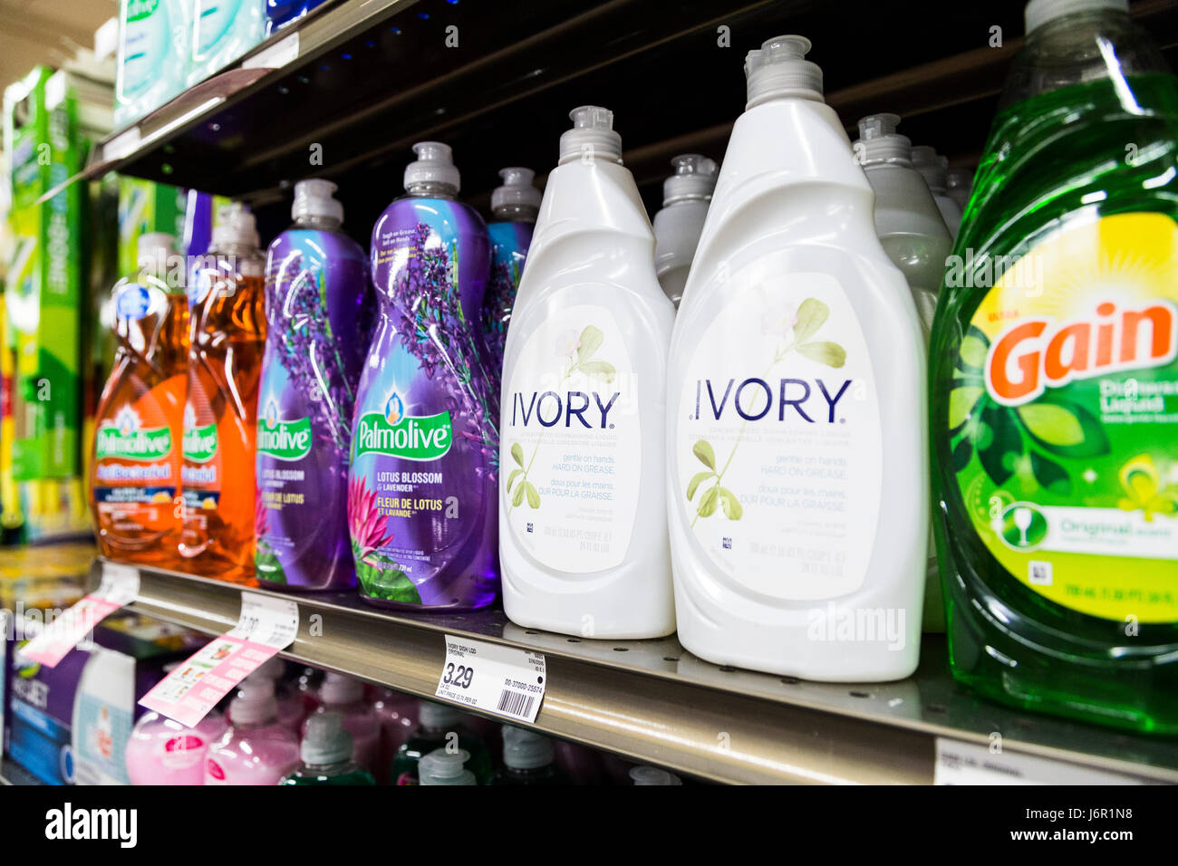
Ammonium Chloride
Ammonium chloride can be found in shampoo, hair color and bleach, body wash and cleanser, facial cleanser, conditioner, hand dishwashing detergent, as well as in bath oils and salts, and as an electrolyte in dry cell batteries where it is used because it is an ionic compound.

Slide 4
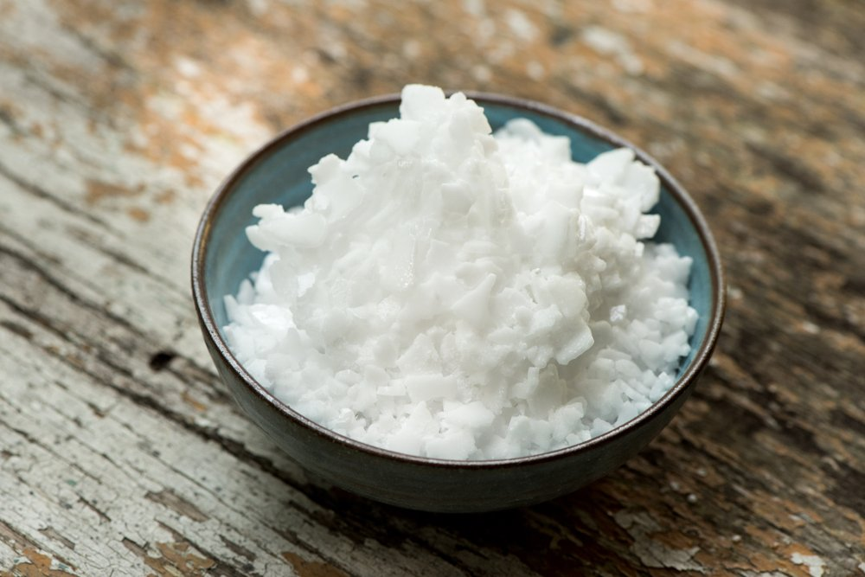
Potassium hydroxide
Potassium hydroxide has a white/clear color, its chemical structure is Koh, and it has an exothermic reaction when it dissolves in water. a melting point of 360 °C and boiling point of 1,327 °C meanwhile a density of 2.12 g/cm³

Slide 5
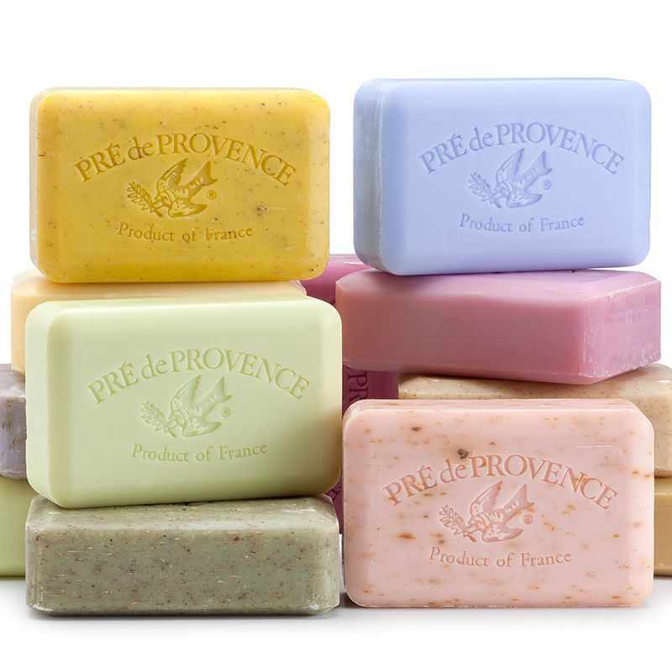
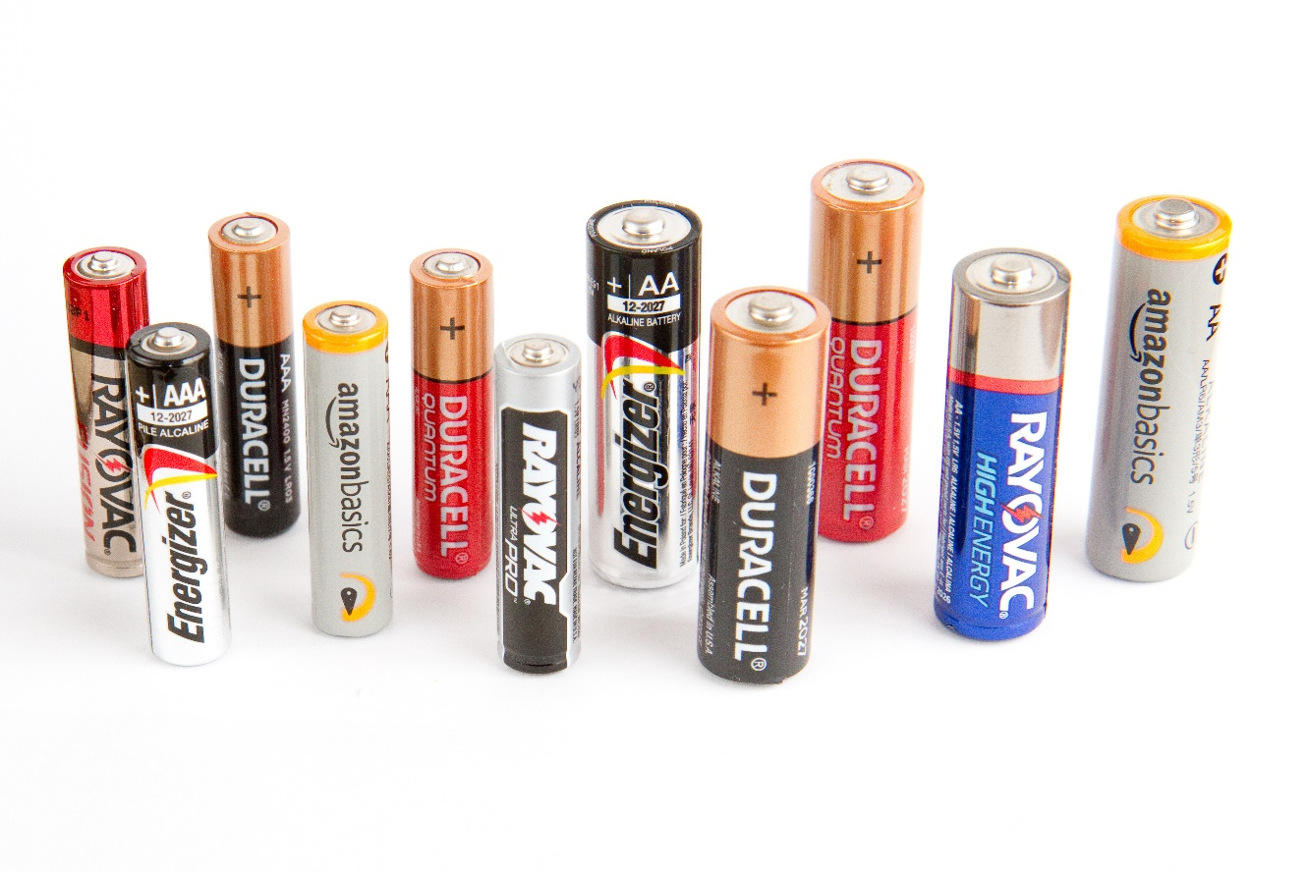
Potassium hydroxide
potassium hydroxide is used in making soap, as an electrolyte in alkaline batteries and in electroplating, lithography, and paint and varnish removers

Slide 6
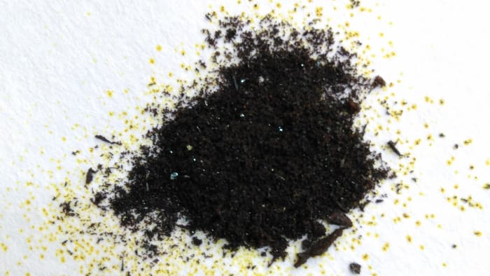
Iron chloride
Iron chloride is a a crystalline solid it appears as a dark green colour by reflected light, but by transmitted light they appear purple-red its chemical structure is Feci3 and it has an exothermic reaction when It dissolves in water ,and melting point of 306 °C and boiling point 315 °C and a density 2.8 g/cm³

Slide 7
Iron chloride
It is used to treat sewage, industrial waste, to purify water, as an etching agent for engraving circuit boards, and in the manufacture of other chemicals

Slide 8
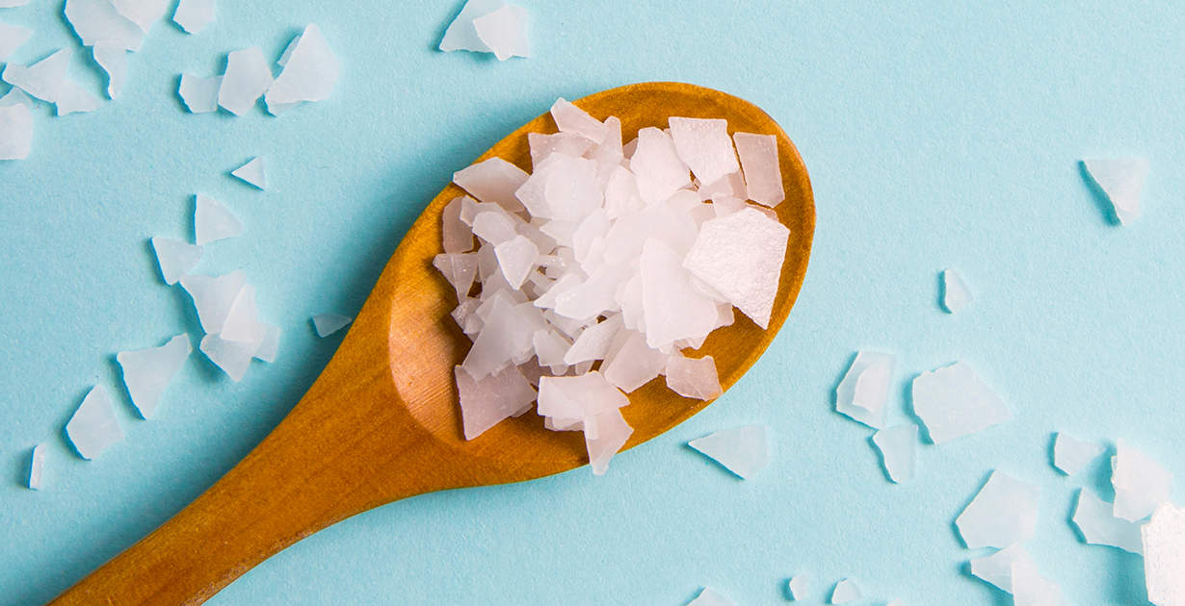
Magnesium chloride
Magnesium chloride is a white or colorless crystalline solid its chemical structure is Mgci2 and it has an exothermic reaction when it dissolves in water, and It has a melting point of 714 °C and a boiling point of 1,412 °C and a destiny of 2.32 g/cm³

Slide 9
Magnesium chloride
Magnesium Chloride is used in medications for to prevent and treat low amounts of magnesium in the blood

Slide 10
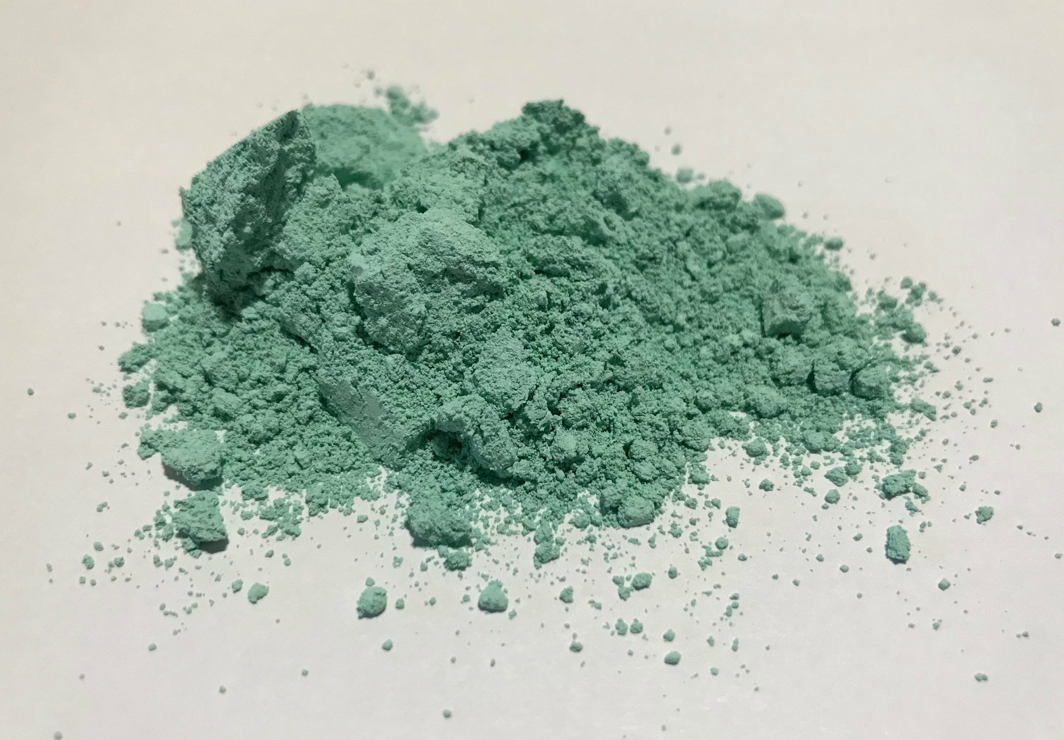
Copper Carbonate
Copper Carbonate has a color of green, its chemical structure is CuCo3, and it has an endothermic reaction when it dissolves in water, it and melting point of 200 °C and boiling point of 290 °C ,and a density of 4 g/cm³

Slide 11
Copper Carbonate
copper carbonate used as a pigment in products, paints, and varnishes and is highly demanded in fireworks and pottery glazes as pigment and colorant and fireworks

Slide 12
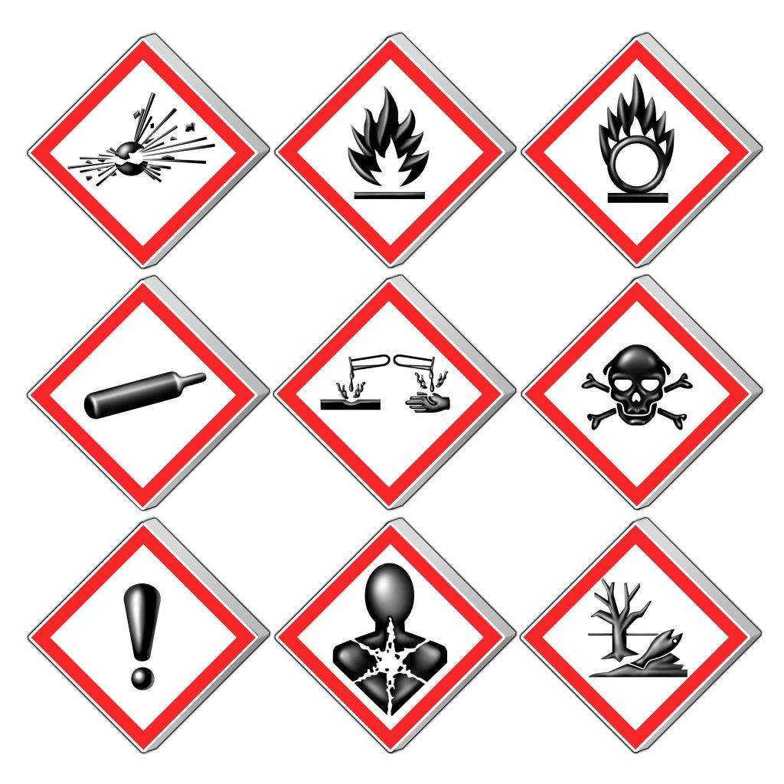
Hazards
ammonium chloride:
Ammonium Chloride may cause an asthma-like allergy. Future exposure can cause asthma attacks with shortness of breath, wheezing, cough, and/or chest tightness.
potassium hydroxide: contact can severely irritate and burn the skin and eyes leading to eye damage,irritate the nose and throat and irritate the lungs
iron chloride: Iron Chloride is a CORROSIVE CHEMICAL and contact can severely irritate and burn the skin and eyes. Breathing Iron Chloride can irritate the nose, throat and lungs causing tightness in the chest and lungs and/or difficulty in breathing
magnesium chloride: contact can cause, skin irritation Causes serious eye irritation May cause respiratory irritation
copper carbonate: Ingestion may cause irritation of the mouth, throat and stomach. Inhalation of extremely high concentrations could cause pulmonary edema (fluid accumulation).

Slide 13
Sources
Ammonium Chloride:
Chemical structure and appearance :Ammonium chloride – Wikipedia
Pottasium hydroxide:
appearance , melting, boling point and density, chemical strucutre,
https://byjus.com/chemistry/potassium-hydroxide/#:~:text=Potassium%20hydroxide%20is%20an%20inorganic,appears%20as%20a%20clear%20solution.
If its exo/endo thermic: https://persianutab.com/the-formula-for-the-reaction-of-potassium-hydroxide-with-water/?lang=en#:~:text=Perform%20the%20reaction%20between%20potassium%20hydroxide%20and%20water&text=are%20more%20stabilized.-,This%20solvation%20reaction%20is%20exothermic%20(releases%20heat)%20since%20the%20crystallization,crystals%20is%20released%20during%20solvatio.
Uses and hazards
https://nj.gov/health/eoh/rtkweb/documents/fs/1571.pdf
If its endo/exo thermic https://byjus.com/question-answer/predict-the-nature-of-following-changes-whether-exothermic-or-endothermic-dissolution-of-ammonium-chloride-in/
Boling/melting point and density
https://www.aakash.ac.in/important-concepts/chemistry/ammonium-chloride#:~:text=Ammonium%20chloride%20is%20a%20white,soluble%20in%20acetone%20as%20well.\
Uses: https://thechemco.com/chemical/ammonium-chloride/#:~:text=Ammonium%20chloride%20can%20be%20found,it%20is%20an%20ionic%20compound.
Hazards: https://www.nj.gov/health/eoh/rtkweb/documents/fs/0093.pdf

Slide 14
sources
Iron chloride:
Chemical structure and appearance :
https://melscience.com/US-en/articles/hydrolysis-reaction-iron-iii-chloride/
If its endo or exo thermic, density, boling and melting point, https://www.cs.mcgill.ca/~rwest/wikispeedia/wpcd/wp/i/Iron%2528III%2529_chloride.htm
uses:
https://pubchem.ncbi.nlm.nih.gov/compound/Ferric-chloride#:~:text=before%20adding%20water.-,It%20is%20used%20to%20treat%20sewage%2C%20industrial%20waste%2C%20to%20purify,the%20manufacture%20of%20other%20chemicals.&text=BLACK%2DTO%2DBROWN%20HYGROSCOPIC%20CRYSTALS.
Hazards: https://nj.gov/health/eoh/rtkweb/documents/fs/1034.pdf
Magnesium chloride:
Chemical strucutre and appearance, melting and boilng points:
https://en.wikipedia.org/wiki/Magnesium_chloride
If its endothermic or exothermic: https://www.oxycalciumchloride.com/sidewalk-ice-melting/effective-ice-melting/how-to-melt-ice-effectively/choosing-the-right-deicer#:~:text=Magnesium%20chloride%20is%20exothermic%20but,F%20(%2D18%C2%B0C).
Uses: https://www.webmd.com/drugs/2/drug-10702/magnesium-chloride-oral/details#:~:text=This%20medication%20is%20a%20mineral,%2C%20heartburn%2C%20and%20acid%20indigestion.
Hazards:
https://beta-static.fishersci.com/content/dam/fishersci/en_US/documents/programs/education/regulatory-documents/sds/chemicals/chemicals-m/S25401.pdf

Slide 15
sources
Copper carbonate:
Chemical structure appearance, boiling point, melting point , density:
https://en.wikipedia.org/wiki/Basic_copper_carbonate
If its endothermic or exothermic:
https://www.vedantu.com/question-answer/copper-carbonate-is-heated-it-releases-a-brisk-class-10-chemistry-cbse-5f32609ef2247610965baddb
Uses:
https://meghachem.org/what-is-copper-carbonate-and-its-uses.php#:~:text=They%20are%20used%20as%20a,glazes%20as%20pigment%20and%20colorant.
Hazards:
https://uwaterloo.ca/fine-arts/sites/ca.fine-arts/files/uploads/files/copper_carbonate_03-21-13.pdf

