Slide 1
Chemistry project
By Sara, Sama & Joelle

Slide 2
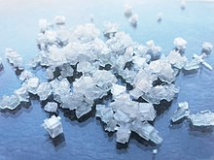
Ammonium chloride (NH4CL)
Ammonium chloride appears as a white crystalline solid that ha no smell.
Ammonium Chloride is commonly used for nitrogen supply in fertilizers and as an electrolyte in dry cells
Ammonium chloride is endothermic in water.
It has a melting point of 338 Celsius and a boiling point of 520 Celsius.

Slide 3
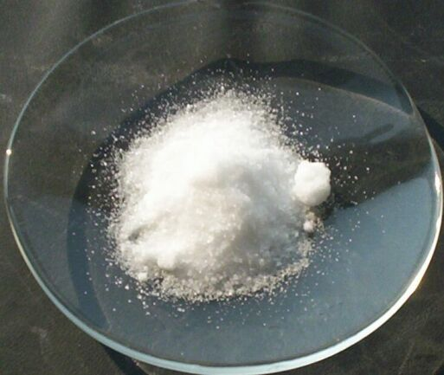
Potassium nitrate (KNO3)
Potassium nitrate is a water soluble salt that appears to be white to dirty grey crystalline solid.
Potassium nitrate is endothermic in water.
It melts at 334 Celsius
It boils at 400 Celsius
Potassium nitrate is used for food preservations, fertilizers, tree stump removal, rocket propellants, and firewroks.

Slide 4
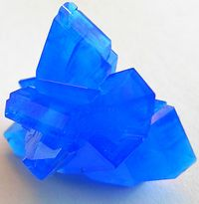
Copper Sulfate (CaSO4)
Copper sulfate is highly solube in water, it has a bright blue color.
It is mostly used as a fungicide, algaecide, root killer, and herbicide in both agriculture and non-agricultural settings.
Copper sulfate melts at 110 Celcius. Its boiling point is 150 Celsius.
It is exothermic in water.

Slide 5
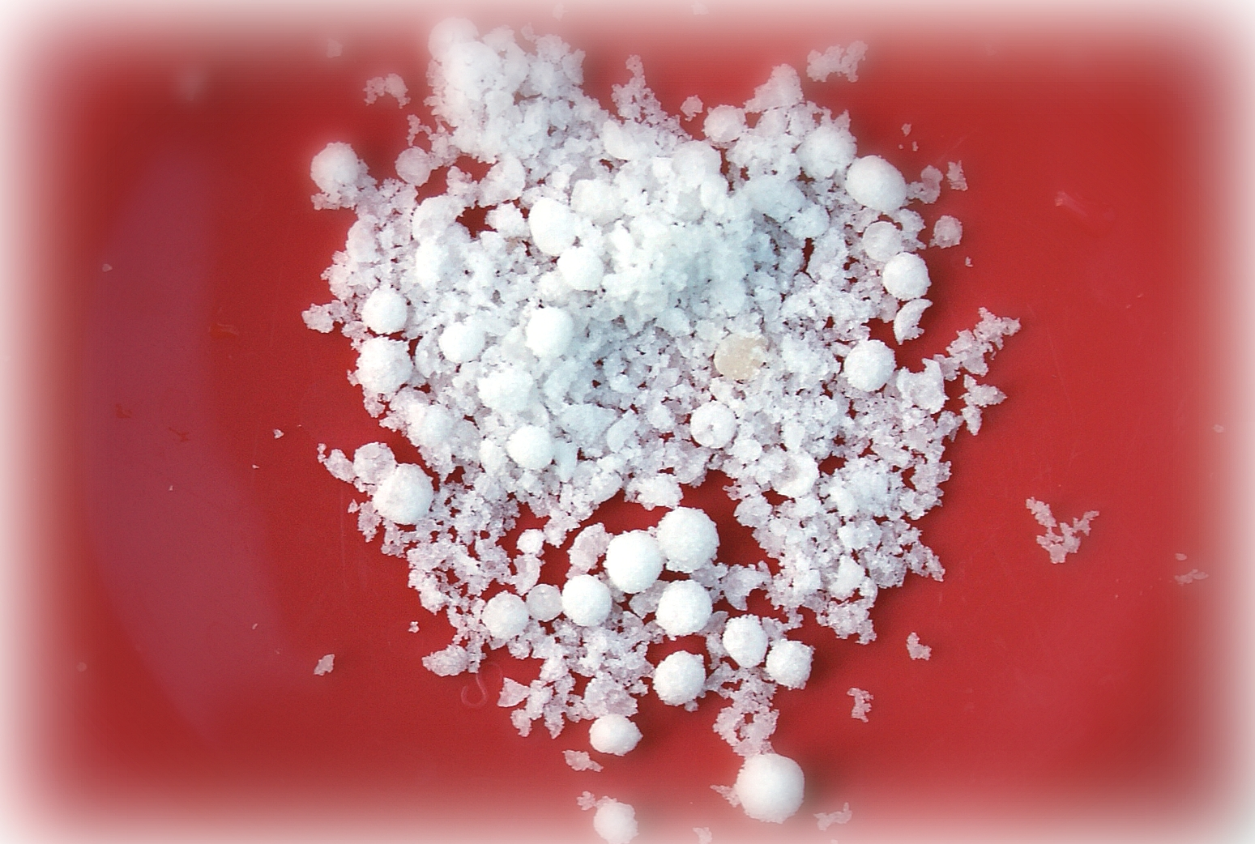
Ammonium nitrate (NH4NO3)
Ammonium nitrate is an odorless white to grey, colorless, (sand like) flake.
Ammonium nitrate’s melting point is 169.6 Celsius, and its boiling point is 210 Celsius.
Ammonium nitrate is endothermic is water.
It is used to make explosives, matches, fertilizers and antibiotics.

