Slide 1
Exothermic and Endothermic reactions
By: Elena Sahawneh, Reine Talhami, Zaid elhalah, Mila kuzouz

Slide 2
What are exothermic and endothermic changes in water
An exothermic process releases heat, causing the temperature of the immediate surroundings to rise. An endothermic process absorbs heat and cools the surroundings.

Slide 3
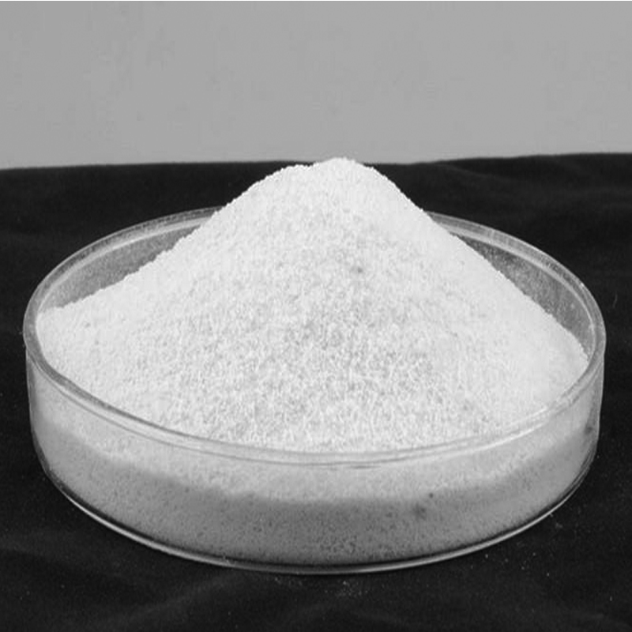
Ammonium chloride properties
Chemical formula: NH4Cl
Properties:
endothermic reaction when dissolved in water
Has a boiling point at 338 ºC
pH:4

Slide 4
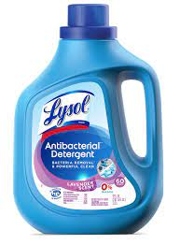
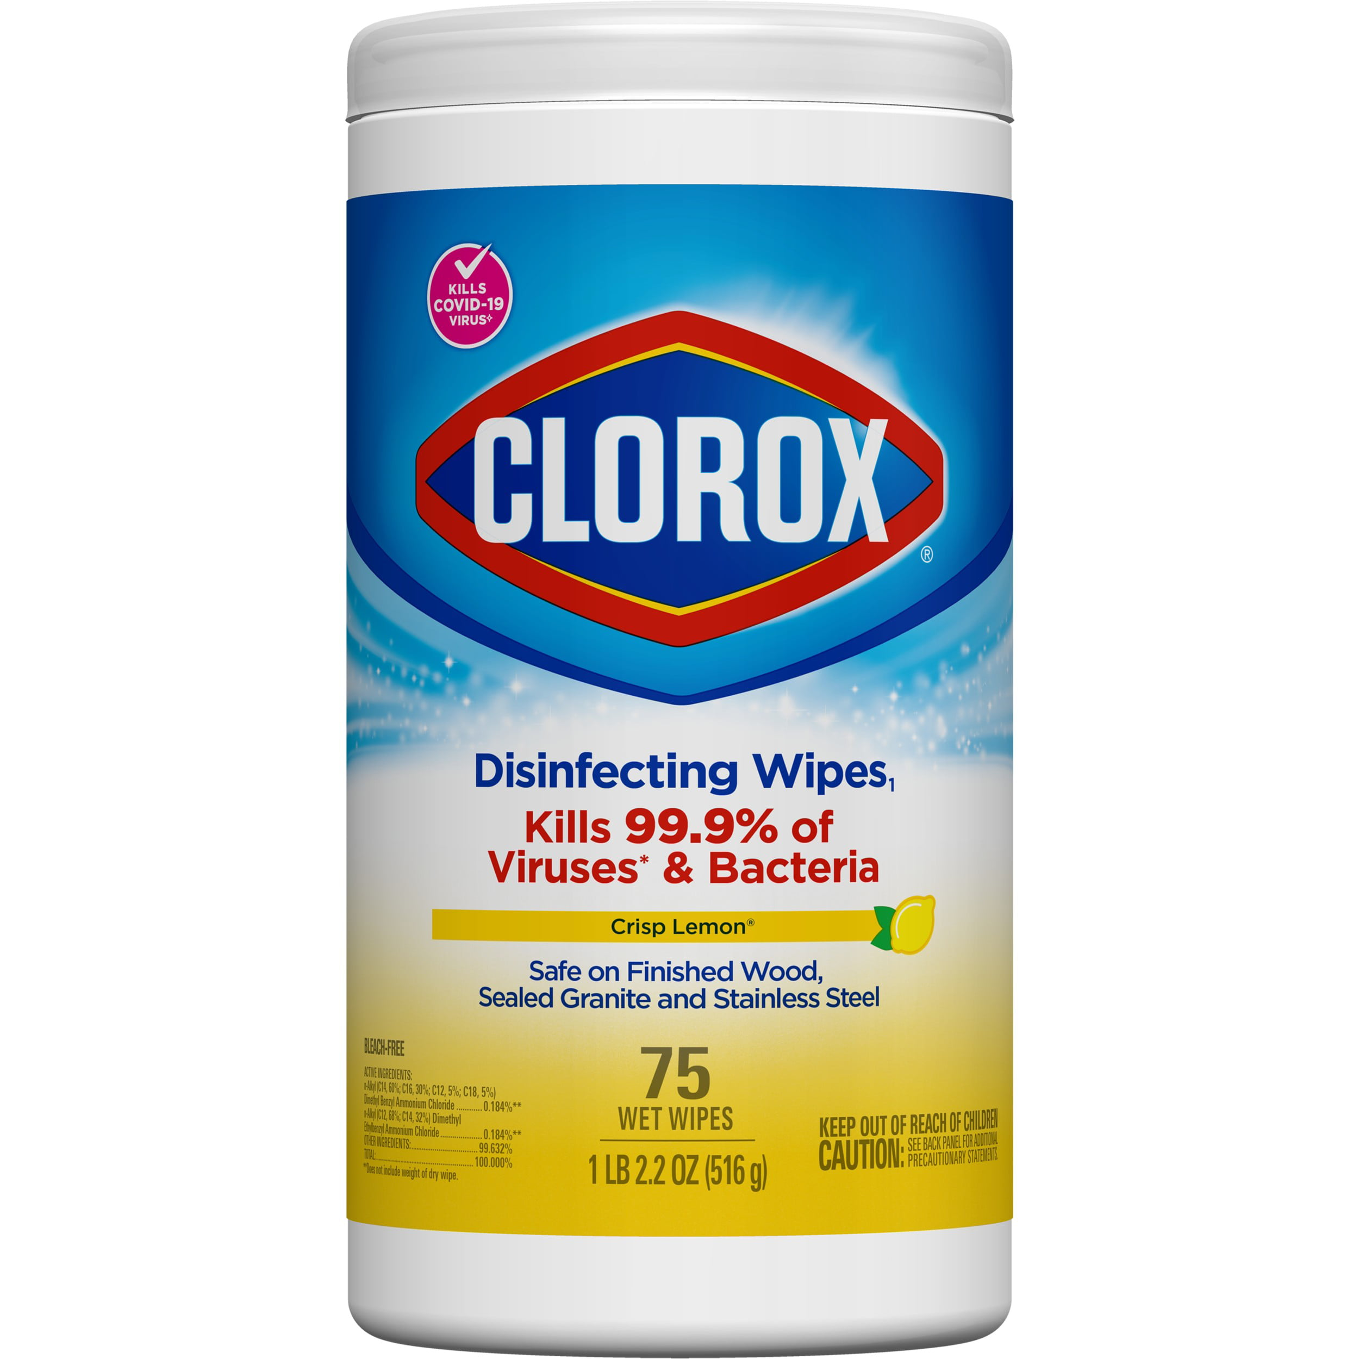
Ammonium chloride uses
Used as a yeast nutrient in breadmaking.
Detergents
Hair dye
Dusting materials

Slide 5
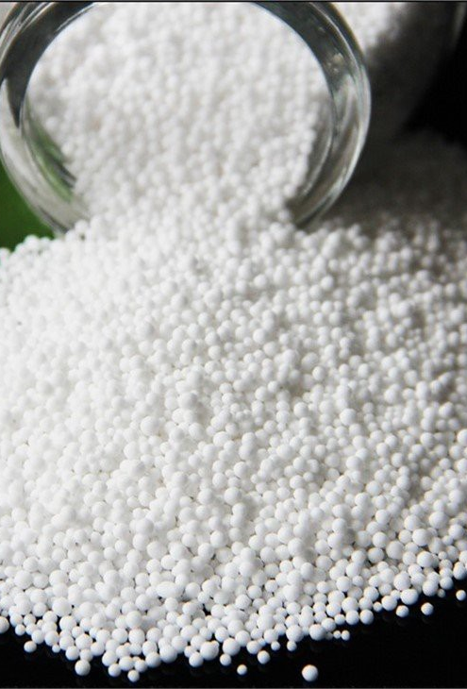
Magnesium nitrate properties
Chemical formula: Mg(NO3)2
Properties:
exothermic reaction when dissolved in water
Has a boiling point of 330 °C
pH:5-7

Slide 6
Magnesium nitrate uses
Catalyst for growing crops
Heart medicine
Anti-anxiety medicine

Slide 7
Calcium hydroxide properties
Chemical formula: Ca(OH)₂
Properties:
Exothermic reaction when dissolved in water
Has a boiling point of 1,484 °C
pH:8

Slide 8
Calcium hydroxide uses
in toothpaste
Plant fertilizer
Used to make cement

Slide 9
Potassium hydroxide
Chemical formula: KOH
Properties:
exothermic reaction when dissolved in water
Has a boiling point of 760 °C

Slide 10
Potassium hydroxide uses
Used in baking
Used to manufacture soap
In fruits such as bananas

Slide 11
Exothermic or Endothermic?
Substances | Initial temperature of the system | Final temperature of the system | Change in temperature | Endothermic or exothermic
Ammonium chloride | 21 | 48 | 27 | endothermic
Magnesium nitrate | 40 | 29.3 | -10.7 | exothermic
Calcium hydroxide | 60 | 24 | -36 | exothermic
Potassium hydroxide | 20 | 15.2 | -4.8 | exothermic

Slide 12
Thank You!

