Slide 1
Reactions with water
By : Saleem wahhab
Emil haddad
Meral sahlieh
Nicola shnoudi

Slide 2
What is endothermic and exothermic reactions?
Endothermic reactions: are chemical reactions that absorb heat energy from the surrounding. (the temperature decrease)
Exothermic reactions: are chemical reactions that release heat energy to the surrounding(the temperature increase)
Examples of exothermic: : Burning magnesium
Examples of exothermic : photosynthesis .

Slide 3
Endothermic Reactions:
Ammonium chloride
Epsom salt
Ammonium nitrate

Slide 4
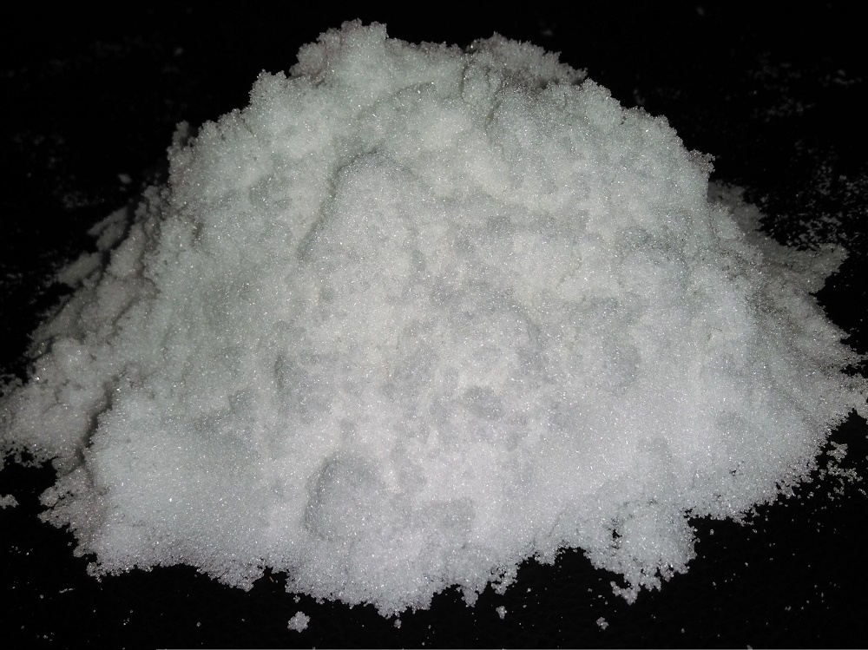
Ammonium chloride
Chemical formula=NH₄Cl
Melting point = 338ºC
Compound / Element= Compound
Uses = used as an electrolytes in dry cells
When it reacts with water it is an endothermic reaction

Slide 5
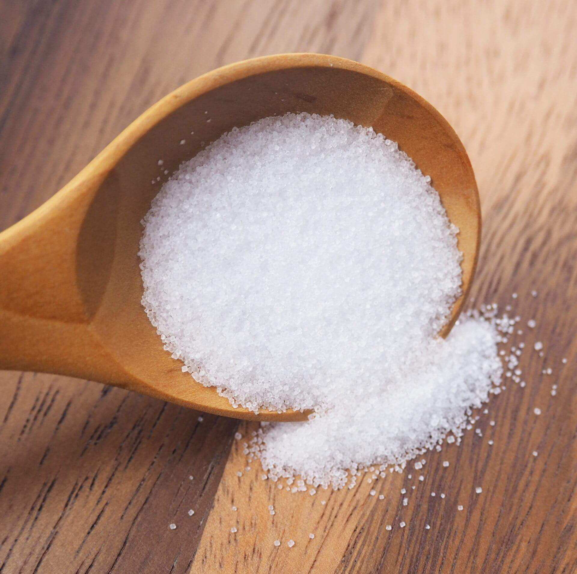
Epsom salt (table salt)
Chemical formula= MgSO₄
Melting Point = 1,137ºC
Compound / Element= Compound
Uses = Relaxes muscles and relieves pain in the shoulders, neck, back and skull
It is an endothermic reaction

Slide 6
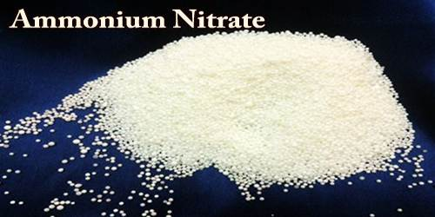
Ammonium nitrate
Chemical formula= NH₄NO₃
Melting point =169ºC
Compound / element = compound
uses=used in fertilisers
It is an endothermic reaction

Slide 7
Exothermic Reactions:
Calcium
Sodium

Slide 8
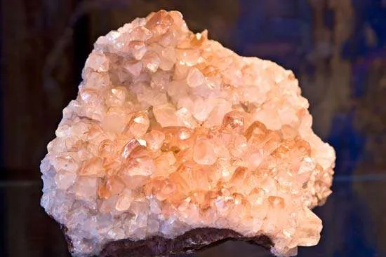
Calcium (Ca)
Calcium is used to strengthen bones for good health
The melting point is 842 c
It is an exothermic reaction

Slide 9
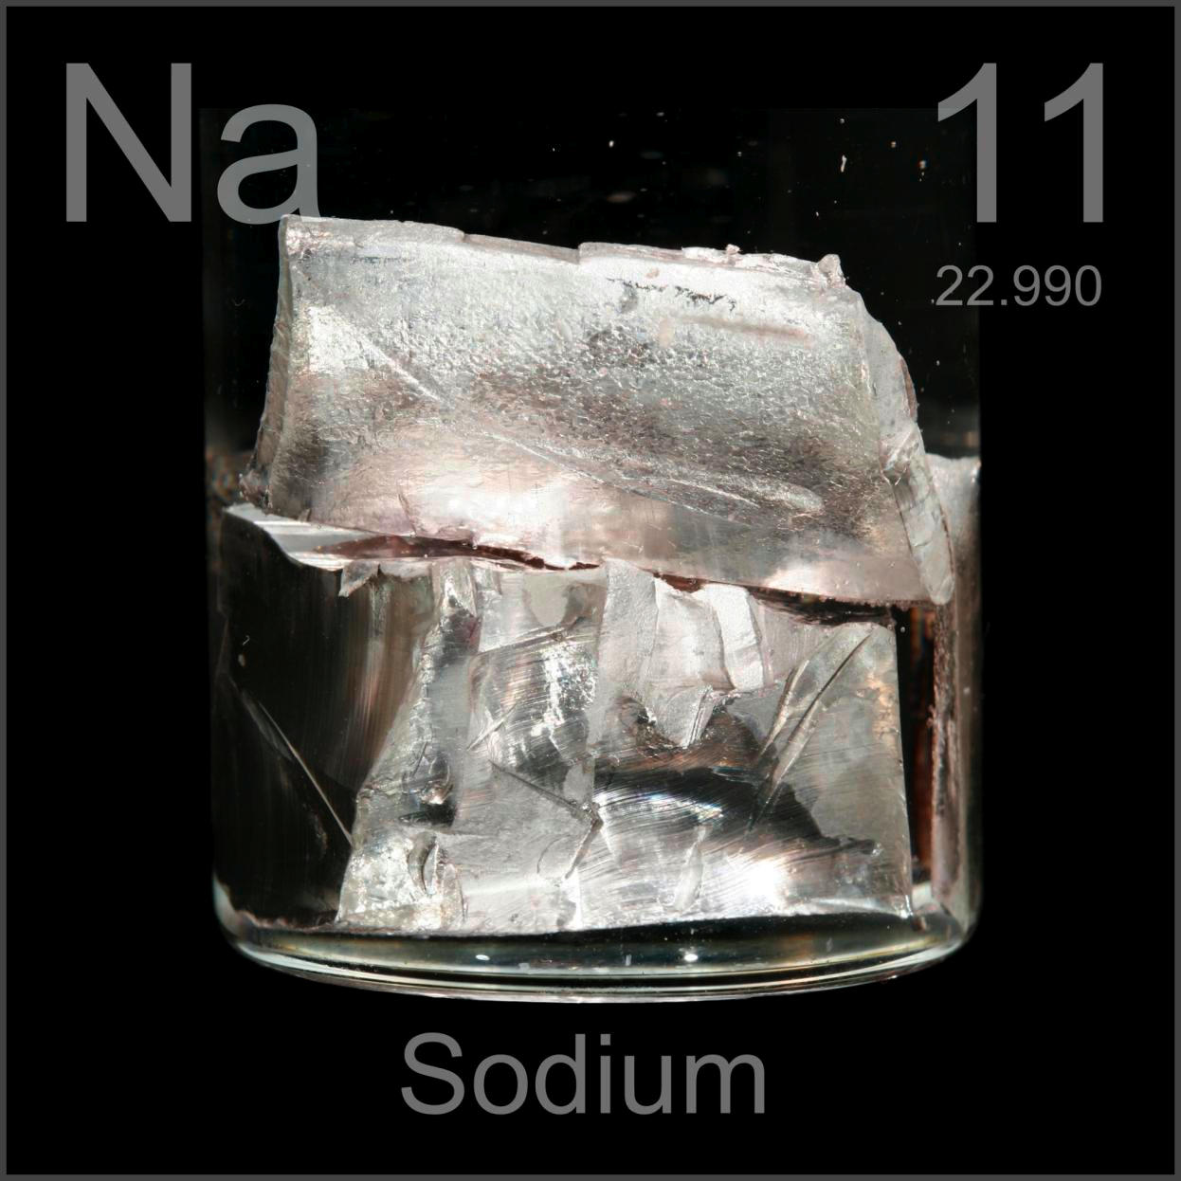
Sodium
Melting point 97.7
Used to make soap
It is an exothermic reaction
Symbol of sodium is (Na)

Slide 10
The End :)

