Slide 1
Obesity
By: adnan halasa, faris sawalha, Jason wahhab , adam Abdullah.

Slide 2
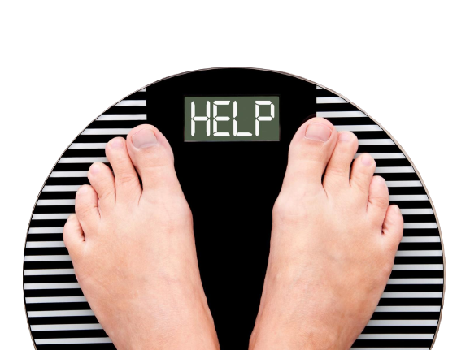
What is obesity?
An increased amount of body fat is a symptom of the severe condition called obesity. Obesity is more than simply a visual problem. It's a medical disorder that makes people more susceptible to heart disease, diabetes, high blood pressure, and several types of cancer.

Slide 3
What are some symptoms of obesity?
More sweating
Less confidence
Snoring heavily
Difficulty to breath
Feeling tired
Back and joint pain

Slide 4
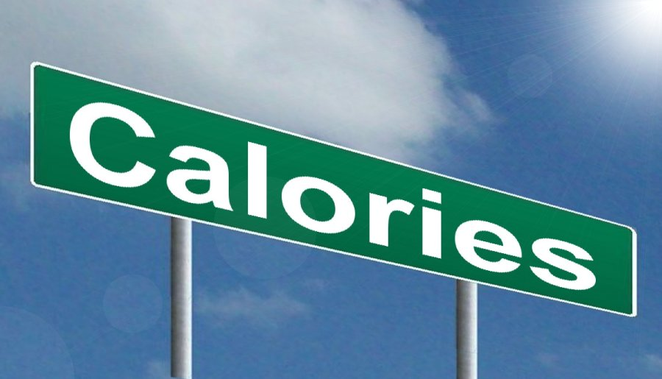
What are the main causes of obesity?
Most people become obese because of extra calorie intake.
A lot of people have obesity in their genetics.
Health conditions and medications can cause an increase of weight which leads to obesity

Slide 5
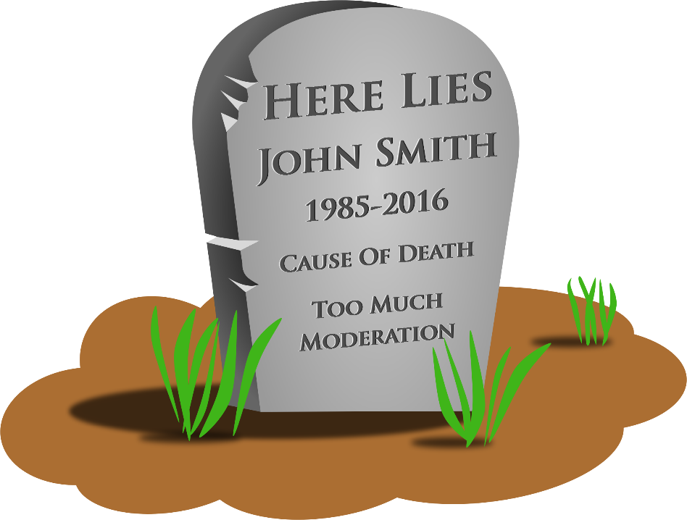
What are the consequences of obesity?
Death
low HDL cholesterol.
high LDL cholesterol.
Diabetes type 2.
Strokes.
Gallbladder illnesses.
food

Slide 6
What are the mental consequences of obesity?
Depression
Emotional and behavioral changes
Low self-esteem
Bipolar disorders

Slide 7
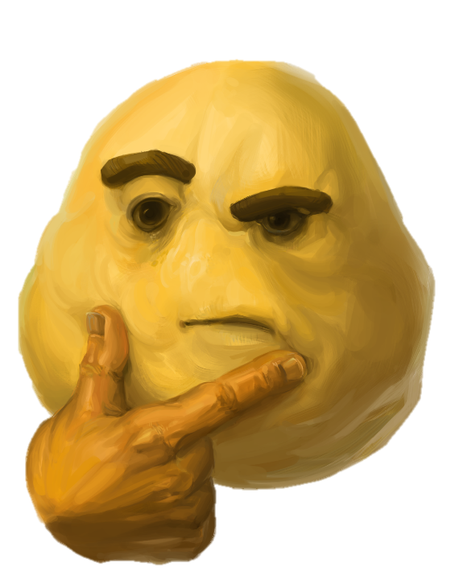
Why should obesity be solved?
The fact that childhood obesity is more likely to persist into adulthood as a child gets older is one of the main reasons why obesity prevention in children is so important. This puts the person at high risk of diabetes, high blood pressure and heart disease.

Slide 8
How to solve obesity
Healthy eating: Eating a balanced diet that is low in calories, fat, and sugar can help prevent and manage obesity.
Physical activity: Regular physical activity can help burn calories, improve cardiovascular health, and prevent obesity.
Behavior therapy: Cognitive-behavioral therapy can help people identify and change the behaviors that contribute to obesity.
Medications: Medications can help people lose weight by reducing appetite or blocking the absorption of fat.

Slide 9
Resources:
1. https://www.mayoclinic.org/
2. https://www.nichd.nih.gov/
3. https://www.hsph.harvard.edu/obesity-prevention-source/obesity-prevention/#:~:text=Choosing%20healthier%20foods%20(whole%20grains,%2C%20and%20other%20%E2%80%9Csit%20time%E2%80%9D
4. https://www.cdc.gov/healthyweight/effects/index.html
5. https://www.hopkinsmedicine.org/health/conditions-and-diseases/obesity/preventing-obesity#:~:text=A%20primary%20reason%20that%20prevention,blood%20pressure%20and%20heart%20disease.

