Slide 1
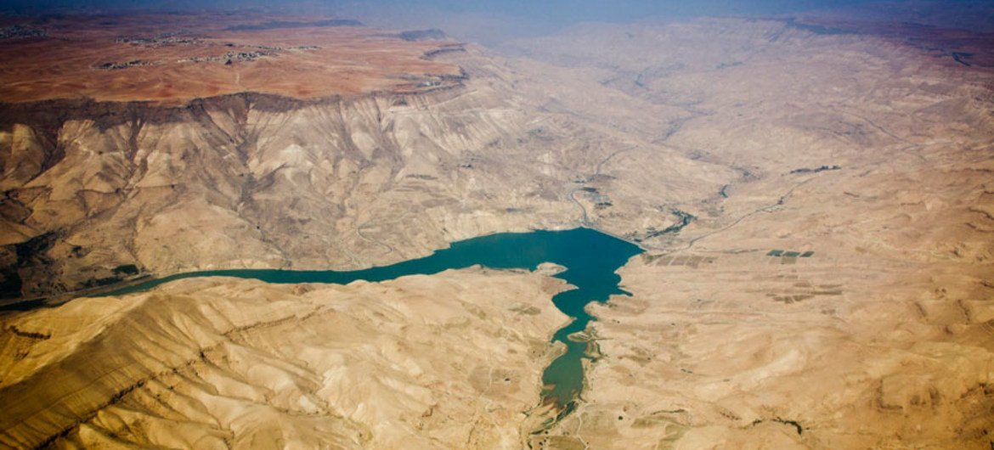
Water Crisis in Jordan
Made by: Haya sunna
Leah azar
Rita Qsous
Raya akkawi

Slide 2
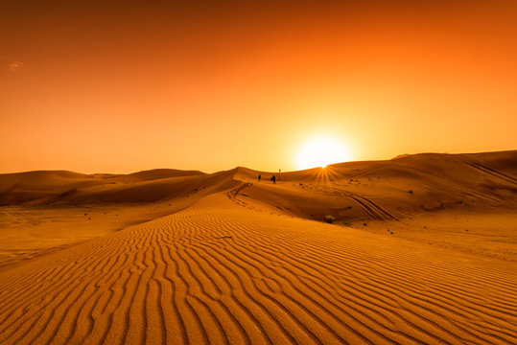
What is water crisis?
Water crisis refers to a situation where the demand for water exceeds the available supply, or when access to safe and clean water is limited or inadequate. A water crisis can have serious consequences for human health, ecosystems, and economic development, and it is a growing challenge in many parts of the world.

Slide 3
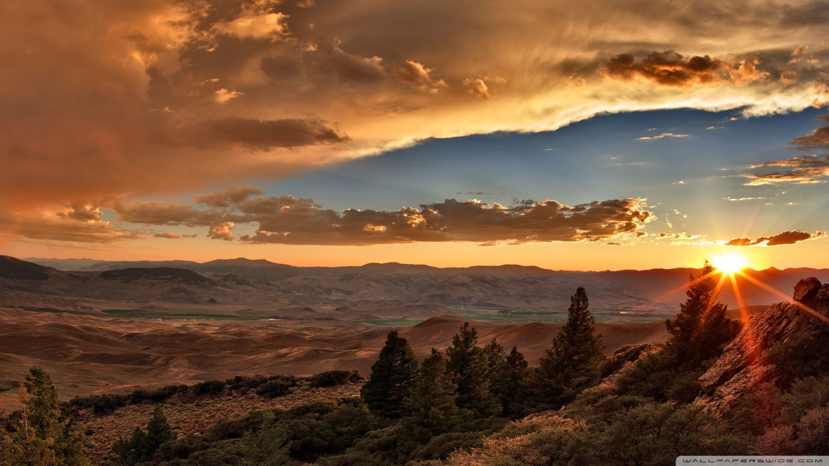
Issues for water crisis In Jordan
Climate change
Climate-related hazards in Jordan include droughts, extreme temperature, storms, landslides and flash floods. Other natural hazards include periodic earthquakes and epidemics. While these hazards are a natural occurrence in Jordan, they nevertheless pose serious constraints on development, and their intensity and frequency are likely to increase under a changing climate.
Population growth
Jordan is already one of the most water-stressed nations globally, and climate-induced record low levels of rainfall, heightened evaporation and increases in temperature will further drive desertification, reduce water supply and exacerbate water scarcity in the future.

Slide 4
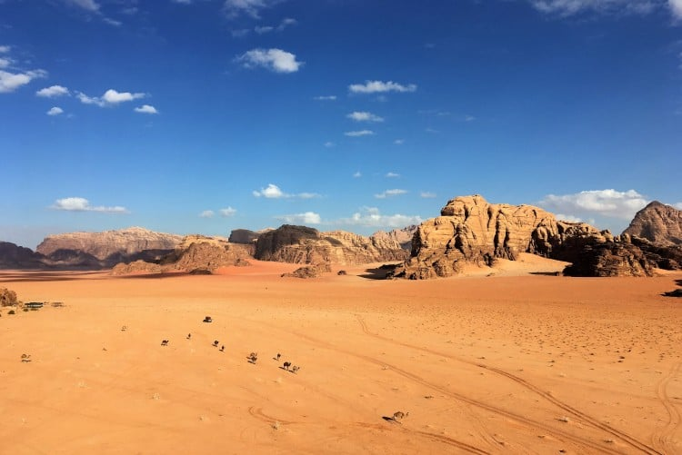
Causes for water crisis In Jordan
Climate Change
Climate change in Jordan is mainly caused by human activities that emit greenhouse gases into the atmosphere, such as burning fossil fuels for energy, transportation, and industrial processes. These gases trap heat in the Earth's atmosphere and contribute to a global rise in temperatures, which can have severe impacts on Jordan's climate.
Population Growth
There are many factors that contribute to population growth in Jordan, including increased access to healthcare, better sanitation, and improved living conditions. Additionally, Jordan has a high birth rate and a relatively young population

Slide 5
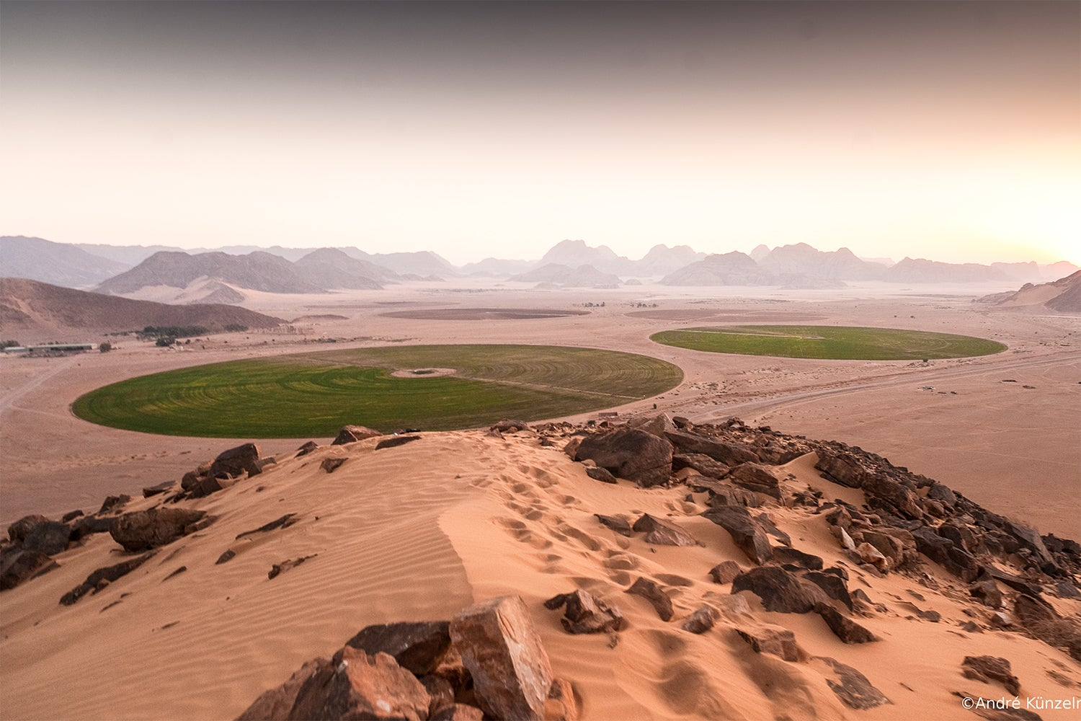
Consequences for water crisis In Jordan
Climate Change
Climate change is expected to lead to decreased water availability in Jordan, as rising temperatures and changing precipitation patterns reduce the amount of water that is available for human use. This can lead to increased water scarcity and competition for water resources.
Population Growth
The over-extraction of groundwater, which accounts for over 60% of Jordan's total water supply, has led to significant depletion of groundwater reserves. As the population grows, so does the demand for groundwater, leading to further depletion of this vital resource

Slide 6
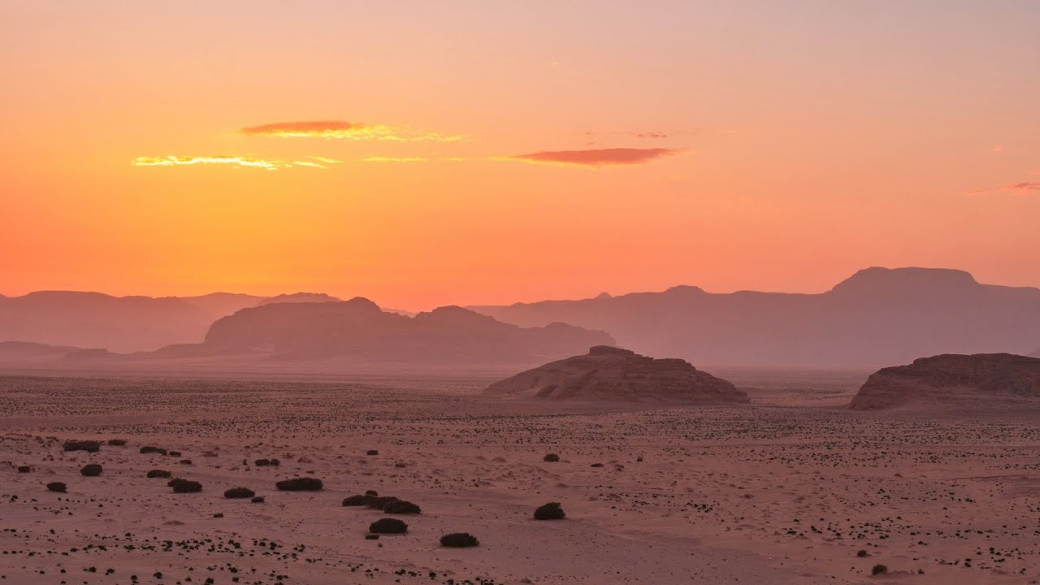
Solutions for water crisis In Jordan
Climate Change
Reducing greenhouse gas emissions is critical to mitigate the impacts of climate change on Jordan's water resources. This can be achieved through policies and measures that promote renewable energy, energy efficiency, and sustainable transportation.
Population Growth
Promoting family planning and reproductive health programs can help manage population growth and reduce the demand for water. This can include measures such as education and access to contraceptives.

Slide 7
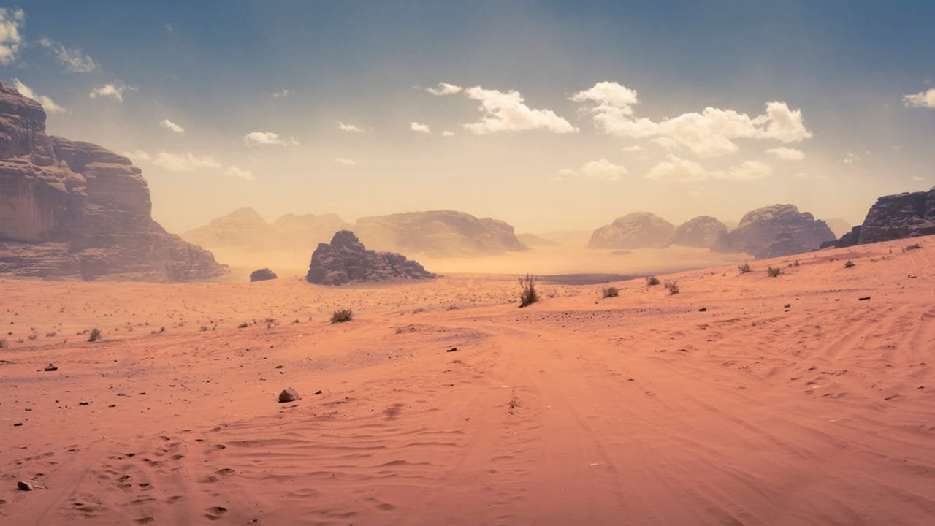
Jordan . World Bank Open Data. (n.d.). Retrieved May 7, 2023, from https://data.worldbank.org/country/jordan
Water, sanitation and hygiene (WASH) | unicef. (n.d.). Retrieved May 7, 2023, from https://www.unicef.org/wash
Elsevier. (n.d.). How do I cite a sciencedirect article? How do I cite a ScienceDirect article? - ScienceDirect Support Center. Retrieved May 7, 2023, from https://service.elsevier.com/app/answers/detail/a_id/29581/supporthub/sciencedirect/~/how-do-i-cite-a-sciencedirect-article%3F/
Home. UNDP Climate Change Adaptation. (n.d.). Retrieved May 7, 2023, from https://www.adaptation-undp.org/
Climate change knowledge portal of the World Bank (CCKP). Climate Change Knowledge Portal of the World Bank (CCKP) - English. (n.d.). Retrieved May 7, 2023, from https://climate-adapt.eea.europa.eu/en/metadata/portals/climate-change-knowledge-portal-of-the-world-bank-cckp-year-of-launch

