Slide 2
Obesity
work of students : Naya Al-Qamhawi, Nour Saba

Slide 3
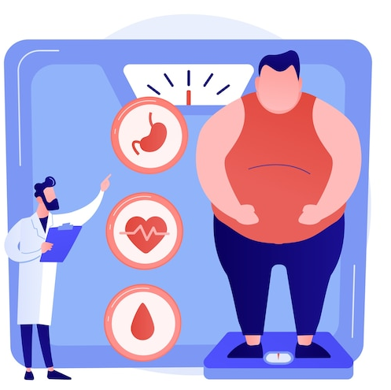
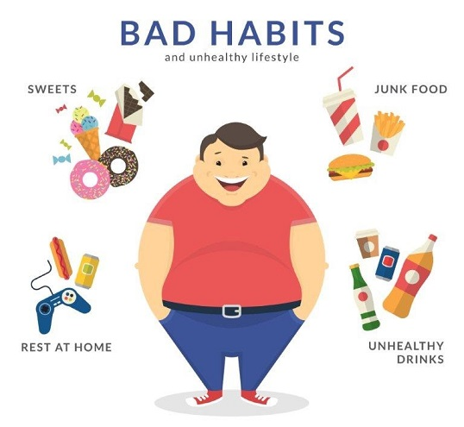
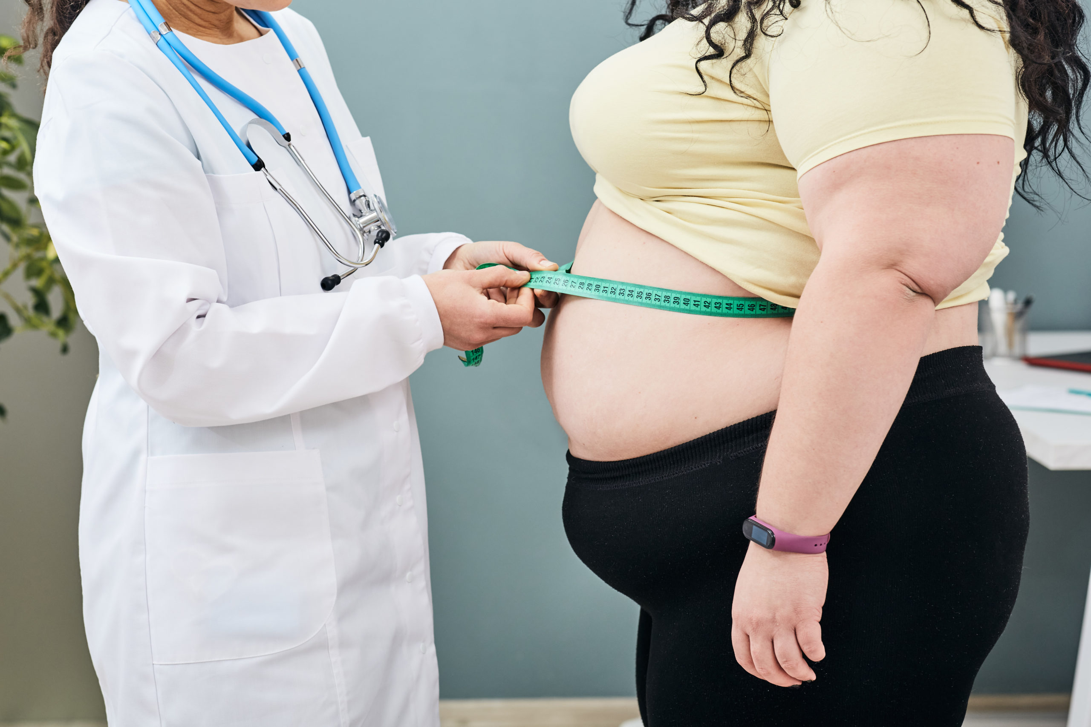
What is Obesity ?

Slide 4
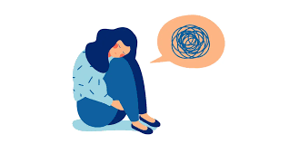
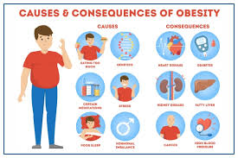
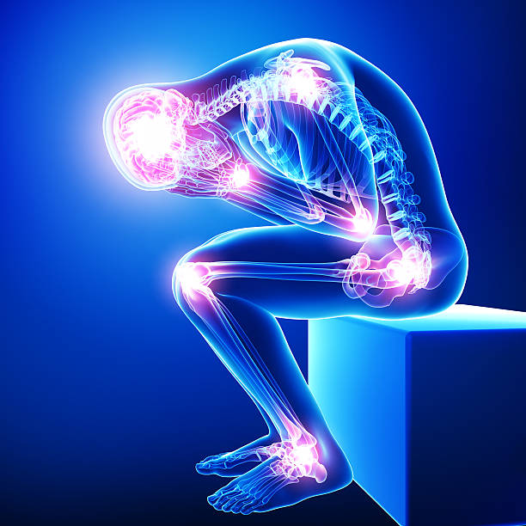
What are the issues caused by obesity?

Slide 5
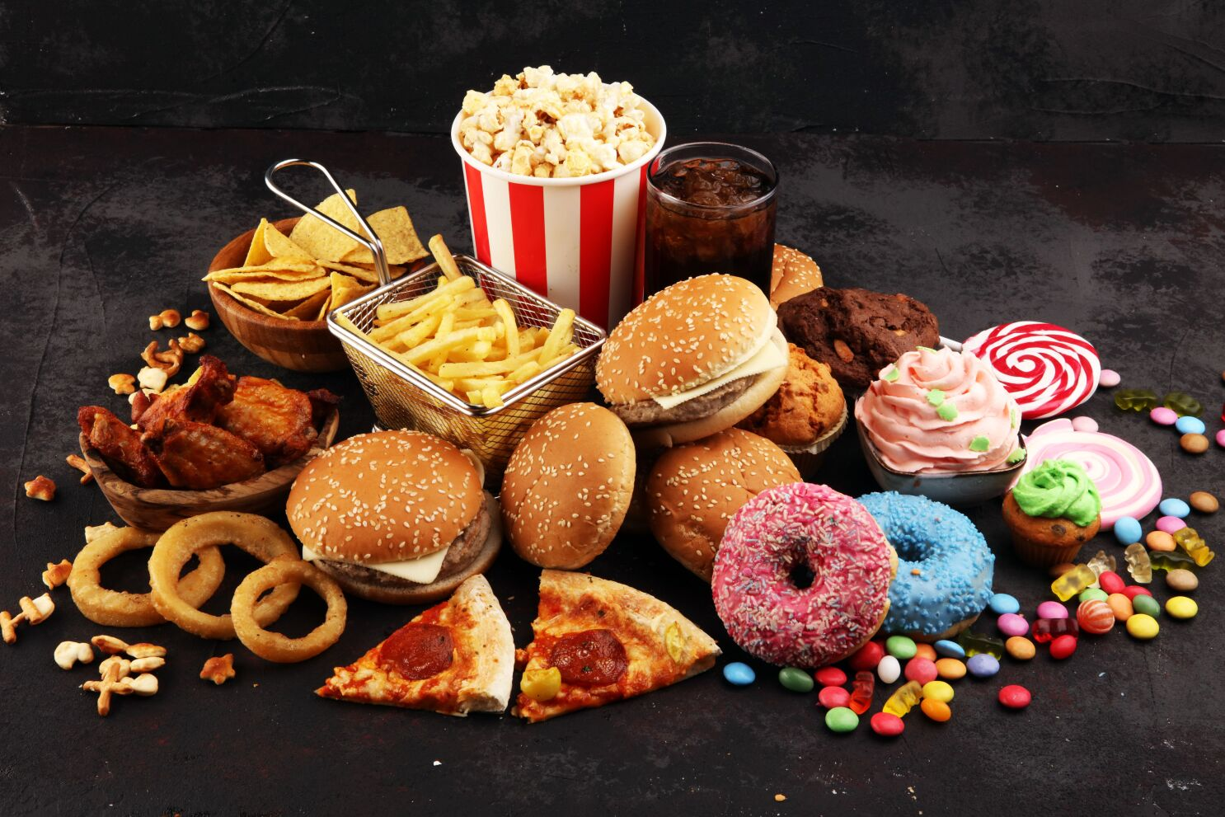
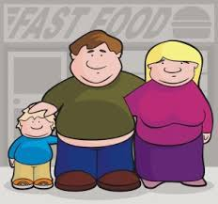
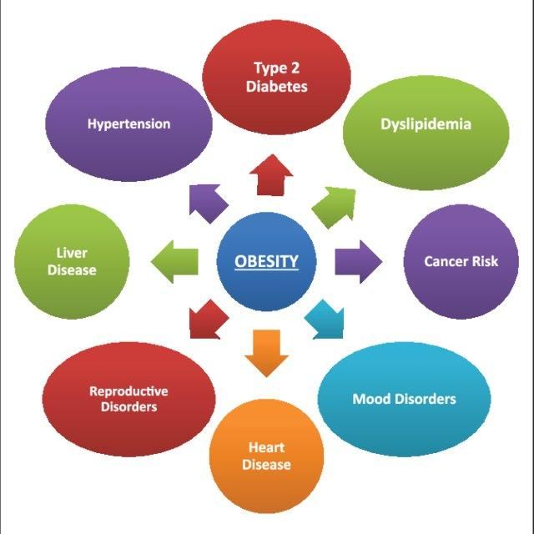
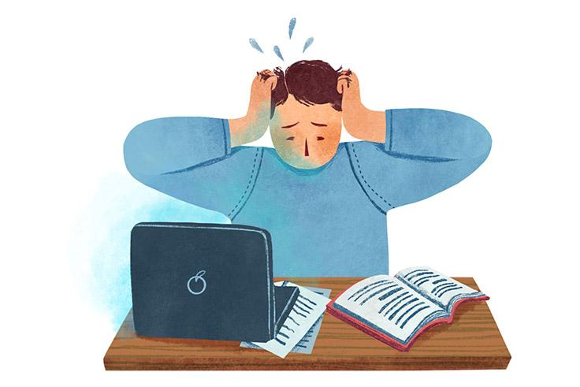
Causes of obesity

Slide 6
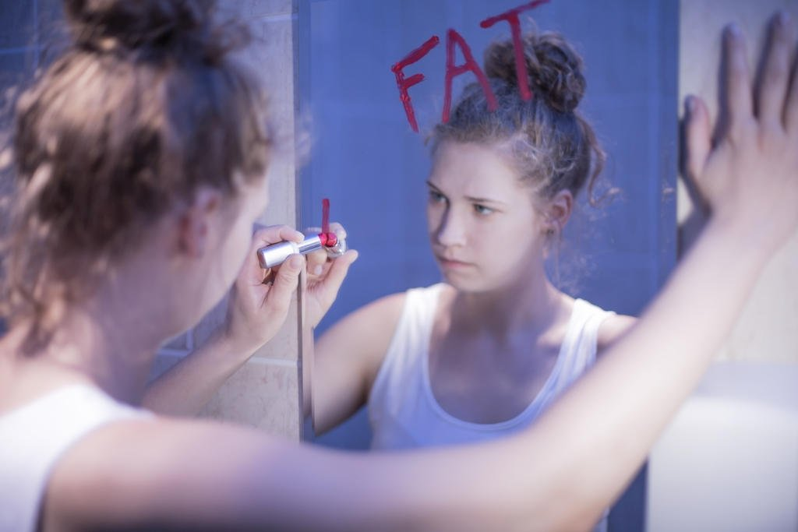
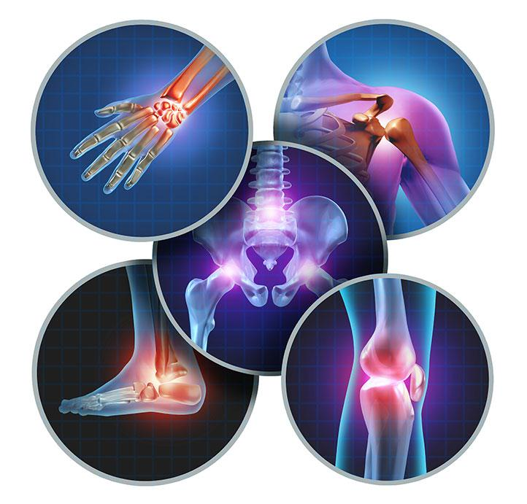
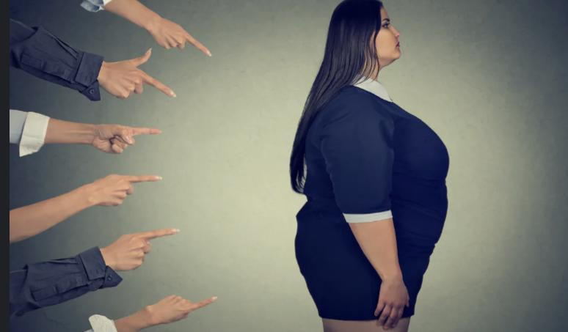
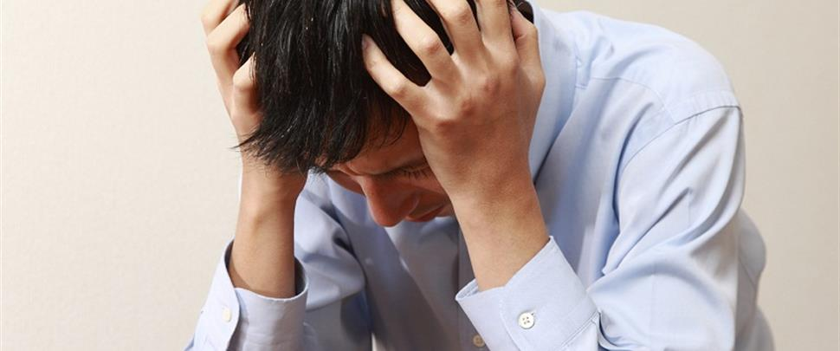
Consequences of obesity

Slide 7
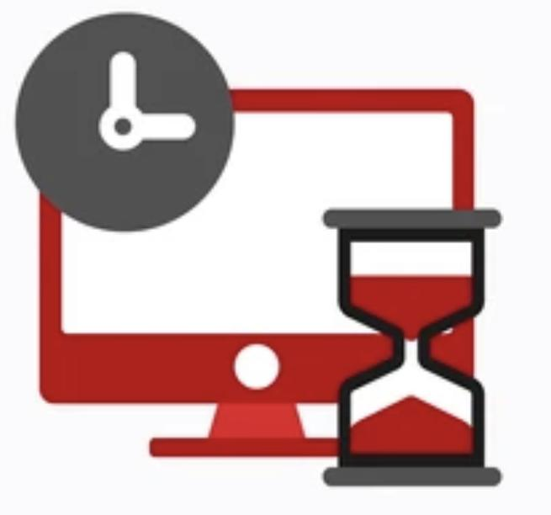
How can you overcome obesity?

Slide 8
Video
https://www.youtube.com/watch?v=ZEoZSjb_s0A

Slide 9
What have i learnt about obesity ?
What factors lead to obesity?
Do you think obesity is common among our society today and why?
Can obesity shorten life expectancy?
Does obesity affect a person's quality of life?
Can obesity cause cancer?
Can obesity be cured, and how?
Do you think obesity will be more of a problem in the future?

Slide 10
Thank you for listening !

Slide 11
Citation
-Mayo Foundation for Medical Education and Research. (2021, September 2). Obesity. Mayo Clinic. Retrieved May 4, 2023, from https://www.mayoclinic.org/diseases-conditions/obesity/symptoms-causes/syc-20375742
-“Body Mass Index (BMI).” Centers for Disease Control and Prevention, Centers for Disease Control and Prevention, 3 June 2022, https://www.cdc.gov/healthyweight/assessing/bmi/index.html.
-“Obesity Consequences.” Obesity Prevention Source, 12 Apr. 2016, https://www.hsph.harvard.edu/obesity-prevention-source/obesity-consequences/#:~:text=The%20High%20Cost%20of%20Excess%20Weight&text=No%20less%20real%20are%20the,overweight%20does%20not%20decrease%20mortality. https://www.ncoa.org/article/how-e.
-The National Council on Aging, https://www.ncoa.org/article/how-excess-weight-impacts-our-mental-and-emotional-health/.
-“What Causes Obesity & Overweight?” Eunice Kennedy Shriver National Institute of Child Health and Human Development, U.S. Department of Health and Human Services, https://www.nichd.nih.gov/health/topics/obesity/conditioninfo/cause.
-“Obesity Prevention Strategies.” Obesity Prevention Source, 12 Apr. 2016, https://www.hsph.harvard.edu/obesity-prevention-source/obesity-prevention/#:~:text=Choosing%20healthier%20foods%20.

