Slide 1
Substances dissolving in water
By:
Natalia abu hadba , kareem fakhoury , marius sahawneh , nuor azzawi , sama khair

Slide 2
Calcium chloride
When dissolved in water calcium chloride releases heat into the surrounding making it a exothermic reaction
The starting temperature is 25.4 and the final is 28.9 so the change in temperature is 28.9-25.4= 3.5
The chemical formula is CaCl2

Slide 3
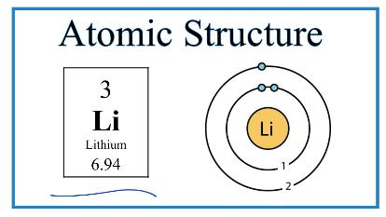
Lithium
When lithium reacts with water the Lithium reacts intensely with water forming lithium hydroxide and highly flammable hydrogen
The starting temperature when dissolving in water is 22.1 and the final temperature is 31.9 so the temperature change is 31.9-22.1= 9.8
It is an exothermic reaction
Its chemical formula is Li

Slide 4
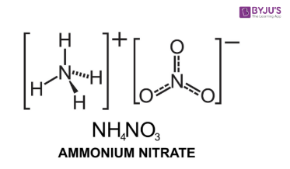
Ammonium nitrate
When Ammonium nitrate dissolves in water the ammonium nitrate readily dissolves in water by dissociating into its constituent ions
The starting temperature is 25.7 and the final temperature is 29.5 so the temperature change is 29.5-25.7 = 3.5
It is an endothermic reaction
Its chemical formula is NH4NO3

Slide 5
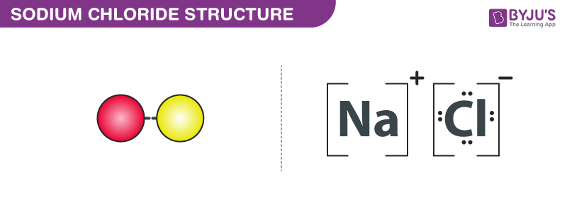
Sodium chloride
When sodium chloride reacts with water the water molecules pull the sodium and chloride ions apart breaking the ionic bond that held them together
The starting temperature is 24.8 and the final temperature is 22.3 so the change in temperature is 22.3-24.8= -2.5
It is an endothermic reaction
The chemical formula is NaCl

Slide 6
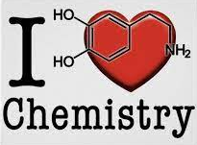
THANK YOU FOR LISTENING !!!

