Slide 1
Water Crisis in jordan
Made By Ammar , Kareem And Rakan.

Slide 2
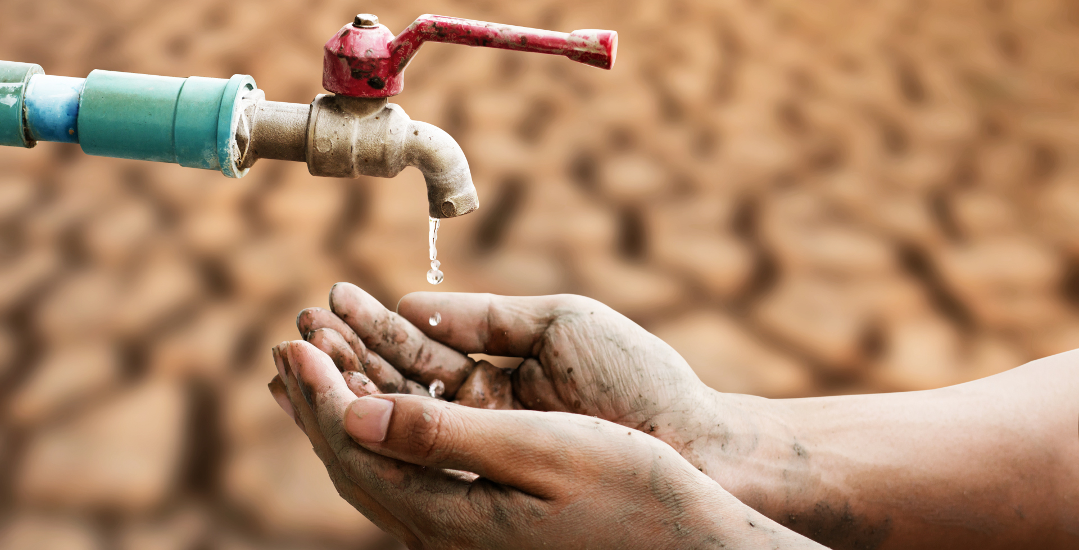
What is water crisis?
Water crisis is a crisis of managing water so badly that billions of people - and the environment - suffer badly.

Slide 3
issues of water crisis in jordan.
more than 98% of the population has access to an improved water source, only 93% access a safely-managed source and 86% to a piped network. In urban areas, water is usually available once a week, and less than once every two weeks in rural areas, with reduced frequency during the summer. Only 77.3% of existing sanitation systems are safely managed and only a third of schools have basic sanitation services.
These challenges have been exacerbated by increased water demands due to growth in population and in industrial and agricultural capacity. Long term groundwater monitoring in the country’s main aquifers suggests that water levels are falling, with annual declines of more than ten metres in some aquifers.
Water Pollution

Slide 4
Consequences of water crisis in Jordan.
Consequences:
water crisis in Jordan has got so bad that 91 percent of households will be receiving less than 40 liters daily for 11 consecutive months per year by 2100, 44 percent of Jordanians face water shortage.

Slide 5
Causes Of Water Crisis In Jordan.
The overflow of wastewater pumping stations, leaks from sewage systems and exposure to industrial and commercial waste.
Population growth, diminished water supplies and climate change.
Water pollution.

Slide 6
Solutions for water crisis in Jordan.
by recycling and reuse of municipal wastewater which is an attractive method in terms of water savings.
Another cheap and natural option for wastewater reuse is the construction of wetlands.
Reasonings:
industries would not need to draw extensive freshwater sources that could be utilized more exclusively for potable water purposes.
improving the removal of nutrients, suspended material and pathogens from water prior to its return to the environment.

Slide 7
Conclusion.
In conclusion Jordan is the second most water scarce country in the world and this issue needs to be solved as soon as possible so the world would be a better place.

Slide 8
Sources.
UNICEF jordan. UNICEF. (n.d.). Retrieved May 4, 2023, from https://www.unicef.org/jordan
Home Page - Jordan News : latest news from Jordan, mena. Jordan News | Latest News from Jordan, MENA. (n.d.). Retrieved May 4, 2023, from https://www.jordannews.jo/
U.S. Agency for International Development. (2023, May 2). Retrieved May 4, 2023, from https://www.usaid.gov/
Downsize poverty. The Borgen Project. (2023, March 17). Retrieved May 4, 2023, from https://borgenproject.org/
University, S. (n.d.). Stanford News. Retrieved May 4, 2023, from https://news.stanford.edu/

