Slide 1
Blue Gold: Water Crisis
By:Miral,Salma,Natalie,Selina

Slide 2
Does Jordan Have a Water Crisis?
Jordan is one of the most water-scarce countries in the world. The country's renewable water supply currently meets around two-thirds of the population's water demands, with groundwater being used twice as quickly as it can be replenished

Slide 3
2 Main issues Water Crisis caused in Jordan:
Pollution: The overflow of wastewater pumping stations, leaks from sewage systems and exposure to industrial and commercial waste are polluting Jordan’s surface river sources.
Rainfall: Jordan gets 110 mm of rainfall a year and ranked ninth in the top 10 countries with the lowest rainfall in 2017.

Slide 4
2 Main Causes of water crisis in Jordan:
Pollution has resulted in nitrate and phosphorus contamination of water supplies. Researchers point to improper industrial discharges and lack of regulation as the leading cause of water pollution in Jordan.
Rainfall has Atmospheric conditions such as climate change, ocean temperatures, changes in the jet stream, and changes in the local landscape are all factors that contribute to drought.

Slide 5
2 Main consequences of water crisis in Jordan:
Rainfall amounts can be affected seriously by the climate change due to the global warming. Climatological studies showed that rainfall trends from region to region in the world.
Water pollution increases operational costs and increased complexity in supply chains.

Slide 6
2 solutions to prevent water crisis in Jordan:
The other way to counter water scarcity in Jordan is by recycling and reuse of municipal wastewater which is an attractive method in terms of water savings. Infact, the reuse of the treated wastewater in Jordan has reached one of the highest levels in the world.
Warmer oceans increase the amount of water that evaporates into the air. When more moisture-laden air moves over land or converges into a storm system, it can produce more intense precipitation.

Slide 7
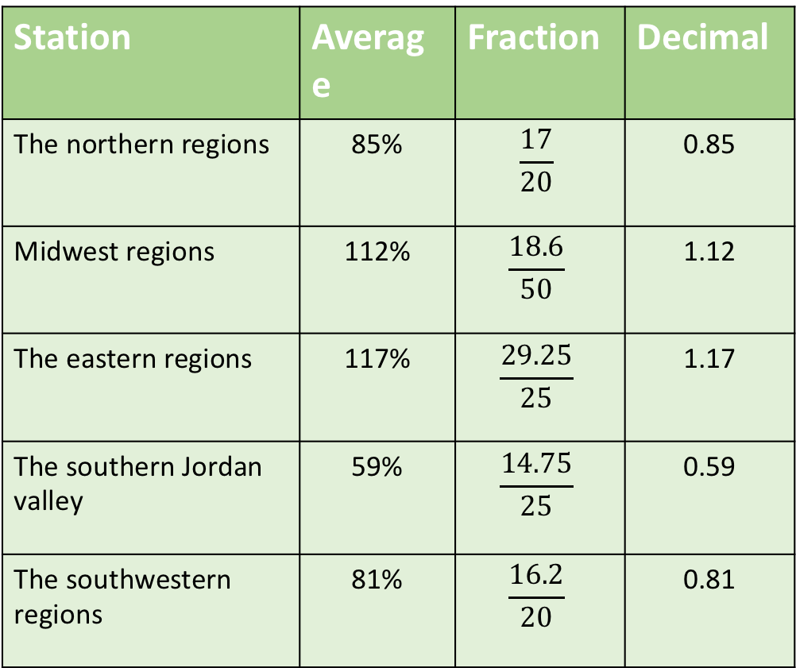
Math
Station | Average | Fraction | Decimal
The northern regions | 85% | $$\frac{17}{20}$$ | 0.85
Midwest regions | 112% | $$\frac{18.6}{50}$$ | 1.12
The eastern regions | 117% | $$\frac{29.25}{25}$$ | 1.17
The southern Jordan valley | 59% | $$\frac{14.75}{25}$$ | 0.59
The southwestern regions | 81% | $$\frac{16.2}{20}$$ | 0.81

Slide 8
Citation and Resources:
Halawa, A. (2022, May 18). Land of no rain: How Jordan is facing a parched future - al-fanar media. Al. Retrieved May 5, 2023, from https://www.al-fanarmedia.org/2020/08/land-of-no-rain-how-jordan-is-facing-a-parched-future/
Water Resources &amp; Environment: Basic page: Jordan. U.S. Agency for International Development. (2022, August 16). Retrieved May 5, 2023, from https://www.usaid.gov/jordan/water-resources-environment
Land of no rain: How Jordan is facing a parched future. HAED. (2020, August 6). Retrieved May 5, 2023, from https://www.haed-jo.org/page/land-no-rain-how-jordan-facing-parched-future Water Resources &amp; Environment: Basic page: Jordan. U.S. Agency for International Devel
Project, B. (2019, December 18). Sustainable water solutions in Jordan also fuel diplomatic progress. The Borgen Project. Retrieved May 5, 2023, from https://borgenproject.org/sustainable-water-solutions-in-jordan/
United Nations. (n.d.). Building resilience to cope with climate change in Jordan through improving water use efficiency in the agriculture sector (BRCCJ) in Jordan. United Nations. Retrieved May 5, 2023, from https://jordan.un.org/en/111315-building-resilience-cope-climate-change-jordan-through-improving-water-use-efficiency
دائرة الأرصاد الجوية &gt; الموسم المطري. (n.d.). Retrieved May 5, 2023, from http://jmd.gov.jo/%D8%A7%D9%84%D9%85%D9%88%D8%B3%D9%85-%D8%A7%D9%84%D9%85%D8%B7%D8%B1%D9%8A

